Slide 1






College
Connect
A Community Needs Analysis with
Traveller and Roma Students on
Their Experiences of Higher Education
A Call to Action for Accountable and Transformative
Policy and Practice Throughout the Higher Education System.

Slide 2






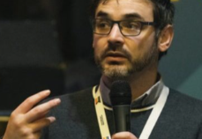



The Research Team

Slide 3
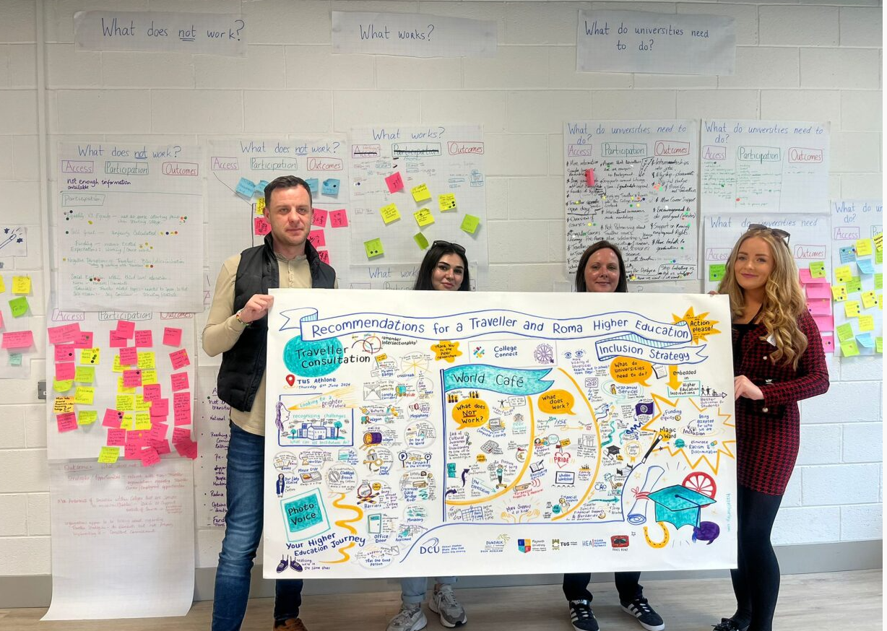
Peer-led Participatory Approach
  Collaborative and reflective and values based research approach.
  Active involvement and collaboration of community members in all phases of the research process.
  Aims to produce actionable outcomes that directly address the needs or issues identified by the participants.
Notes:
mt

Slide 4
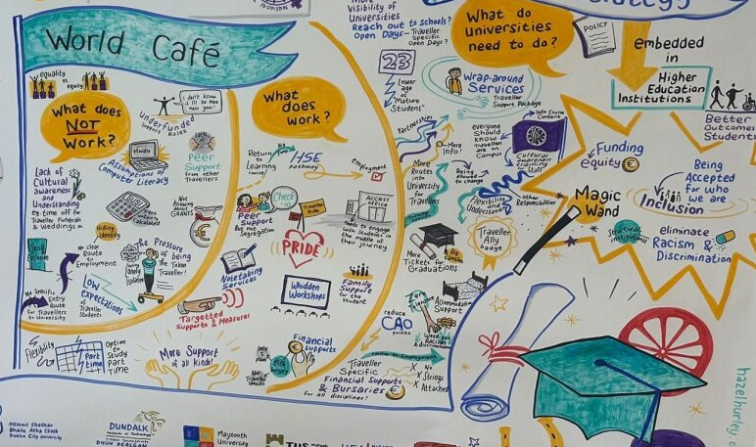
Research Questions
1. What doesn’t work?
2. What works?
3. What do universities need to do to support Travellers/ Roma in Higher Education?
Notes:
mt

Slide 5
Participants
  Traveller Consultations
Data gathered from 15 Students and 4 Travellers Researchers during consultation, 3 additional interviews (N=22)
DCU-2
DkIT- 2
MU-9
TUS-9
  Roma Consultation
Data gathered from 8 Students and 2 Roma Researchers (N = 10)
o MU – 6
o TCD – 1
o TUD – 1
o UCD – 2
Notes:
mt and vp

Slide 6
Participant Voice:
Experiences, knowledge and actions

Slide 7
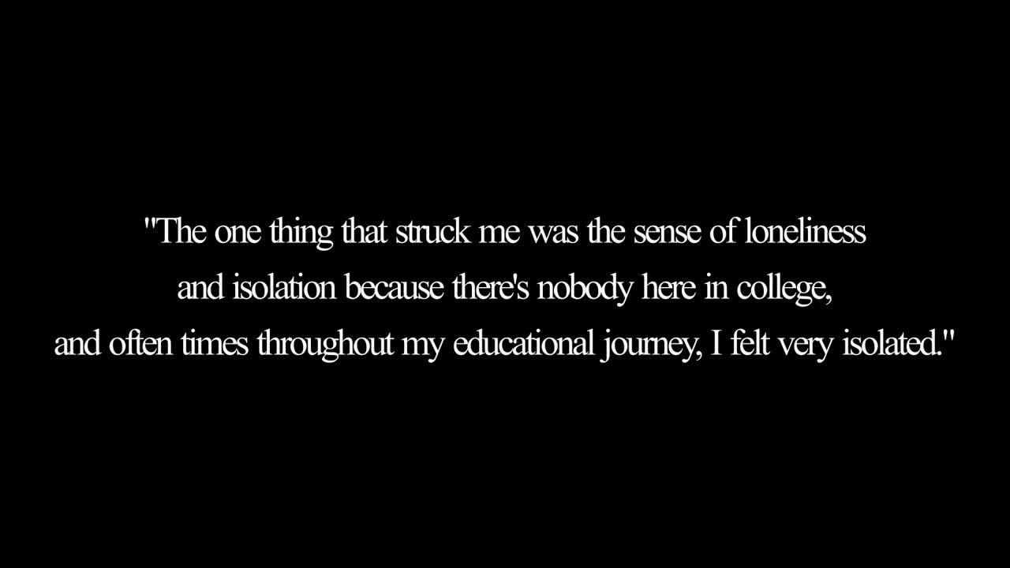

Slide 8

Roma Findings
Notes:
vp

Slide 9
01
Racism and Discrimination
02
Intergenerational Trauma
03
Hidden Identity
04
Family and Community Support
05
Financial Support
06
Language and Digital Literacy Support
07
Outreach, Guidance, and Support
08
Entry Routes and Access to Higher Education
09
Visibility, Representation and Celebration
10
Postgraduate and Employment Opportunities
Notes:
vp

Slide 10
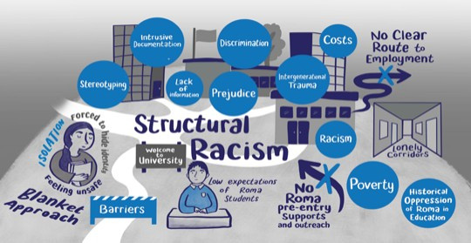

1.Racism and Discrimination
  Low expectations from educators
  Begins early in educational journey
  Systemic barriers
Main Heading
2. Intergenerational Trauma
  Rooted in historic and systemic racism and exclusion
  Leads to isolation and mental health challenges
Notes:
cm

Slide 11


3. Hidden Identity
  Concealing identity to avoid discrimination and racism
  Fear of exclusion, isolation and the fear of identifying
4. Family and Community Support
  Being first in a family can create additional pressure
  More pathways and supports required for Roma families
Notes:
vp

Slide 12

5. Financial Support
  Meeting basic survival needs, and navigating financial aid systems are barriers
  Culturally sensitive funding and outreach required
6. Language and Digital Literacy Support
  Significant language and digital literacy barriers
  English language and digital skills supports required
Notes:
cm

Slide 13


7. Outreach, Guidance, and Support
  Culturally sensitive mentoring
  Dedicated Roma Access Officers
  Long-term institutional commitment required
8. Entry Routes and Access to Higher Education
  Application processes like CAO, HEAR, and DARE need to be simplified
  Supports instead of intrusive documentation process
Notes:
vp

Slide 14


9. Visibility, Representation and Celebration
  Lack of knowledge about Roma culture and history (e.g. Roma Genocide)
  Integrate culture, history, and contributions into curricula and campus activities
10. Postgraduate and Employment Opportunities
  Fear of not securing employment after graduation due to racism and discrimination
  Access to internships and job opportunities required

Slide 15

Traveller Findings

Slide 16
01
Racism and Discrimination
02
Identity and Belonging
03
One Good Person
04
Family Support
05
Financial Support
06
Visibility, Celebration and Representation
07
Cultural Awareness Training
08
Flexibility of Options and Culturally Appropriate Supports
09
Employment and Post-Graduate Opportunities
Notes:
dj

Slide 17


1. Racism and Discrimination
  Experienced throughout the educational journey, from primary school through to higher education.
2. Identity and Belonging
  Systemic racism, discrimination, and fear of prejudice
  Leading to isolation and mental health struggles.
Notes:
hm

Slide 18


3. One Good Person
  The impact of one person who supported and encouraged them during educational journey.
  E.g. a mentor, community worker, teacher, guidance counsellor, lecturer or access worker.
4. Family Support
  A crucial role in many participants’ educations
  Ripple effect of one family member pursuing higher education on others.
Notes:
hm

Slide 19


5. Financial Support
  Financial challenges, including poverty, overcrowded housing, caregiving responsibilities, and travel costs.
6. Visibility, Celebration and Representation
  To ensure a sense of belonging, combat isolation, and create a welcoming environment on campus.
Notes:
mb

Slide 20


7. Cultural Awareness Training
  Mandatory Traveller-led cultural awareness training needed for staff and students.
8. Flexibility of Options and Culturally Appropriate Supports
  Rigid HEI structures and limited accommodations
  Part-time courses, culturally sensitive teaching, and flexible pathways required.
Notes:
dj

Slide 21

9. Employment and Post-Graduate Opportunities
  Concerns about post-graduation job opportunities, racism and discrimination limiting their employment prospects.
Notes:
dj

Slide 22
Recommendations
Notes:
mb

Slide 23
Recommendations
  Prioritise Action, Implementation and Accountability.
  Policy Alignment:
  HEI Action Plan (Appendices of Report)
DFHERIS Statement of Strategy 2023–2025
National Access Plan 2022–2028
National Action Plan Against Racism
Race Equality in Higher Education Sector Implementation Plan (2022–2024)
National Traveller and Roma Inclusion Strategy II (2024–2028)
Traveller and Roma Education Strategy (2024–2030)
MB
Notes:
mb

Slide 24

Implement a National, Coordinated Approach to Supporting Traveller and Roma Higher Education Students
Provide Pre-Entry Targeted Outreach and Information for Traveller and Roma Students
Provide Ring-fenced, Long-term Funding to Support Traveller and Roma Higher Education Students
Establish Flexible Access Routes
Mandate Institution-Wide Anti-Racism and Cultural Awareness Training for Staff and Students
Provide Traveller and Roma Financial Scholarships
Embed Traveller and Roma Culture and History into University Practices and Curricula
Implement Comprehensive Mental Health, Wellbeing Support, and Post-Entry Support for Traveller and Roma Students
Collect and Report on Ethnicity Data
Develop Employment Pathways and Post-Graduate Outcomes
MB
Notes:
mb

Slide 25

Pre-Access Targeted Outreach to support Roma mature students
Roma-Specific Recommendations
Further Participatory Action Research
Strengthen Data Collection
Embed Roma History into Curricula
Address Habitual Residence Condition (HRC) PPS number Barriers
VP and CM
Notes:
vp and cm

Slide 26

Discussion:
Q + A

