Slide 1
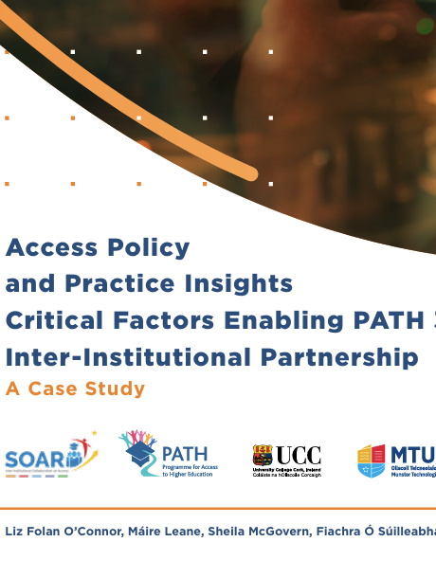
Olive Byrne
UCC
SOAR Project
South Cluster

Slide 2
Partnership Impact
Why This Matters for Students
Improved consistency in outreach and supports
Reduced duplication of services
Shared expertise strengthens access provision
Regional commitment to widening participation

Slide 3

Partnership
National policy shift to regional clusters
PATH 3 funded regional collaboration
Focus on widening participation
South/Southeast HEI cluster
Explore inter-institutional partnerships in access
Understand enabling factors for collaboration

Slide 4
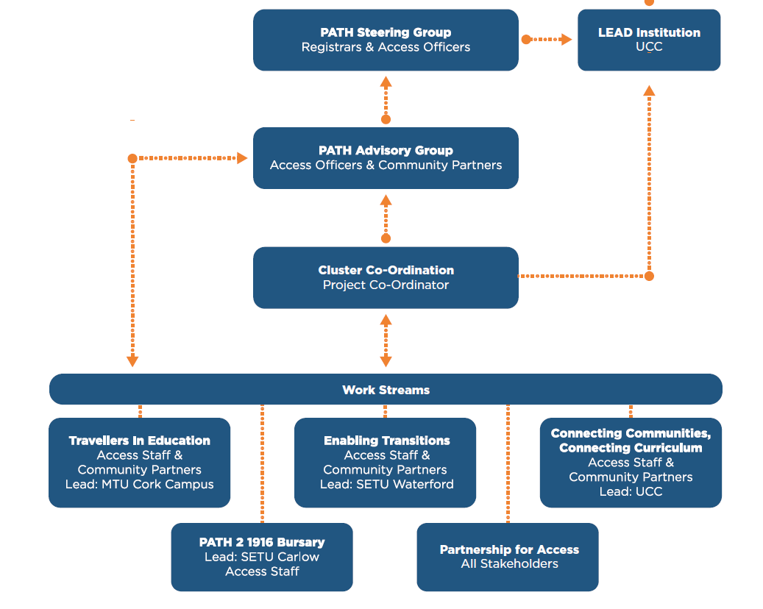
The SOAR Project – Overview
Five workstreams

Slide 5
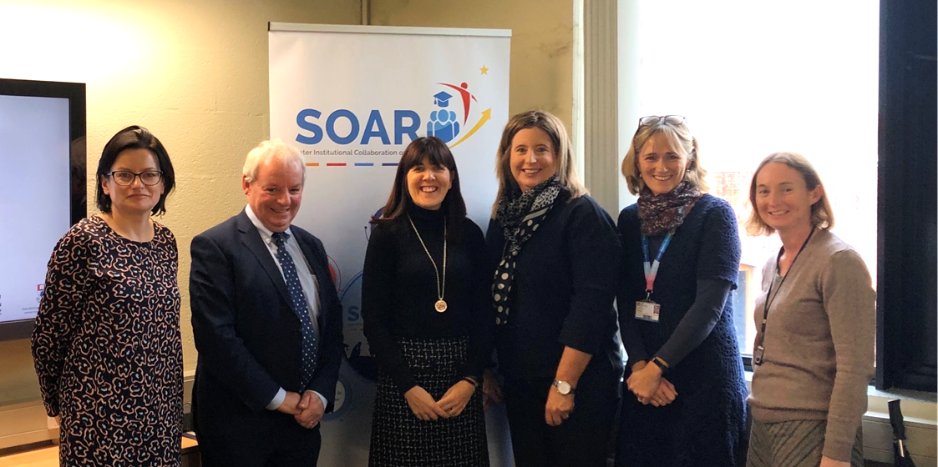
Trust, Professional Collaboration and Shared Goals
• Pre-existing professional relationships
• Strong inter-institutional trust
• Shared commitment to inclusion
• Flexibility and collaboration

Slide 6
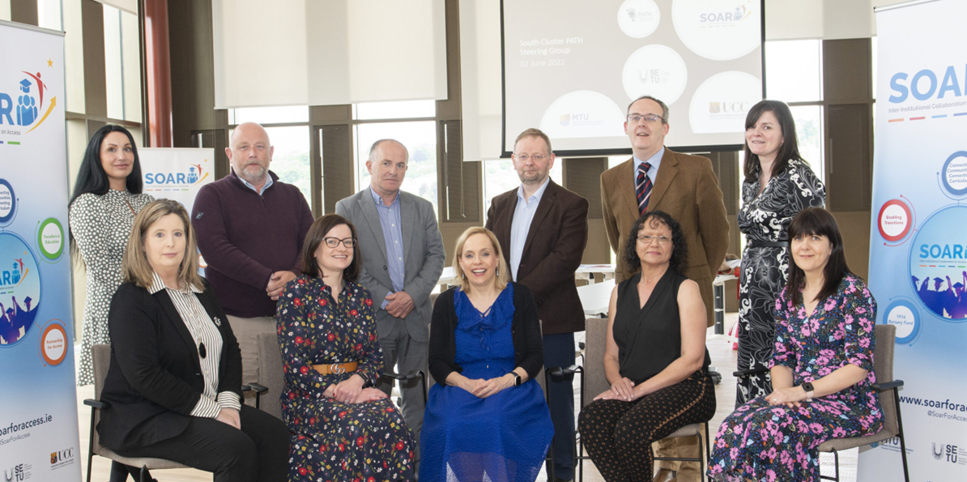
Governance & Leadership
• Steering and Advisory Groups
• Clear roles and responsibilities
• Lead Institution coordination
• Dedicated Project Coordinator

Slide 7
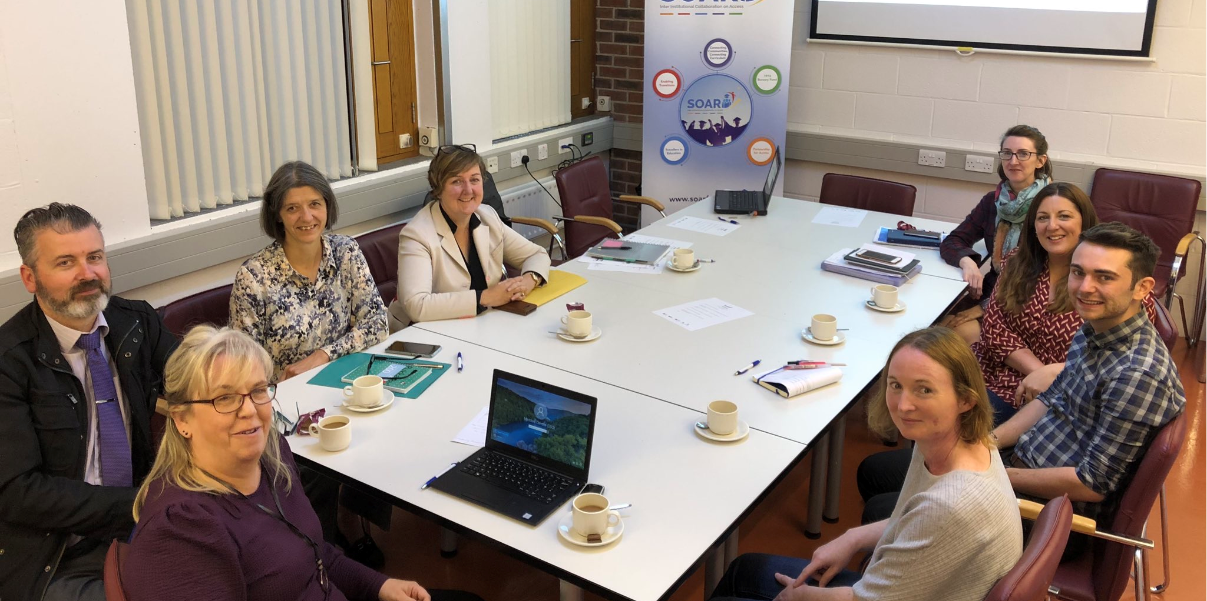
Shared Learning & Communities of Practice
• Cross-institutional knowledge exchange
• Community of practice development
• Shared problem-solving
• Reduced duplication of effort

Slide 8
Quotes from Access Practitioners
‘… that sort of signposting, guiding each other, learning from each other’s mistakes, you know, and learning from each other’s wins as well, which I think is huge’
‘… a place that you could actually bounce ideas off, you could get feedback from colleagues on what they thought, why things worked, why they didn’t work – which was sometimes more important – and, I suppose, for me personally, there has been huge learning and advantages in having that group to be able to come to, to bring things to; so that to me was a huge advantage’.
‘… it saved us a lot of time in terms of, you know, not starting from scratch and maybe making some of the mistakes or going down the avenues that you might go down if you didn’t have this collective expertise from within your own institution but a much greater expertise from outside of the institutions and also from our community partners’.

Slide 9
Challenges Identified
Differences in institutional capacity
Varying levels of readiness
Staffing and recruitment delays
Funding uncertainty
Role clarity for Lead Institution

Slide 10
Successful Inter-institutional Partnerships
Articulate Shared Values and Principles of Working
Clarify Governance and Operational Protocols
Scope and Resource Anchor Posts
Facilitate Partner Engagement
Built-in Opportunities for Shared Learning

Slide 11
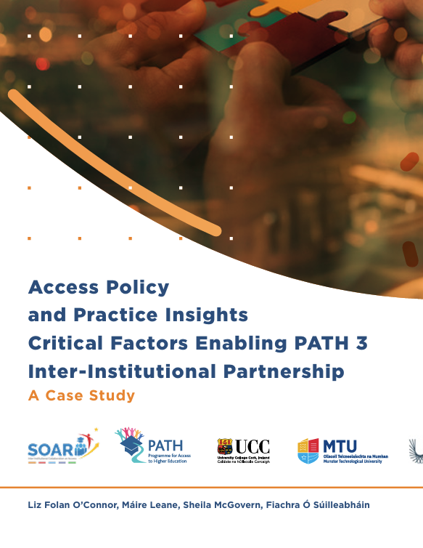
Thank You
www.soarforaccess.ie
Olive Byrne
Head of Access
UCC

