Slide 1

The evolution of the 1916 Bursary
A reflection to mark the tenth academic cycle of the Bursary

Slide 3


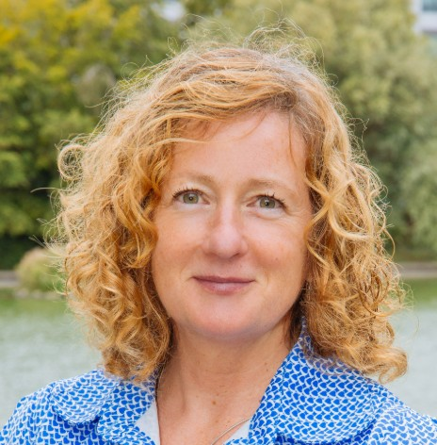
Speakers today
Dr Celia Keenaghan
Participation Officer
Atlantic Technological University
Dr Karina Curley
Widening Participation Officer
Dublin City University
Fiona Sweeney
Head, Outreach, Engagement & Transition
University College Dublin

Slide 4
Presentation overview
Overview of the Bursary
The evolution
Continuous improvement and incorporation of the student voice
Future strategic vision
4

Slide 5
What is the 1916 Bursary?
The PATH 2 1916 Bursary was established to support students from socio‑economically disadvantaged backgrounds to participate in and succeed in higher education.

Slide 6






Collaborative stakeholders
Higher Education Institutions

Slide 7
Eligibility and award
To be eligible for a 1916 Bursary, all applicants must meet eligibility criteria outlined in the Guidelines published each year by the Higher Education Authority (HEA).
  Financial
  Priority Group
  College Entry
Award | Amount | Places
Tier 1 | €5000 | 400
Tier 2 | €2,000 | 200
Tier 3 | €1500 | The number of Tier 3 bursaries to be paid will be based on existing underspends.

Slide 8
Growth of the Bursary
Bursary places have grown by +1300 from the launch of the Scheme.
Introduction of ESF+ funding in 2023/24 sustained the availability of award places.
Year | Places awarded | Value of new awards
2017/18 | 200 | €995,000
2018/19 | 199 | €995,000
2019/20 | 200 | €1,010,000
2020/21 | 323 | €1,255,000
2021/22 | 323 | €1,255,000
2022/23 | 1,178 | €2,713,000
2023/24 | 1,433 | €3,654,000
2024/25 | 1,392 | €3,588,000
2025/26 | 1,585 | €3,877,500
TOTAL | 6,833 | €19,342,500

Slide 9
“I honestly think that the bursary helped me immensely, I mean really, I don’t think I could continue without it, I really genuinely mean that. I cried … I couldn’t believe how lucky I was really and I still can’t believe it, it is amazing, it really is … when you’re hand to mouth, there is nothing spare and there have been times where I’ve had 16 cents in my bank account. And I’m not joking. It’s like it’s huge, unbelievably huge. I’m very grateful and just wish more people would benefit.
A 1916 Bursary recipient
9

Slide 10
The evolution of the 1916 Bursary
National approach agreed with IUA hosting PATH2 Coordinator to oversee
Launch of the Scheme
Bursary extension for 3 years
2017/18
2019/20
2021/22
Bursary managed by six regional clusters
2018/19
Increase in Bursaries awarded (200)
2020/21
Funding secured for national assessment and award
Inefficiencies due dispersed administration
Commitment to centralise the Bursary administration
Introduction of Tier 2 and Tier 3 bursaries
200 Bursaries awarded

Slide 11
The evolution of the 1916 Bursary
Introduction of ESF+ funding
Additional requirement to manage payments and reporting for ESF-funded bursaries
Lessons Learned Report identifies improvement opportunities for the Bursary
Centralised Customer Care function introduced.
Award places increase for Tier 1 and Tier 2
2023/24
2025/26
2022/23
2024/25
2026/27
SUSI identified to support the centralisation of the Bursary administration
Administration of the Bursary supported by SUSI
Creation of a centralised application portal managed by SUSI
Establishment of Strategic Steering Group to support the future

Slide 12
Evolution summary
Challenges
Improvements
Communication.
System limitations.
Complex processes.
Bursary management gaps.
Increased number of bursary places.
Centralised application and assessment model.
More timely payment of students.
Enablers
Collaboration of the key stakeholders.
Student needs.
Operators Group.
European Social Funding (ESF+).
Appointment of the 1916 Bursary Co-Ordinator.

Slide 13
“I was asked for supporting evidence in relation to being in care which I did not have as it was over 28 years ago. I found writing my own experiences emotional and it brought back a lot of painful memories but I felt extremely overwhelmed when I got the call that I had been granted the fund. I felt vulnerable when I put my words onto paper and sharing them not knowing exactly who was reading my life story.”
A 1916 Bursary recipient
13

Slide 14

Continuous evolution
10th academic cycle 1916 Bursary
Significant Progress
Cyle Reviews & Incremental improvements
Challenges Remain
Agreement on the strategic direction of the Bursary.
Strategic vision to be informed by student perspective.

Slide 15
Ongoing Challenges
The student perspective has been gathered from the 2025/26 Lessons Learned Survey and Customer Care data:
Clarity and guidance: Unclear next steps and eligibility requirements, with appeal grounds lead to confusion.
Application experience: Portal limitations create frustration and errors.
Timelines and access: Short application and appeal windows reduce flexibility and increase pressure.
Communication and transparency: Limited visibility of status, decisions, and timelines drives uncertainty.
Evidence requirements: Complex and sensitive documentation requirements create burden and potential stress for applicants.

Slide 16
Reflections and Future Directions
Significant Impact of PATH 2 – Students & HEIs
Collaborative commitment to progressing strategic direction
Opportunities to;
  Streamline funding pathways.
  Aligning awarding frameworks.
  Restructure reporting process.
Strategic centralisation of Bursary Application Process

Slide 18
Student Voice References
Quote from Female; First-time mature entrant; Lone parent) SOAR Evaluation content page 33
Survey participant Without the Help I Would Have Dropped Out- Evaluation of the 1916 Bursary Fund for the Midlands Easter North Dublin (MEND) Region.pdf Page 55

