Slide 1

Advancing Access to Apprenticeship for Members of the Traveller and Roma Communities

Slide 2

Overview of Presentation
Overview of Access & Outreach
Overview of Apprenticeship Days
Overview of Try a Trade Days
Partnerships (ITM & TU Dublin Apprenticeships)
Access to Apprenticeship Programme
Irish Traveller Movement, Traveller Apprenticeship Incentivisation Programme (TAIP)

Slide 3
Originated From
Following consultations Access and Outreach identified a gap about apprenticeships in the Traveller and Roma Community
Organised the Apprenticeship Day as a pilot in partnership with Irish Traveller Movement, Traveller Apprenticeship Incentivisation Programme (TAIP) and TU Dublin Apprenticeships
As a result of the success of the Apprenticeship Day, the Try a Trade Days were established
2 years later it continues

Slide 4
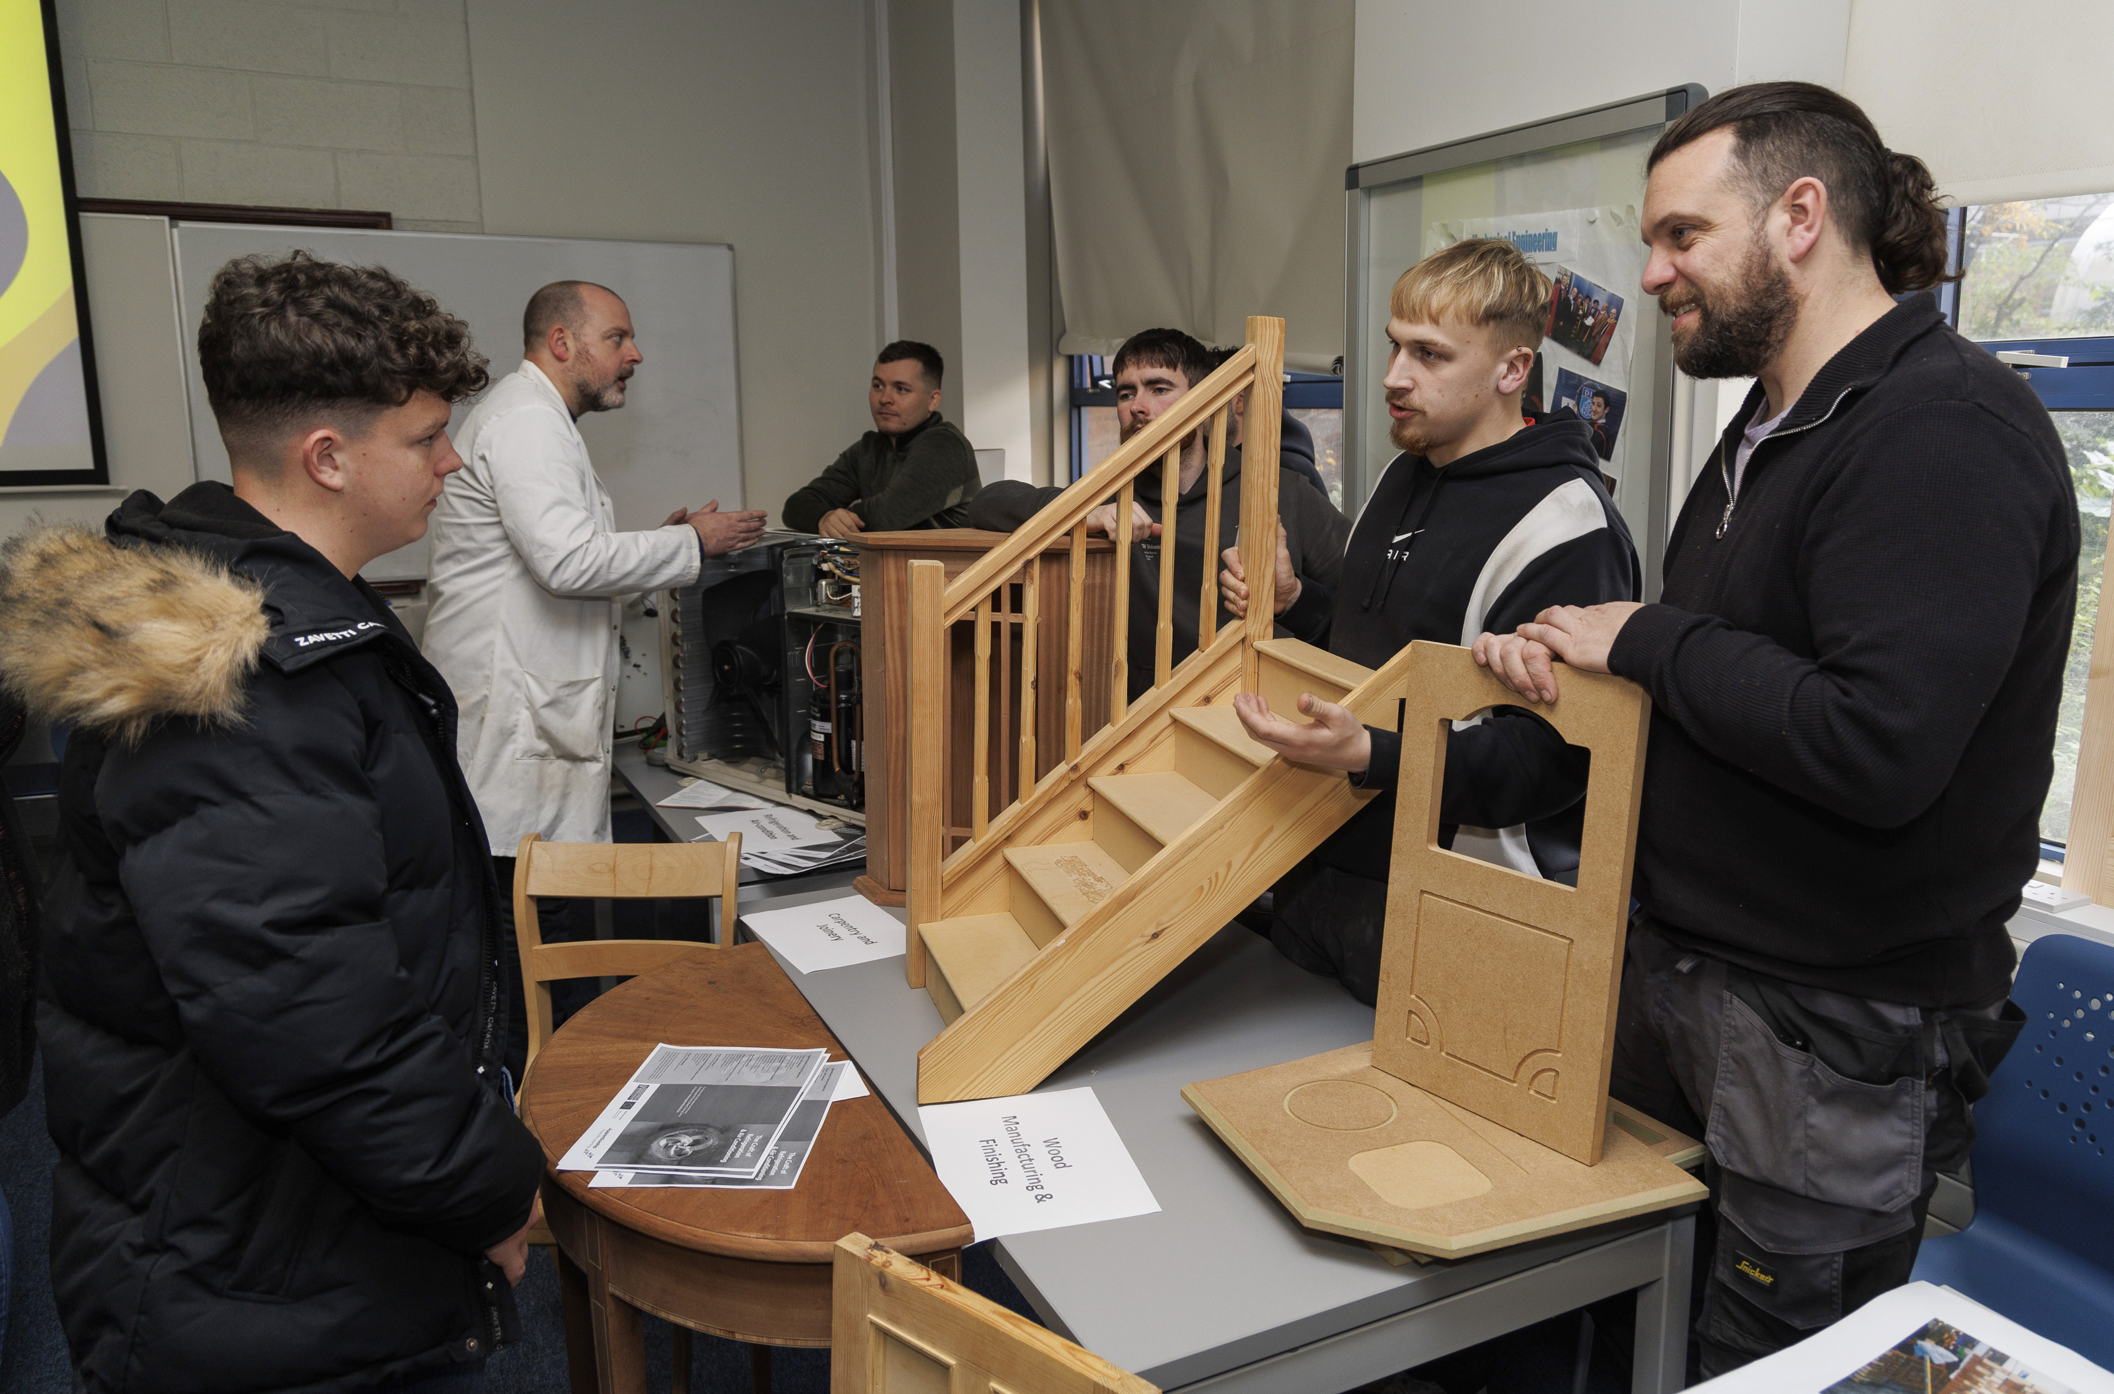
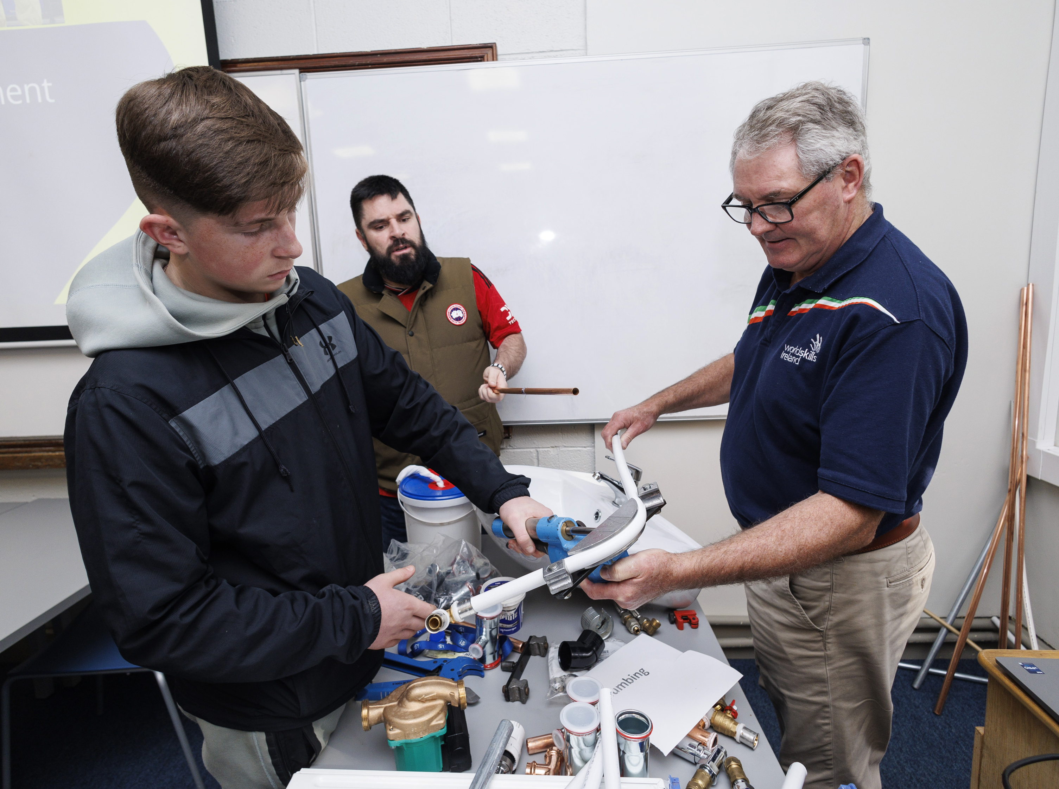
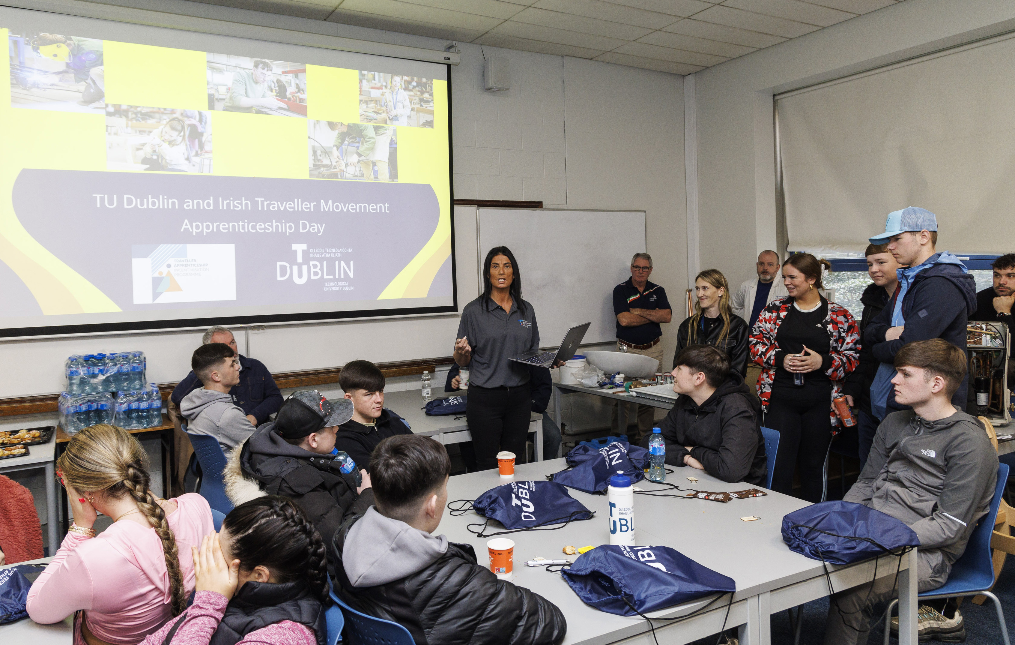
TU Dublin and The Irish Traveller Movement Apprenticeship Days
The days included:
Information about apprenticeships
Guest speakers from ITM, Bus Eireann
Demonstrations from various trades:
  Plumbing,
  Carpentry & Joinery
  Heavy Vehicle Mechanics
  Painting & Decorating
  Brick & Stone
  Vehicle Body Repair

Slide 5
Number for Apprenticeship Days
Year | Sessions | Attendees | Youth services | Schools | Community organisations | National organisations
2024 | 1 | 60 | 1 | 1 | 3 | 2
2025 | 5 | 51 | 2 | 1 | 3 | 3
2026 | 1 | 43 | 1 | 2 | 3 | 3

Slide 6
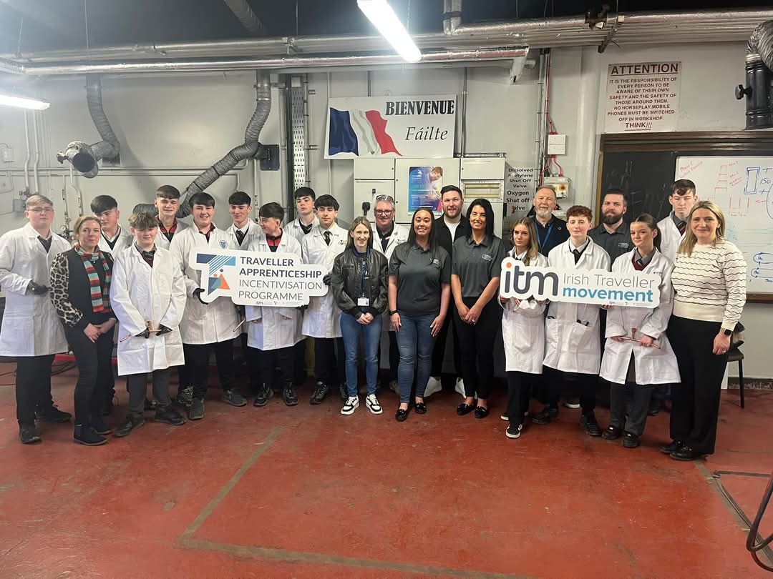
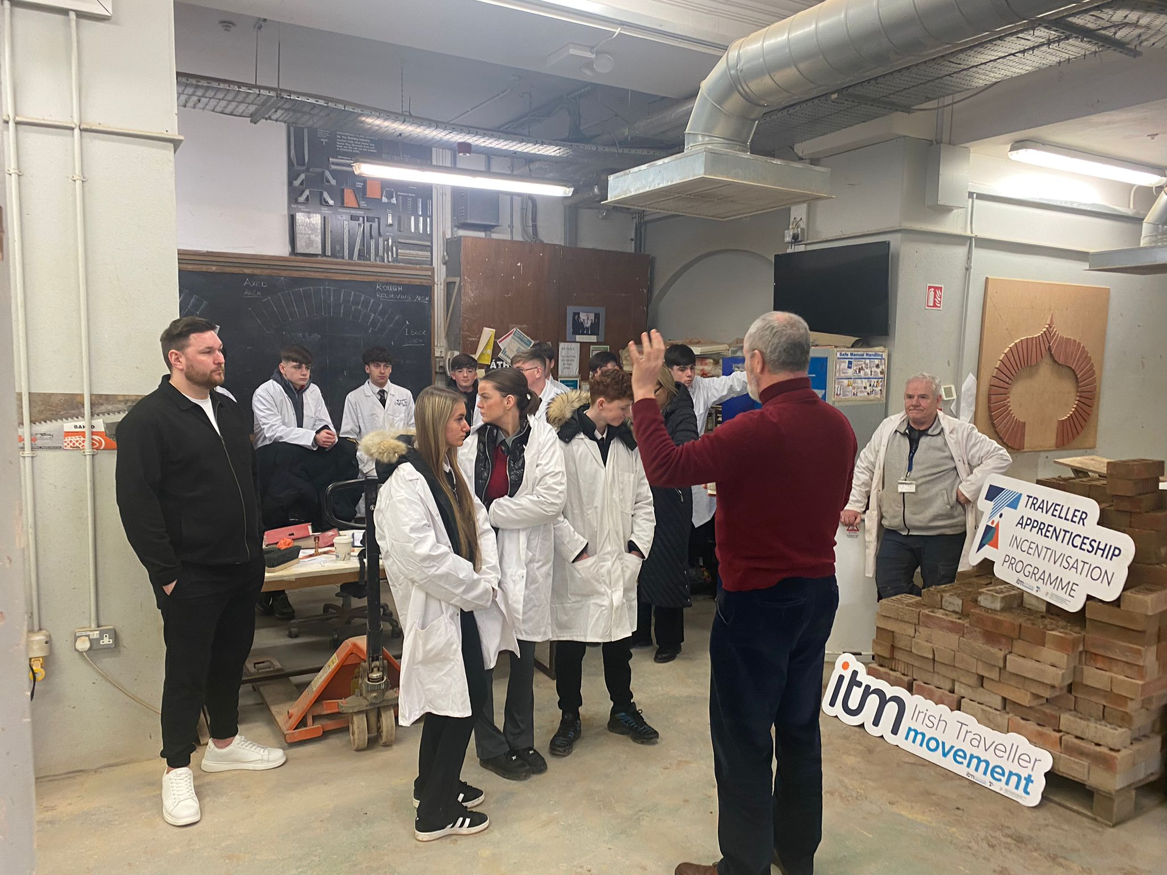
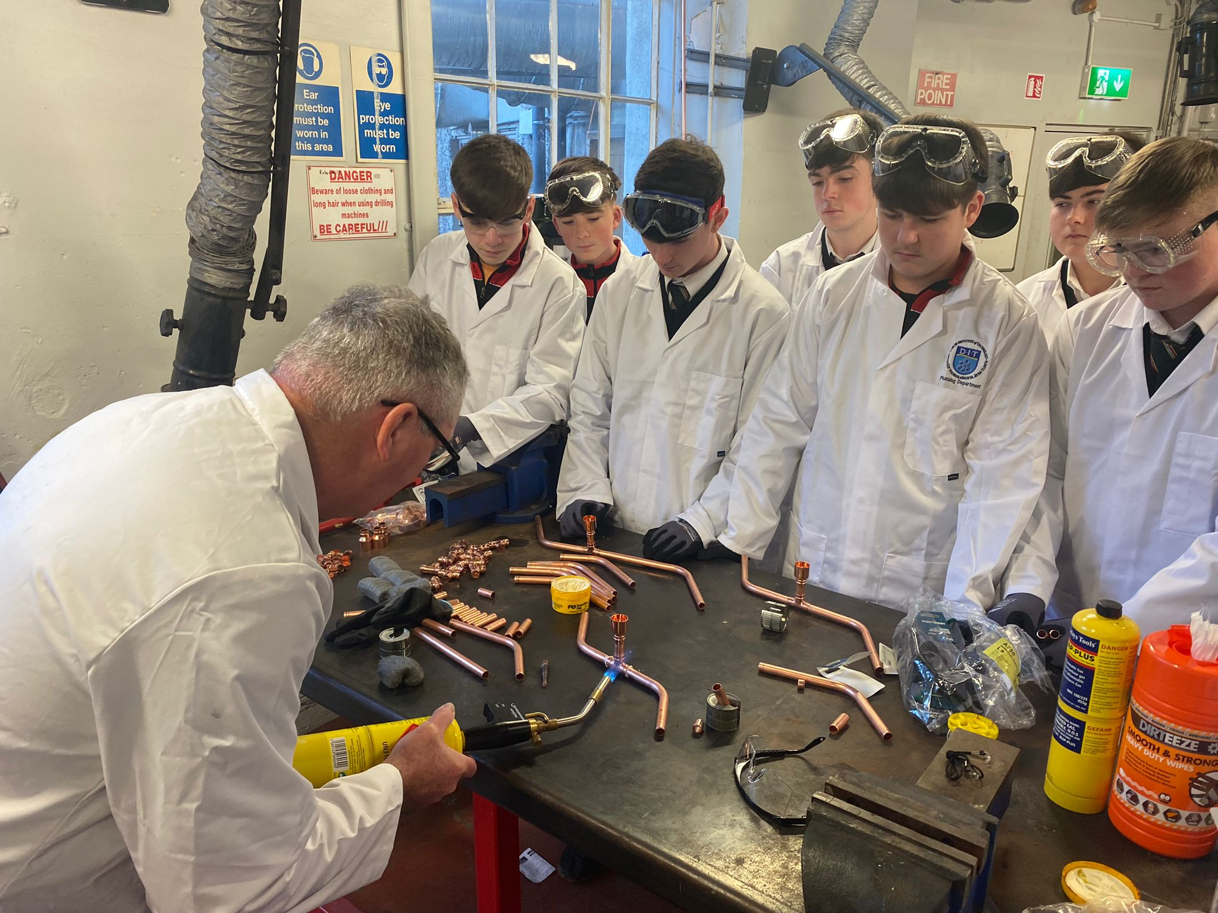
TU Dublin and The Irish Traveller Movement Try a Trade Days
6 Try a Trade Days in 2025
1 in 2026, another planned for 10th June
16 participants can attend
Try out trades such as plumbing, brick laying and electrical
Receive information about PATH 5, ITM and Apprenticeships

Slide 7
Numbers for Try a Trade Days
Year | Sessions | Attendees | Youth services | School | Community organisations
2025 | 5 | 51 | 2 | 1 | 3
2026 | 1 | 12 | 1 | 0 | 1

Slide 8
Outcomes
Apprenticeship Days will be facilitated on an annual basis
Try a Trade Days will continue to be facilitated in 2026 & 2027 due to the high demand
Increase in people seeking information on Apprenticeships and the Access to Apprenticeship Programme
1 Member of the Traveller community completed the Access to Apprenticeship Programme
Members of the community have also applied for the next round of Access to Apprenticeship course which will start in September

Slide 9


Education Supports for Traveller & Roma Communities in Accessing Higher Education
Information available on:
Access Entry Routes
Student Supports
Apprenticeships
TU Dublin Courses
Further information:
E: Annmarie.mcdonagh@tudublin.ie
T: 01-2208612
W: TUDublin.ie/connect/access-outreach/

Slide 10
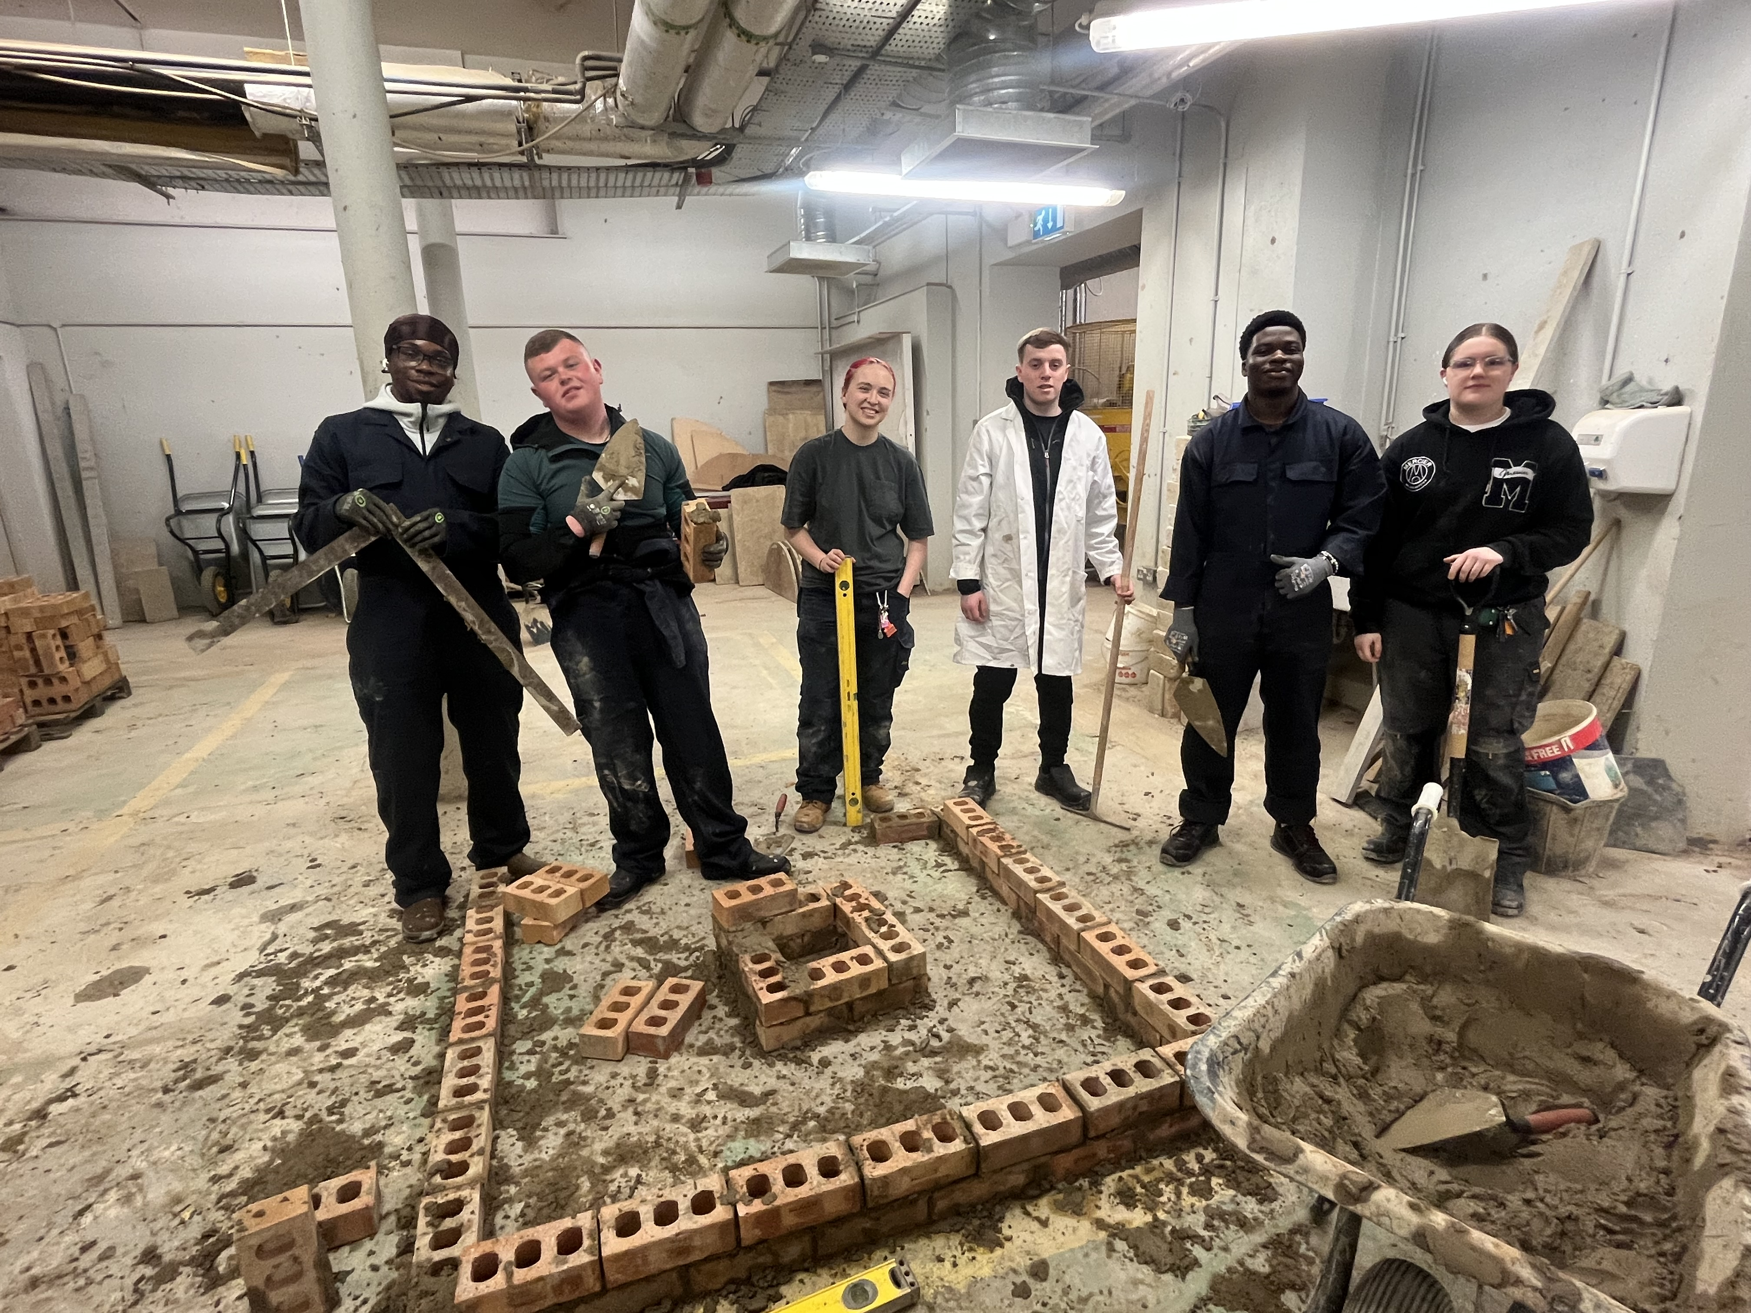
TU Dublin Access to Apprenticeship
Funded by the Higher Education Authority
Programme Team:
Dr Aidan Kenny,
Head of Apprenticeship
Gareth Fallon,
Programme Lead
James Wolfe,
Employability Skills
Amanda Byrne,
Outreach Engagement
tudublin.ie/study/apprenticeships/access-to-apprenticeship

Slide 11
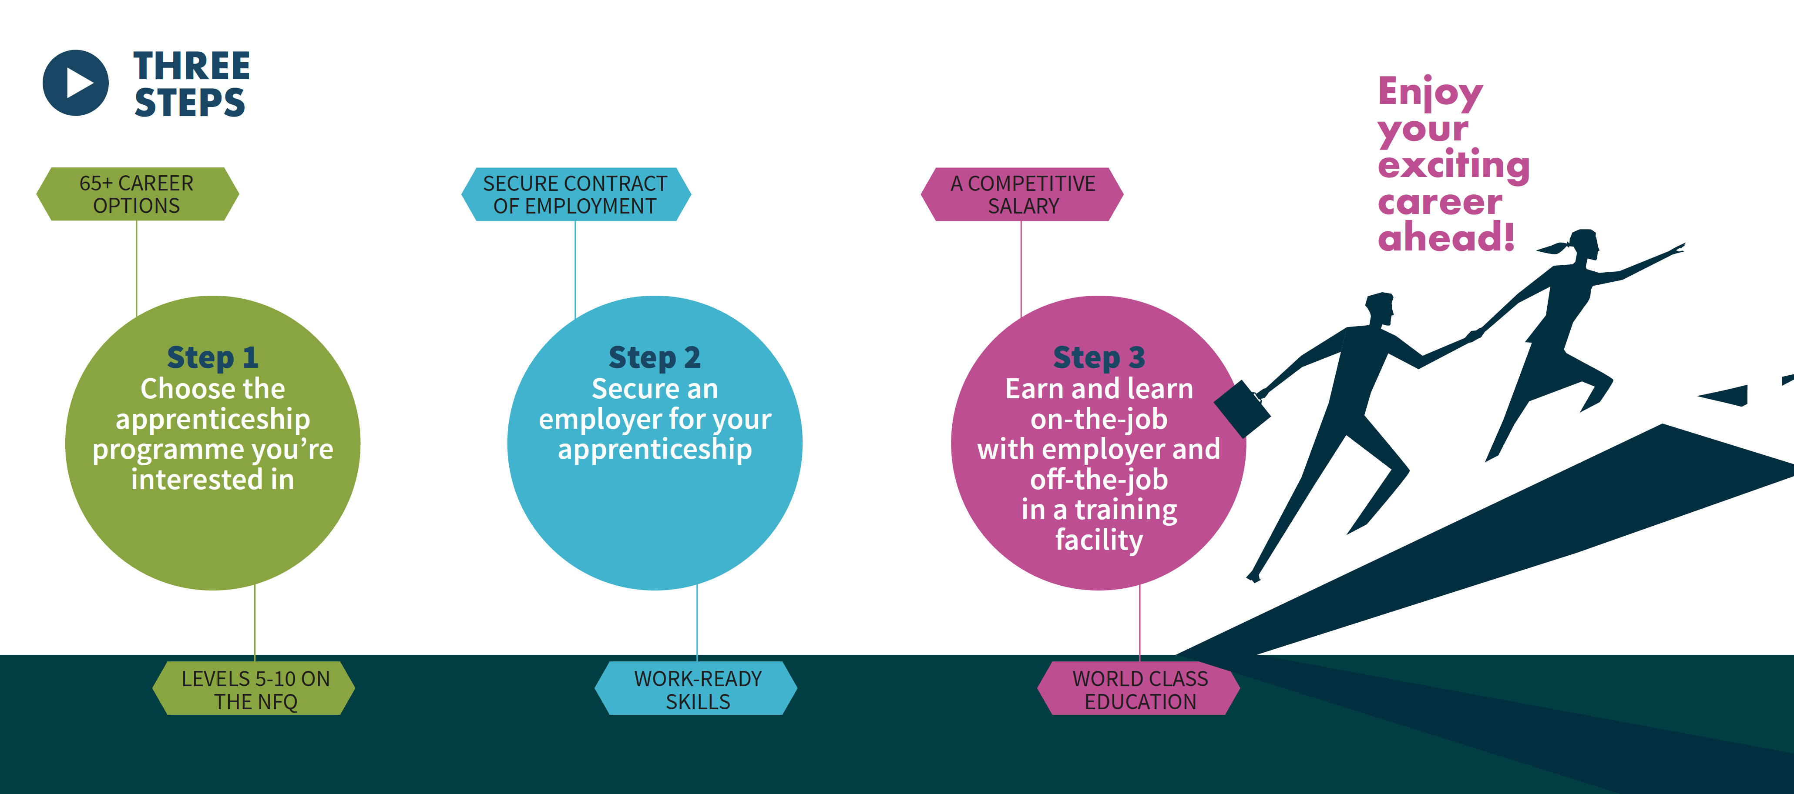
The Journey

Slide 12
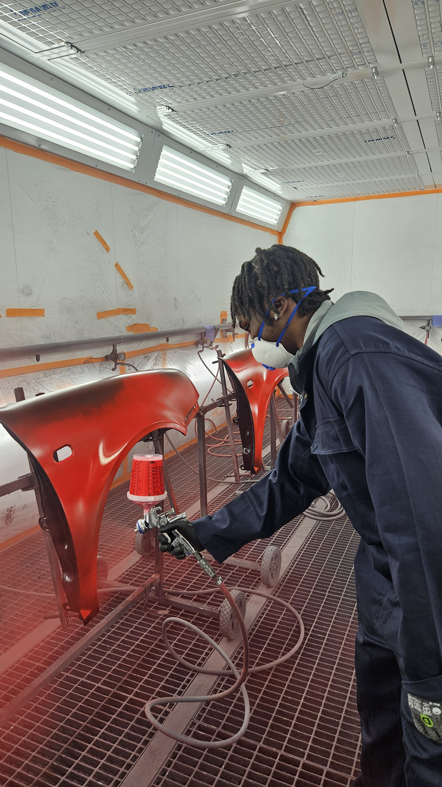
TU Dublin Access to Apprenticeship
DIT developed the programme in 2018
Aimed at 16–24 year olds from disadvantaged backgrounds
Duration 15-week full-time programme (Bolton St Campus)
16 apprenticeships per group per semester
Award Continuous Professional Development NFQ Level 6

Slide 13
Criteria
Gross family income on or below €46,790
You or Your Parents/Guardians in receipt of:
(a) a means tested social welfare payment
OR
(b) A medical card/GP visit card holder in
You:
Attended a designated disadvantaged school (DEIS)
OR
(b) Live in an area of disadvantage. Verified using the Eircode for your address
OR
(c) Are or have been in the care of the state
OR
(d) Your Parents/Guardians have not gone to college (higher education)

Slide 14
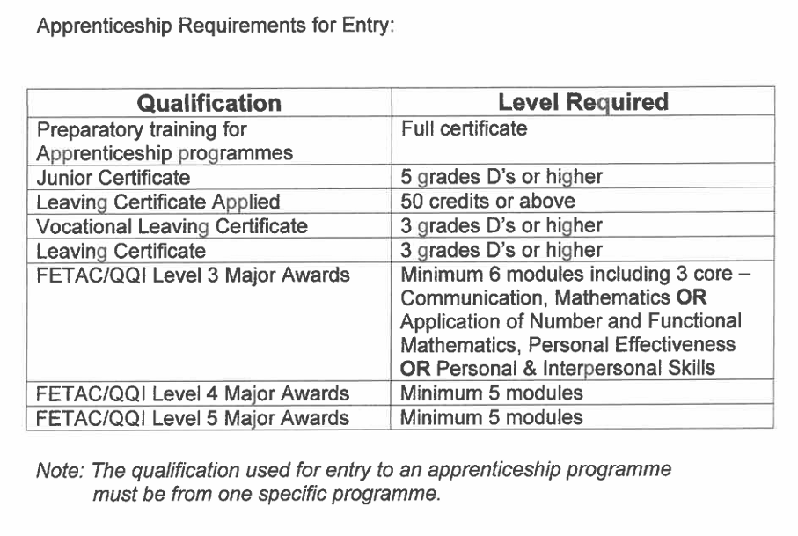

Slide 15
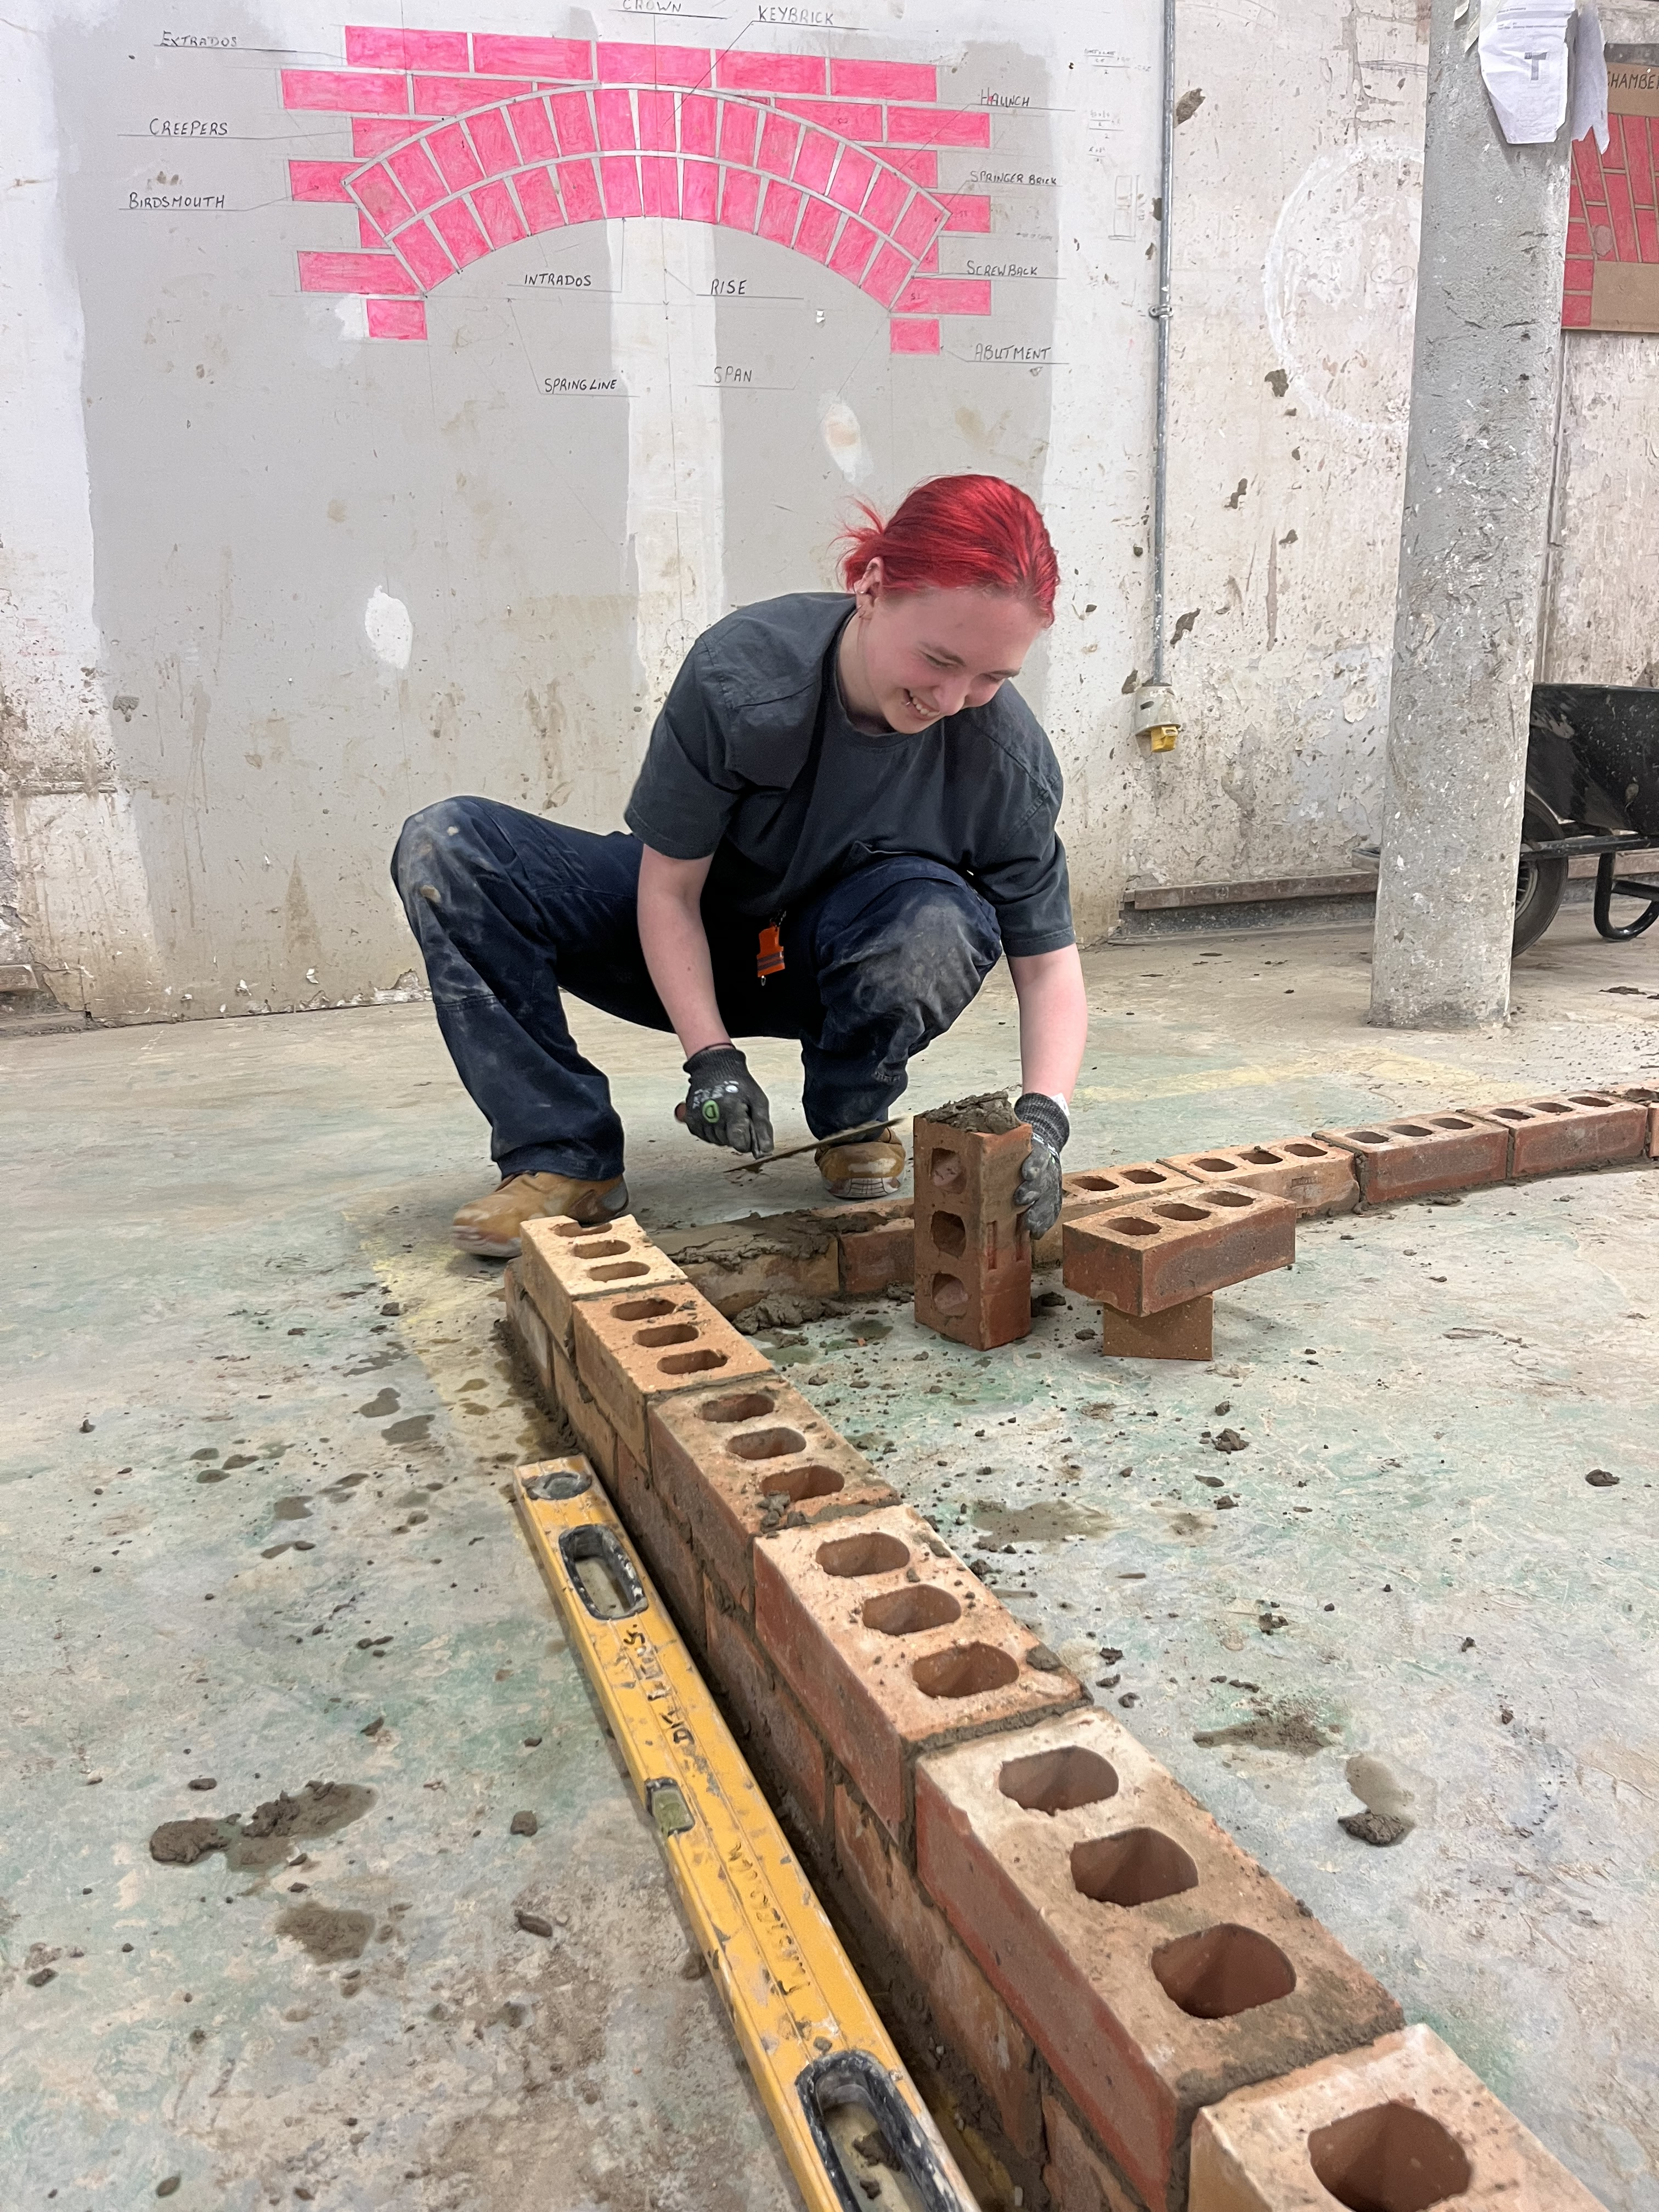
TU Dublin Access to Apprenticeship
Components:
  Safety training
  Workshop training
  Employability skills
  Employers visits
  CV & interview preparation
  Three weeks work experience
  Support services and pastoral care
  Financial support: €3,000 bursary

Slide 16
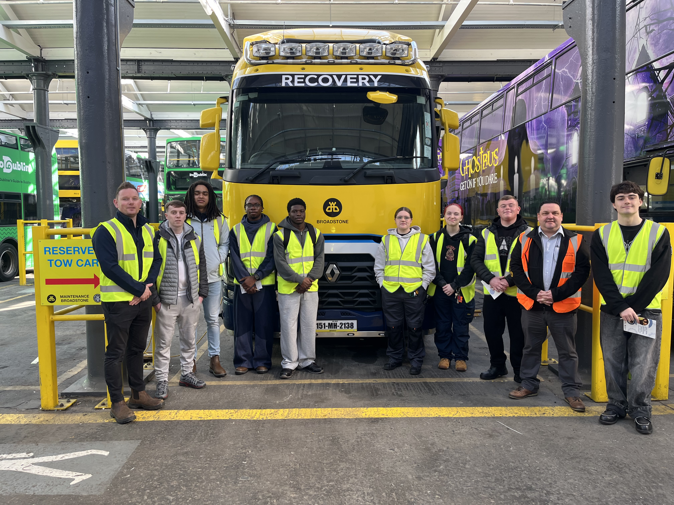
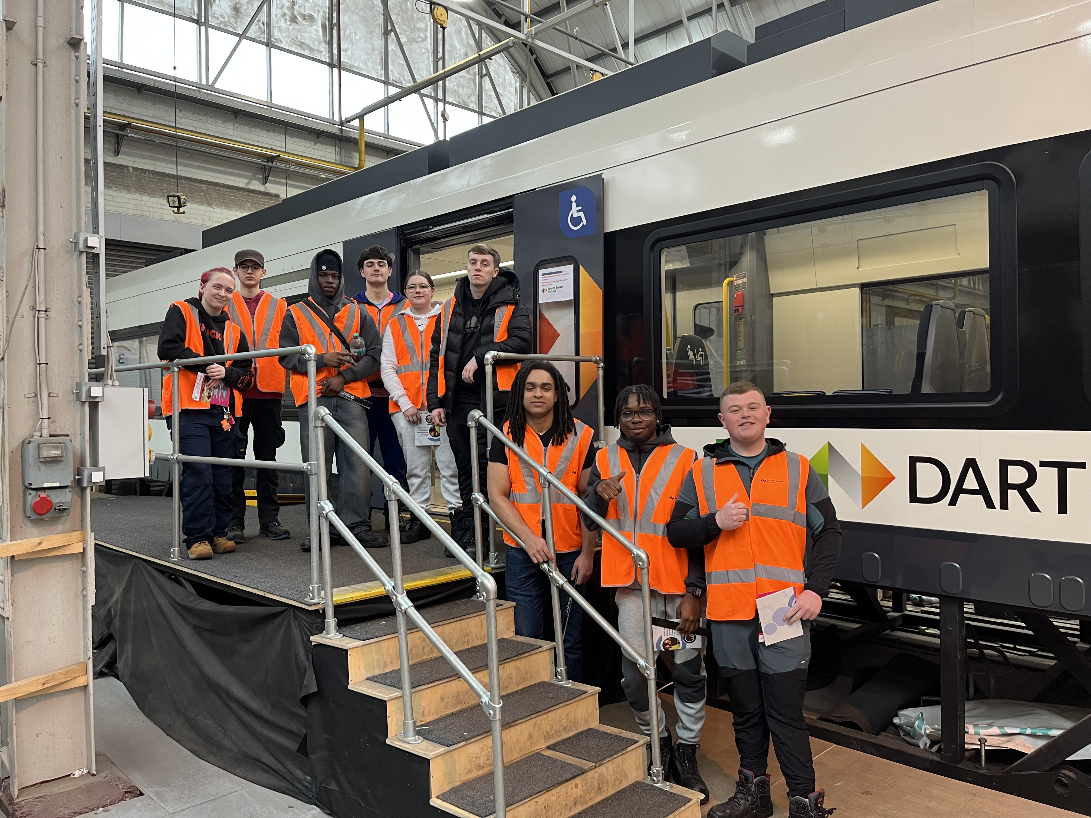
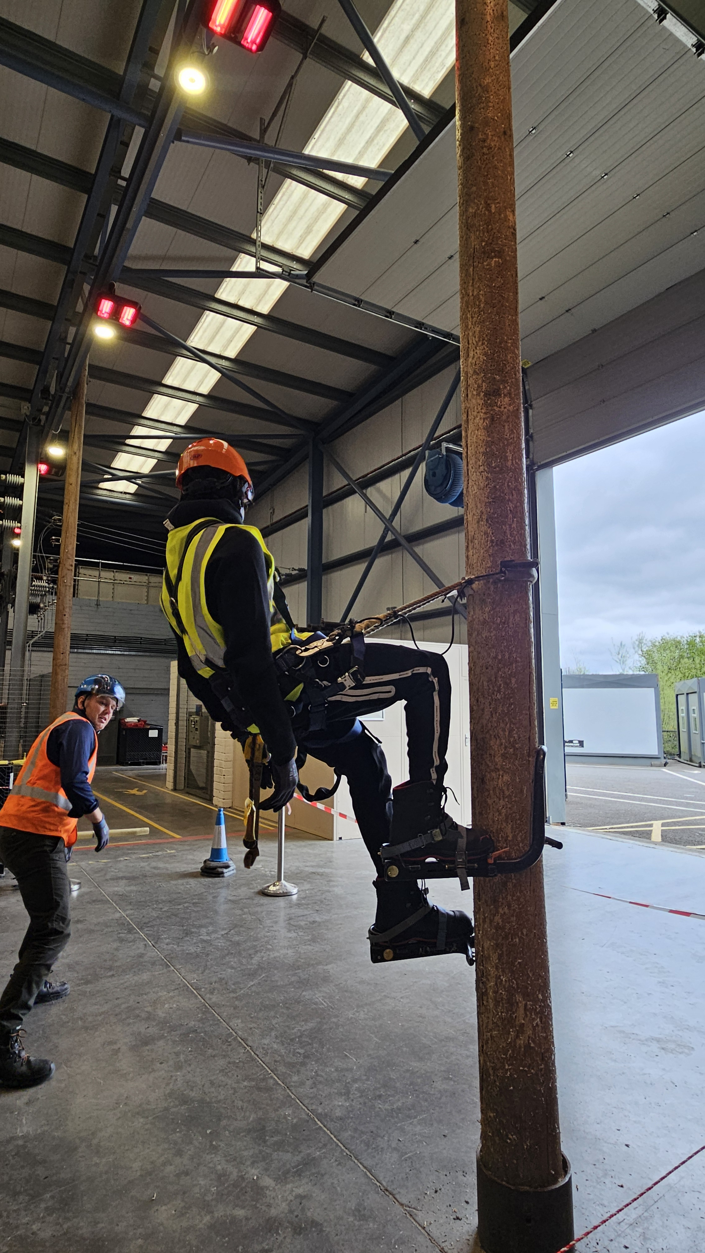
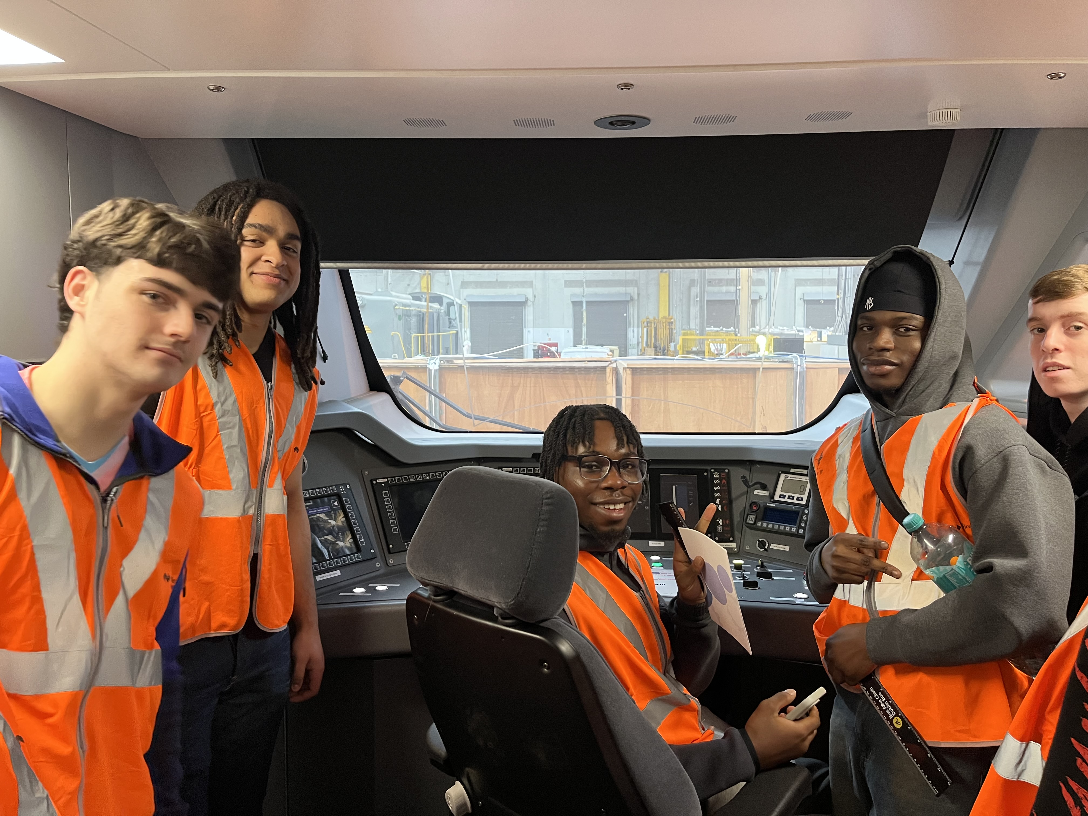
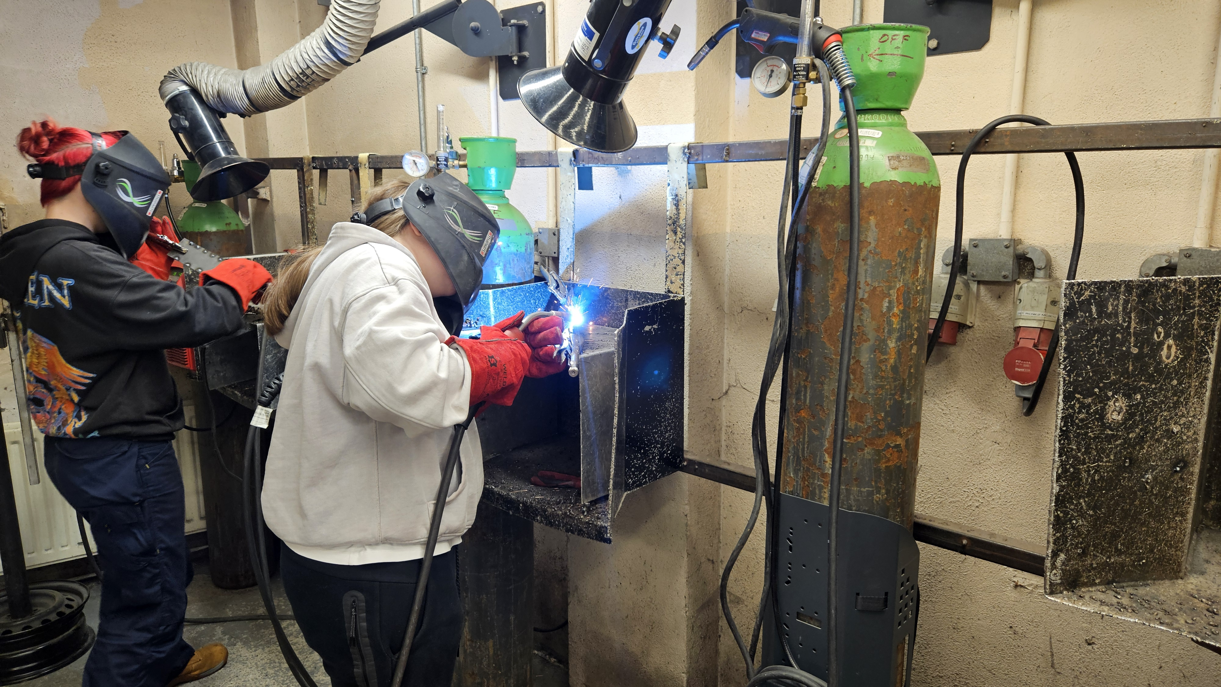

Slide 17
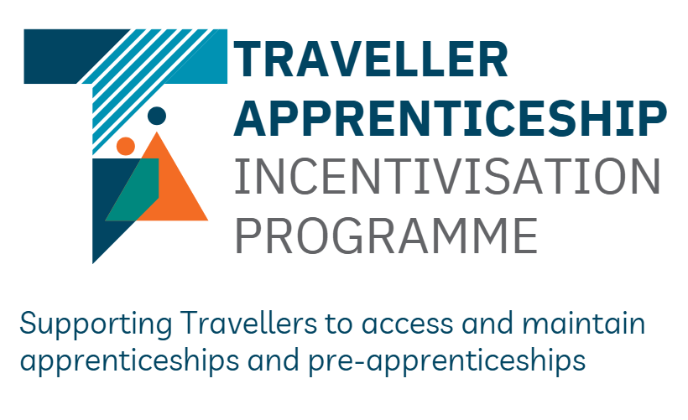


Irish Traveller Movement
&
TU Dublin
HEA Pathways
16th June 2026

Slide 18
The Irish Traveller Movement
The Irish Traveller Movement (ITM), established in 1990, is a national membership organisation that advocates for the rights and equality of Irish Travellers.
It works to combat discrimination, promote social inclusion and support access to education, housing and healthcare for the Traveller community.
ITM also collaborates with Traveller-led groups and other organisations to preserve Traveller culture and heritage while empowering Travellers to have a voice in policy and decision-making that affects their lives.

Slide 19
Traveller Apprenticeship Incentivisation Programme (TAIP)
The Traveller Apprenticeship Incentivisation Programme is funded by the Department of Further and Higher Education, Research, Innovation & Science through Dormant Accounts funding aimed at supporting members of the Traveller community to access apprenticeships. The programme is delivered by ITM. TAIP aims to create equal opportunities for Travellers, build role models and support inclusive workplaces for the Traveller community.

Slide 20
Traveller Apprenticeship Incentivisation Programme (TAIP)
There are €3,000 bursaries available across three streams:
(1) for Travellers who start an apprenticeship or
(2) are in an existing apprenticeship or
(3) enrolled in a pre-apprenticeship or access to apprenticeship training courses. There are also one off grants of €2000 for employers who employed a Traveller on a new apprenticeship.

Slide 21
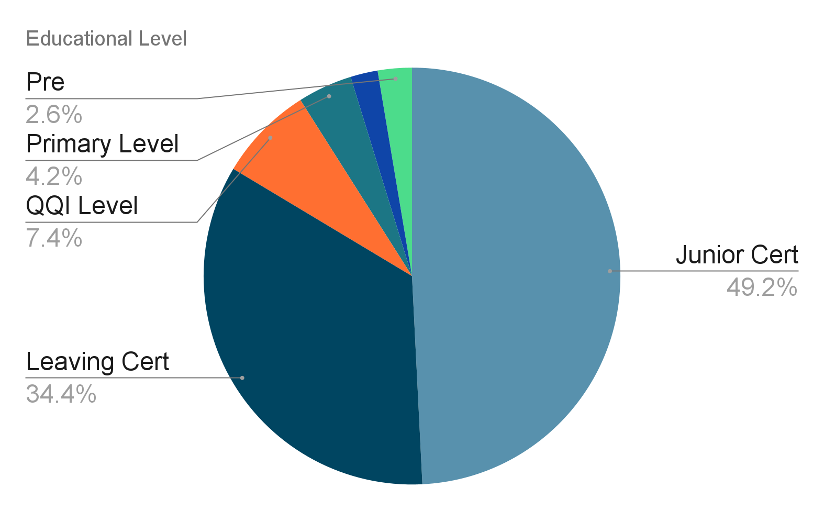
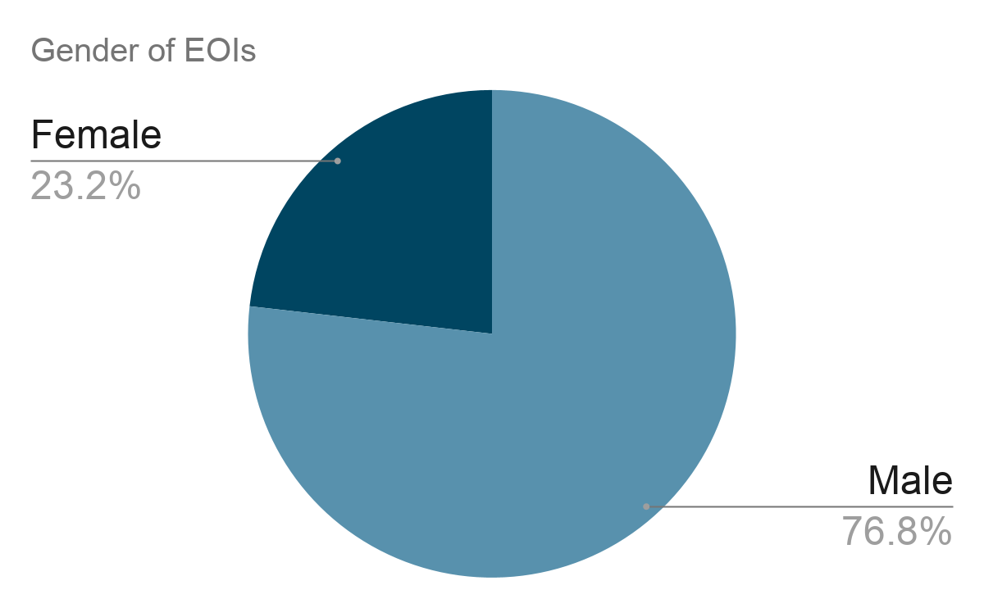
TAIP Overview

Slide 22

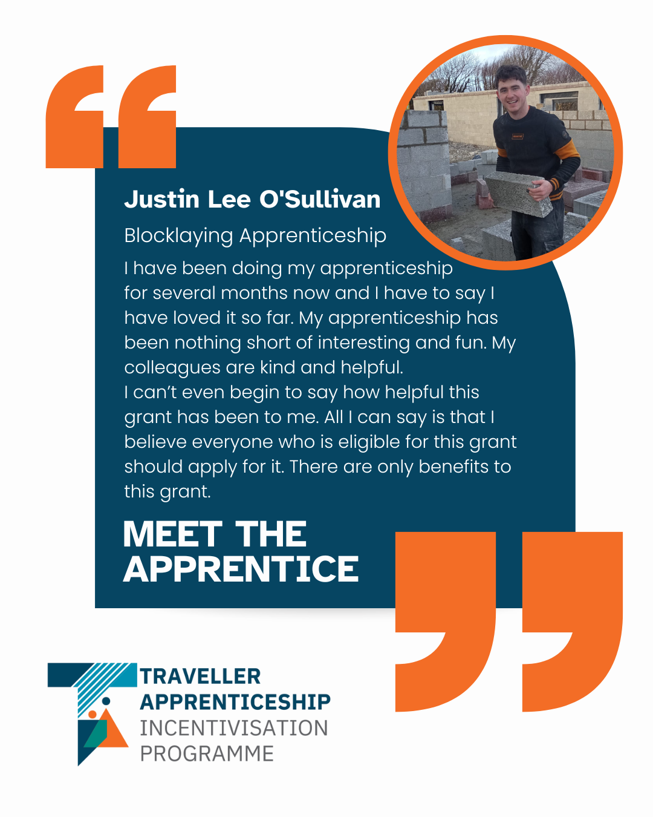
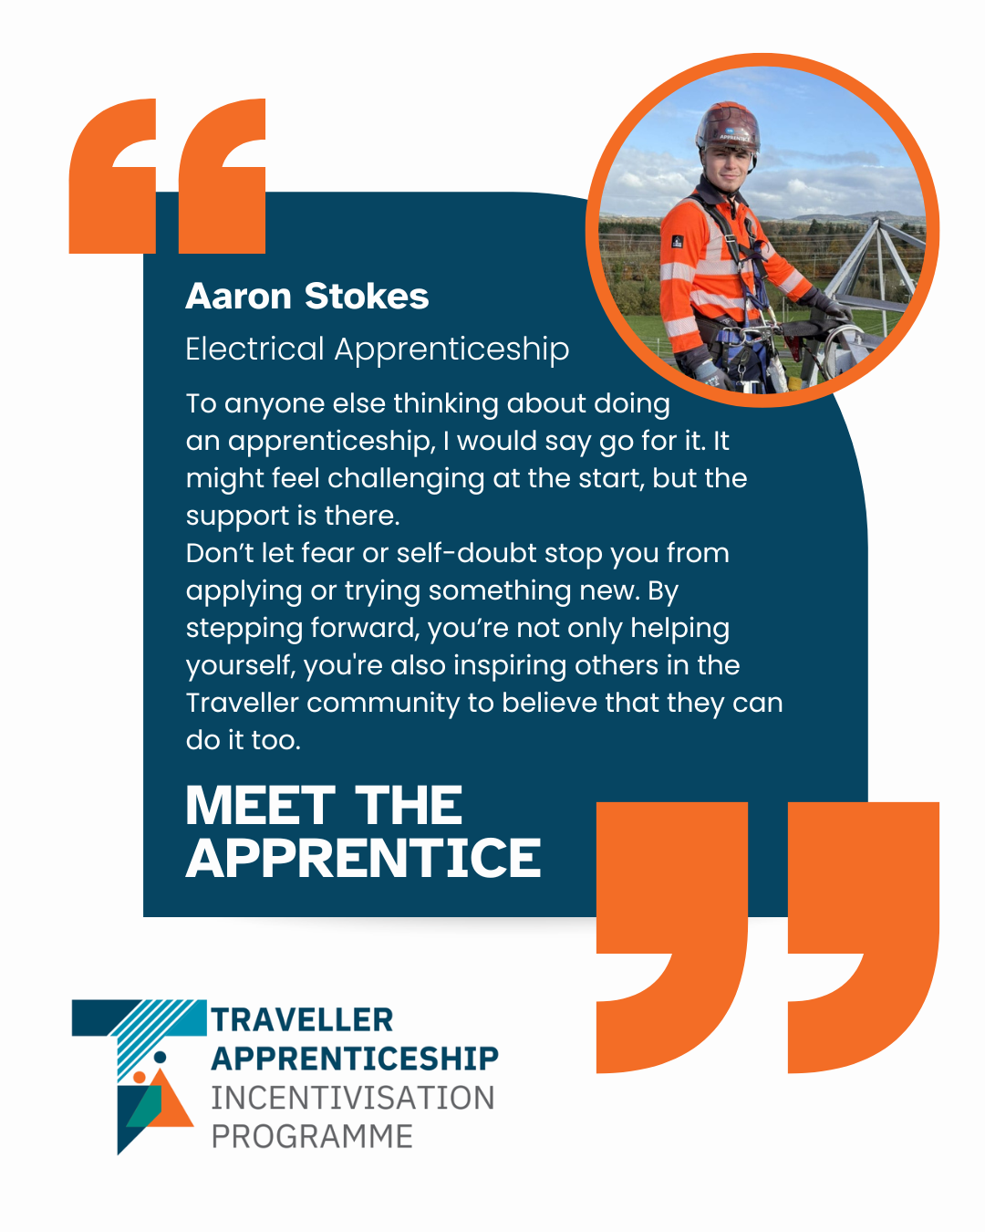
Promotion of TAIP

Slide 23


Referrals
Try-a-Trade Days
Open Days
One-to-one Supports
Financial Support in Apprenticeship
TU Dublin
Access to Apprenticeship
TAIP
Bursary & Supports

Slide 24
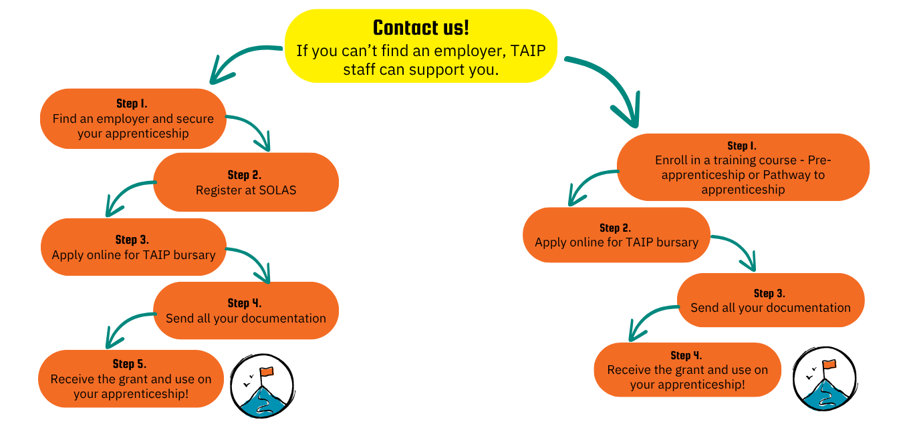
Application Process

Slide 25
TAIP Contact Information
Megan Forrest: meganforrest@itmtrav.ie
Pat Stokes: apprenticeship@itmtrav.ie
Rossa Gilsenan: rossa@itmtrav.ie
Bridget Kelly: bridget.k@itmtrav.ie

