Slide 1


From FET to ITE:
Learnings and reflections from the
Access to Post-Primary Teaching (APT) project
at ATU St Angelas
Dr Eileen Kelly-Blakeney & Ms Caoilfhinn Durkan
ATU St Angelas, Sligo
HEA PATH Showcase Event
16th - 17th June 2026

Slide 2

The Access to Post-Primary Teaching (APT) Project
APT: UoG strand
APT: ATU St Angelas strand
Led by Dr Elaine Keane & Dr Manuela Heinz
Aim: To recruit and support those from lower socio-economic groups in/to the Professional Master of Education (PME).
Supported 47 student teachers from lower socio-economic groups across Phases 1 & 2 (2017-2024).
APT student teachers implemented novel practitioner research project with c.1000 senior cycle pupils in DEIS schools.
Provision of bursaries, academic, mentoring and career supports.
Research: In-depth qualitative studies with APT student teachers across Phases 1 & 2–
Multiple peer-reviewed publications
Aim: to pilot a direct route into ITE programmes at ATU St Angelas for students from under-represented socio-economic groups with a QQI-FET qualification from a partner Further Education institution in the BMW region.
To provide a range of pre- and post-entry supports to project participants.
To establish a permanent new pathway into ITE for QQI-FET award holders (commenced 2021).
Supported 28 students with QQI-FET awards onto BA/PME and B.Ed programmes during Phase 1 & 2 (2018-2024).
Research: Annual survey of APT project participants, as well as qualitative research with ITE APT-route students and FET staff

Slide 3



​
ATU St Angela’s APT project design…
Pre-entry:
Participants engage in ‘Inreach’ and ‘Outreach’ sessions alongside their QQI-FET course
Informed by
research on
‘What Works?’
Post-entry:
Students provided with financial, academic and social supports for duration of their programme

Slide 4


​
Research
Semi-structured interviews with students
Conducted by myself, Dr Andrea Lynch (now MIE), Dr Patricia Kennedy (now UCC)
Two/three times during their ITE programme
About their:
Experiences and perceptions of FET
Experiences of APT project
Motivations to become a teacher
Transition to ITE
Experiences of ITE, and becoming a teacher

Slide 5
​
Reflections and Learnings

Slide 6
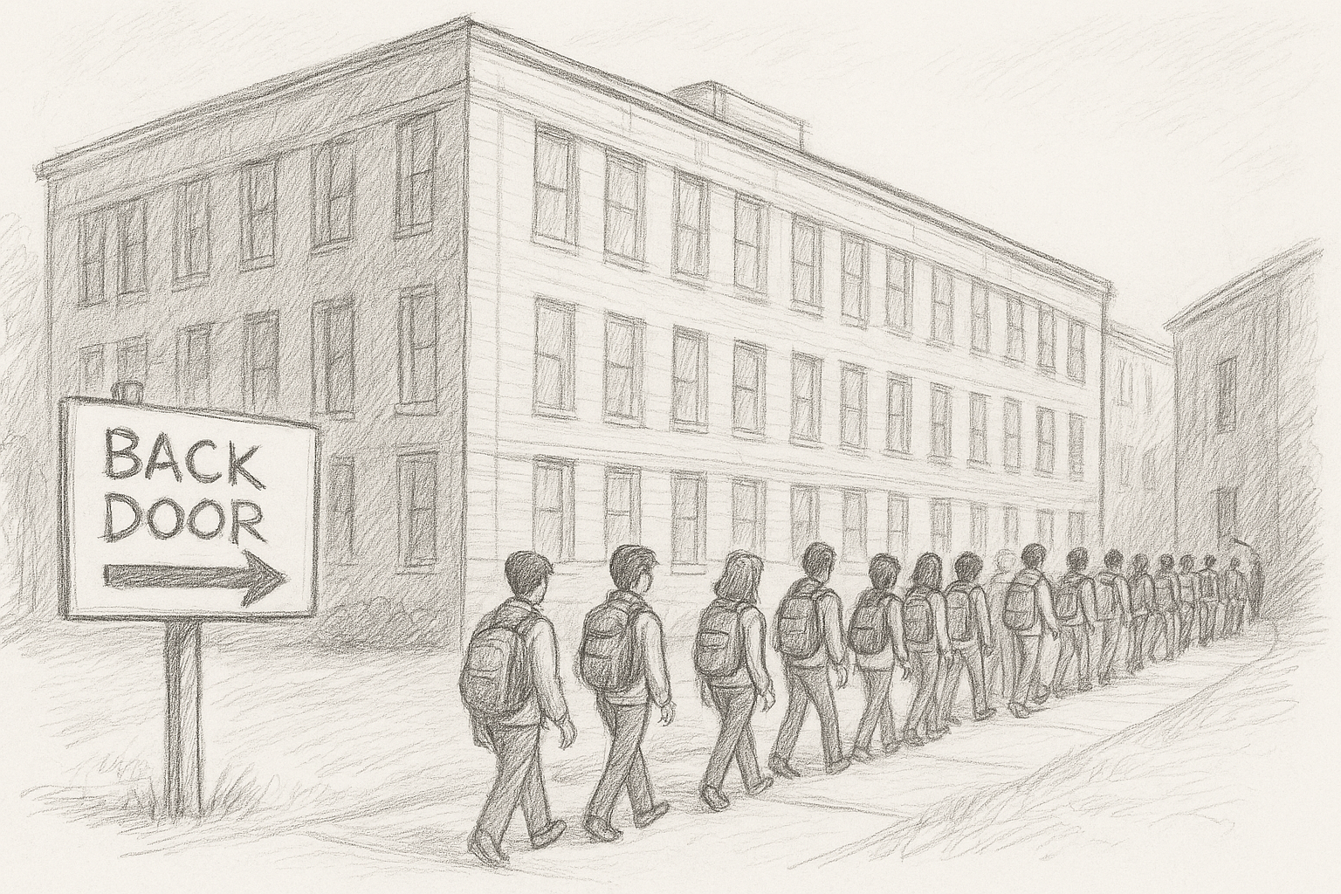
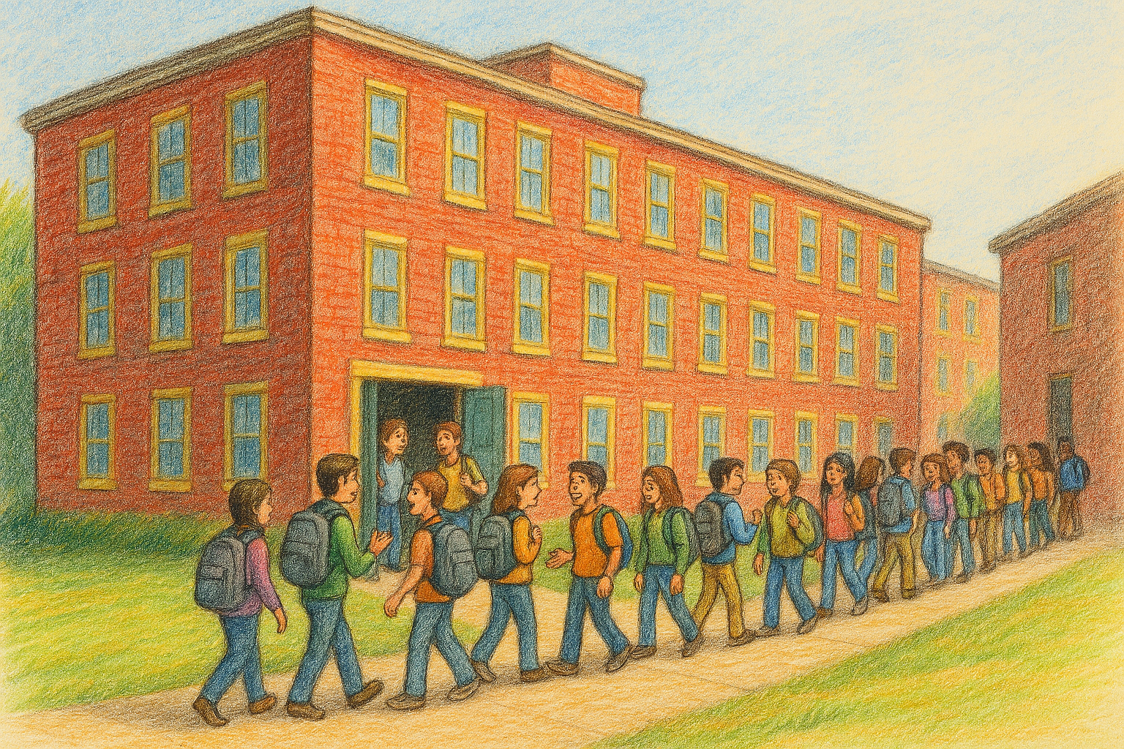
​
1. Perceptions of FET as entry route to ITE have evolved since the project commenced …
2018 2025

Slide 7




​
2. Pre-entry activities and and post-entry supports provided by APT helped students develop a sense of ‘belonging’

Slide 8

​
3. Altruistic reasons and a previous positive experience of the subject (‘professional passion’) were the main motivations for become a teacher

Slide 9

​
4. The journey to ‘becoming’ a teacher isn’t always a linear process …our findings suggest the concurrent model of teacher education supports a smooth transition

Slide 10




​
5. Engaging with and listening to our stakeholders was crucial to the success of the APT project

Slide 11
​
Reflections on the APT project:
Caoilfhinn’s Story

Slide 12
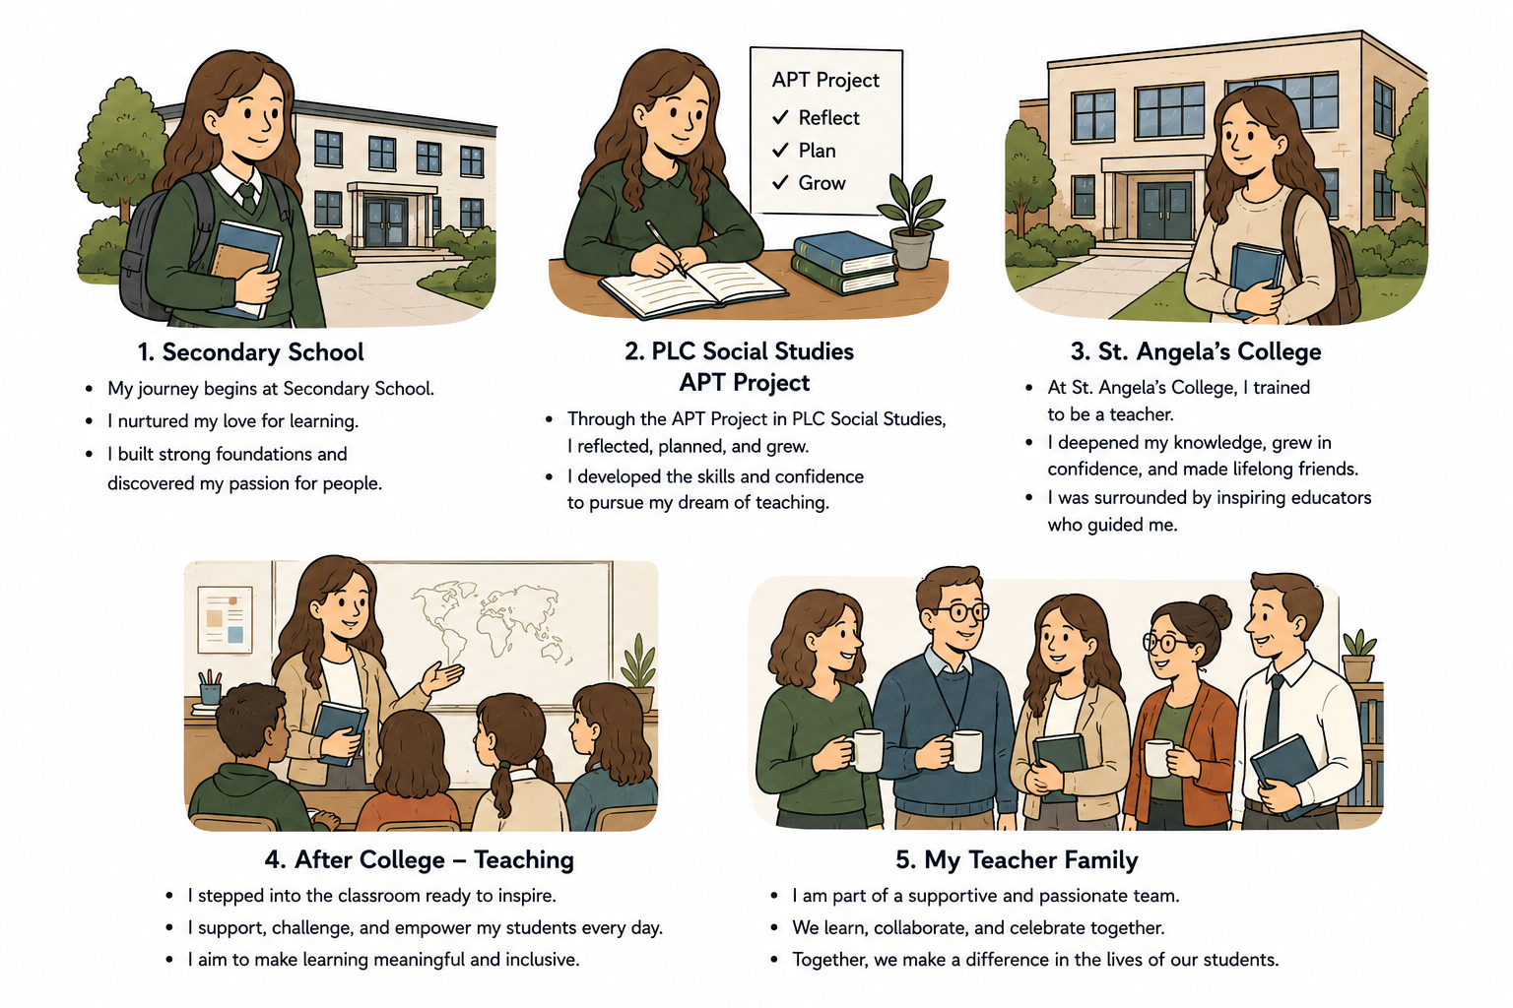


​
Caoilfhinn’s Story

Slide 13


​

Slide 14
​
Thank you for listening!
Eileen.Kelly@atu.ie
cdurkan@mountcarmel.ie

