Slide 1



TURN TO TEACHING
Broadening Access to Initial Teacher Education
in Maynooth University
Dr. Dilara Demir Bloom

Slide 2
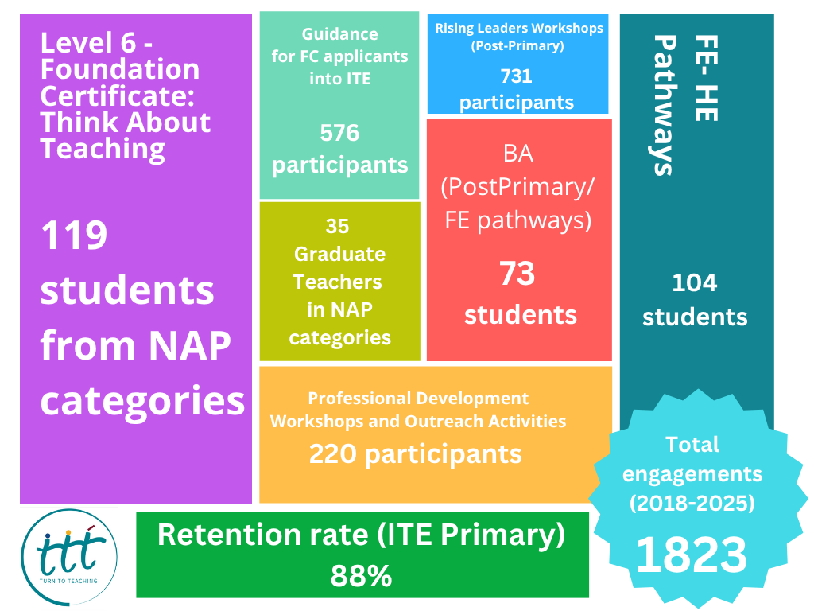

Slide 3
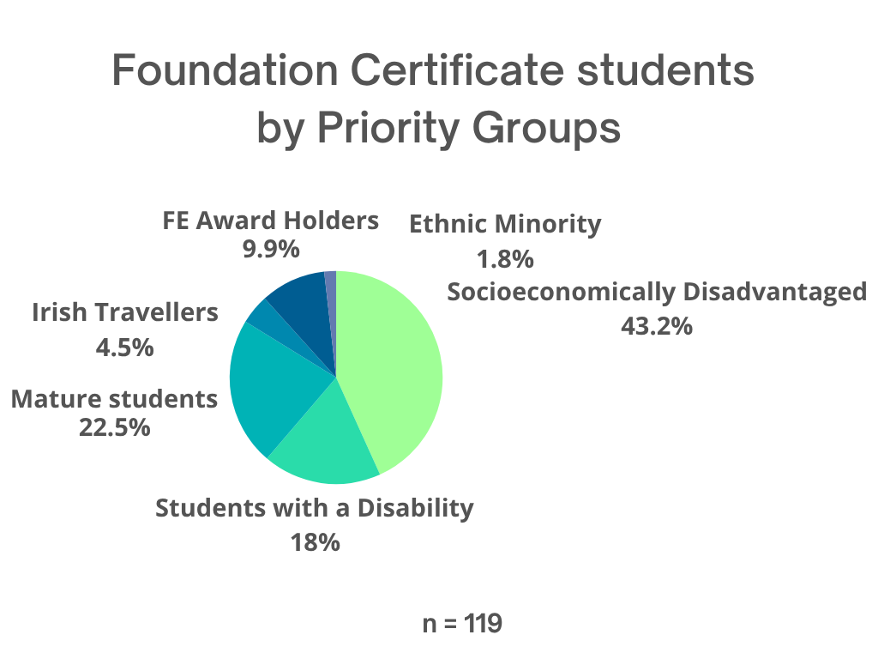

Slide 4
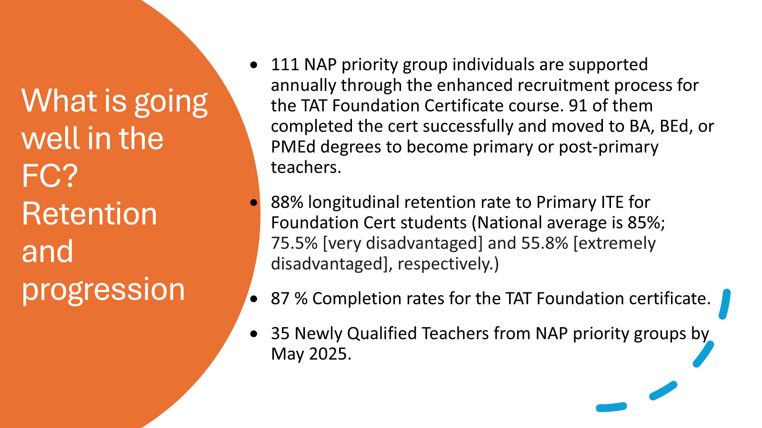

Slide 5
Committed, influential, diverse teachers
“We have some TTT students, who have done extremely well in the placements. Coming at the top of their class and I have seen them in the classroom, and they were phenomenal in what they do. There is one student in particular now [graduating], it is like that she has encapsulated every bit of learning that have ever happened in 4 years [in the Bachelor of Education] …Her impact in the school, her impact on the children, it was phenomenal.”
Lecturer in Froebel
“I'll do the academics no bother, but like, I would be more interested in the culture of the classroom that I would create, and the way they feel when they come in, that they wouldn't be afraid to come in, that they would be comfortable. And therefore, they can learn in all different ways”
Turn to Teaching student in PMEd

Slide 6
Against Deficit Culture
“I don’t think there’s any Traveller primary teachers . . .and I would kind of like to break the barrier in that way, and you know, show them it can be done”.
Turn to Teaching and Froebel Graduate,
A Primary School Teacher
“You have to start where the child is at. If the child is hungry in themorning and they need something to eat, they can’t just be there to learn.. they need you to have a chat for 5 minutes before the class to make sure that they are OK…That support we received in Turn to Teaching even after we started Froebel, was obviously there…It felt like there was always comfort there.”​
Turn to Teaching and Froebel graduate, a Primary School Teacher

Slide 7
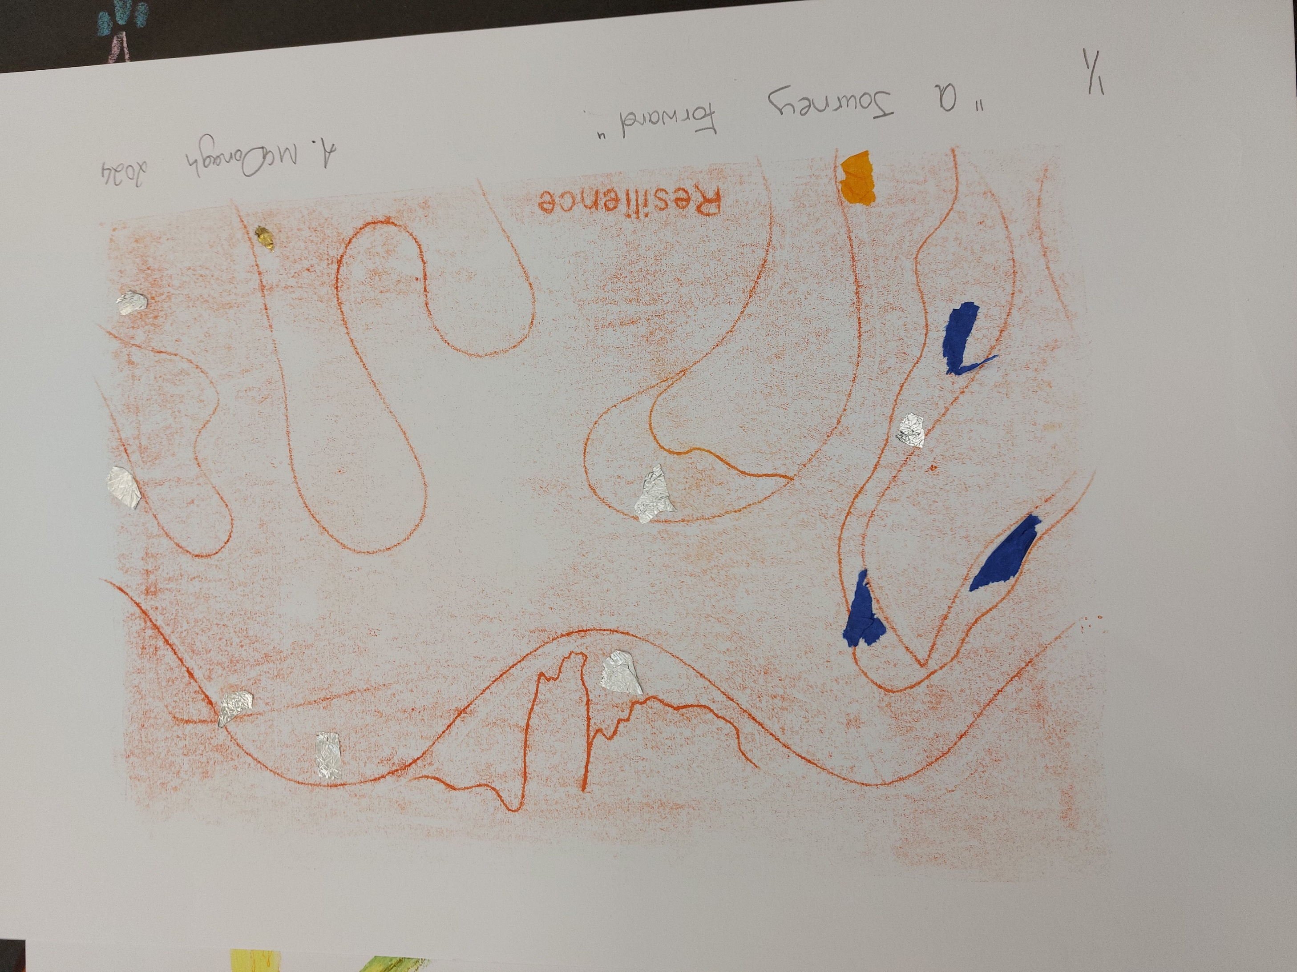
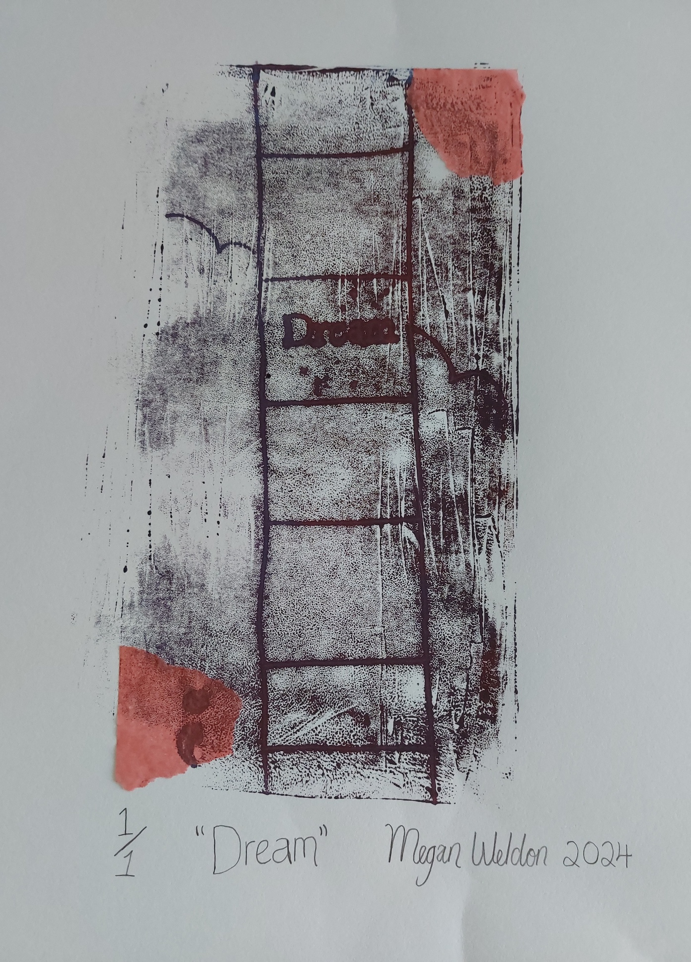
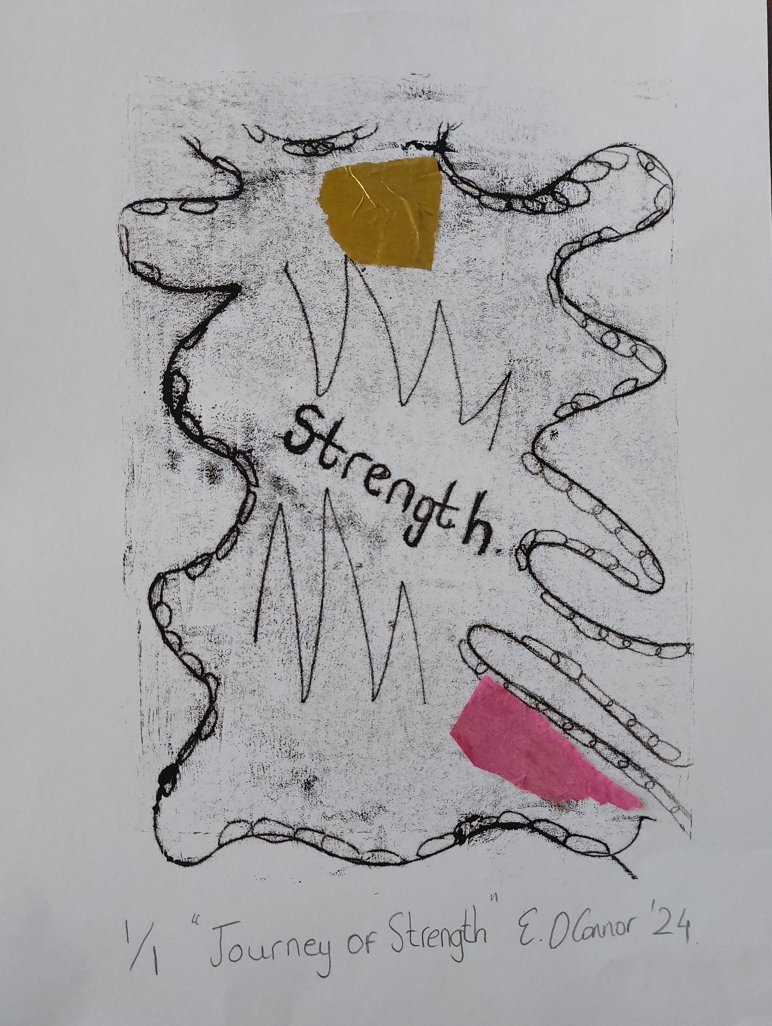

From Art-Based Workshops, April 2024
Prints done by our graduates who become primary school teachers,
moderated by my colleague, Laura Thornton

Slide 8
What works?
“Turn to Teaching is a constant hook, like someone is always there to tell you ‘It’s OK’, they are there for you for anything. Everyone is always welcomed so I never felt alone. No matter if the problem is big or small, someone was always there to listen, and not only listen, but they are also your friends to help [with those problems], there is a lot of care there.”
A recent TTT graduate from Clondalkin in Froebel
  Regular, continuous check-ins and holistic supports
  Collaborations and partnerships
  Longitudinal research and evaluation
  Tapping on lived experiences and adult education methodologies
  Critical education and critical pedagogies approach
Notes:
Using Freirean Framework, TtT team argues that challenging lived experiences hastransformative impacts on Turn Toteaching students becomingcritically conscious teachers(hooks 2014; Farren 2016).​
Rowan and Grootenbauer (2016)emphasizes the importance ofrapport and continuousengagement with students for theircompletion of degrees.

Slide 9
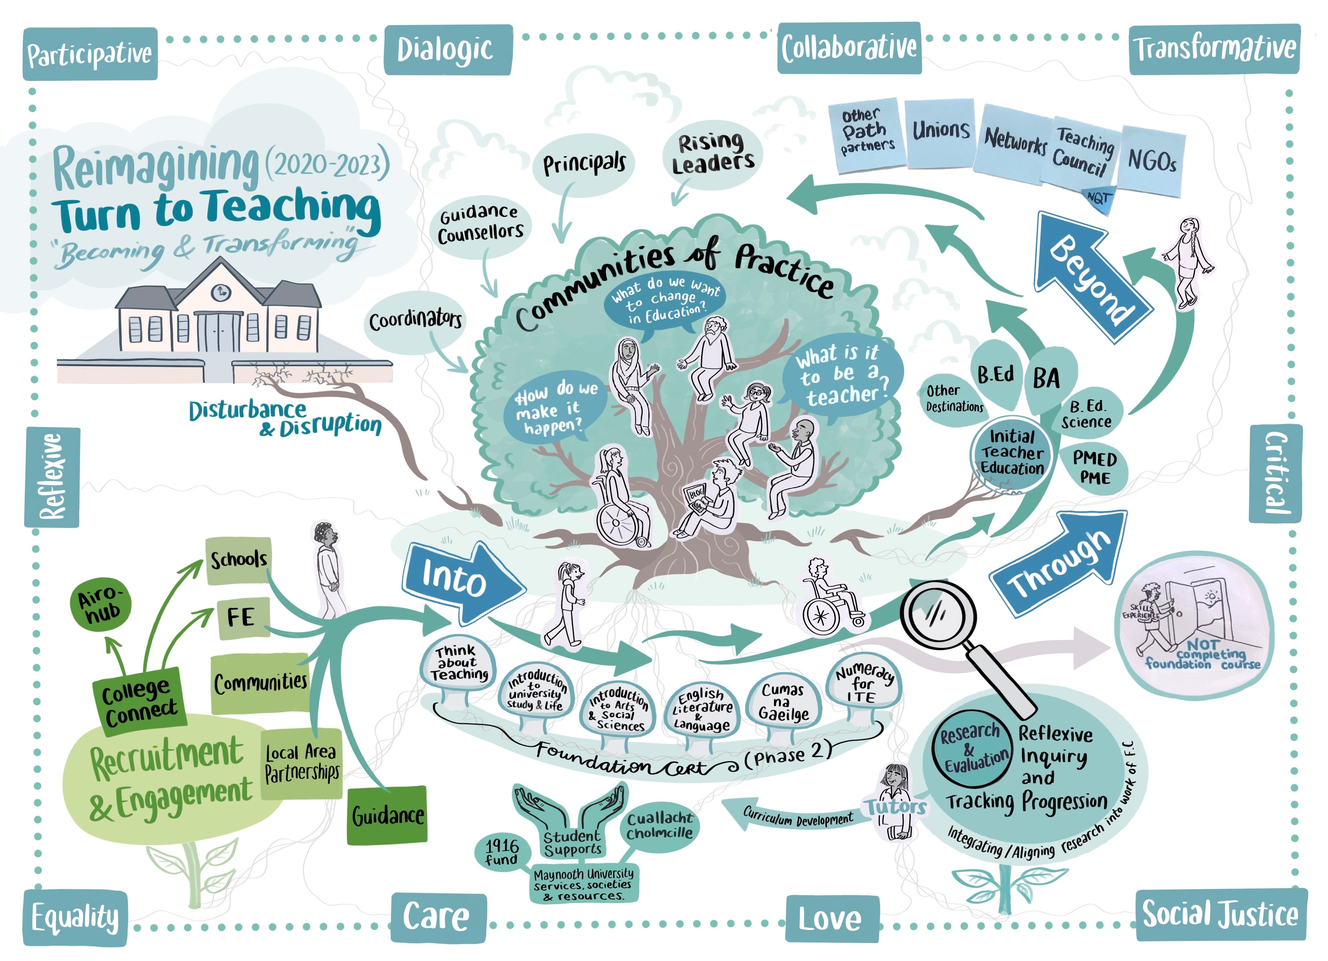

Slide 10
What is next?
More longitudinal research on TTT teachers
More socialization between different cohorts to create a community of
practice and mentorship networks
More placements or shadow teaching in Gaelscoils
More focused on clusters of underserved students in admissions
Currently free from fees, but hoping to lobby for SUSI extension to part-time certificate programmes for maintenance grants

Slide 11
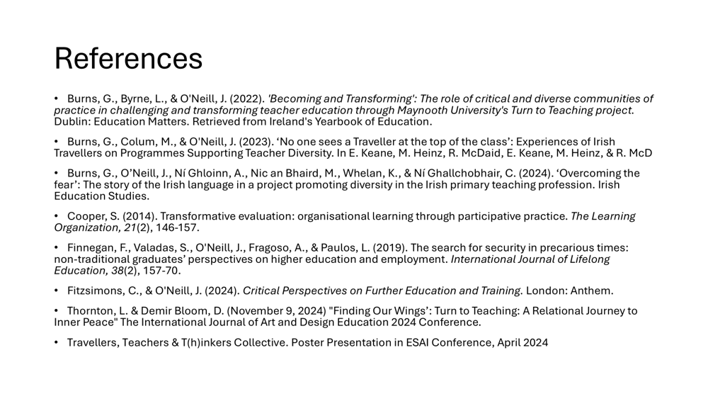

Slide 12
THANK YOU FOR LISTENING!
ANY QUESTIONS?
CONTACT: dilara.demirbloom@mu.ie

