Slide 1
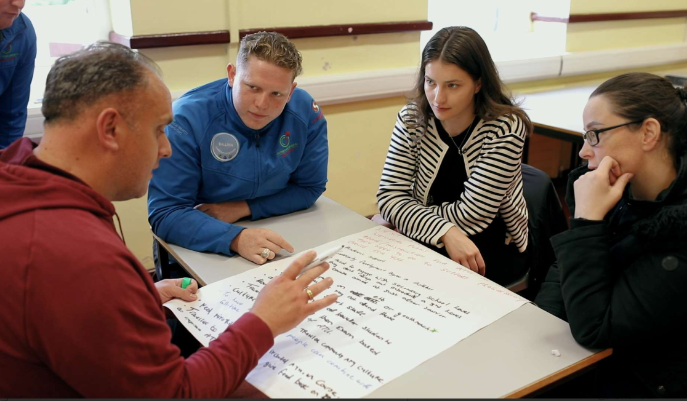
Co-creating Inclusive Pathways: Supporting Traveller Access to Higher Education through Community Partnership
Mairéad Cluskey | Atlantic Technological University

Slide 2
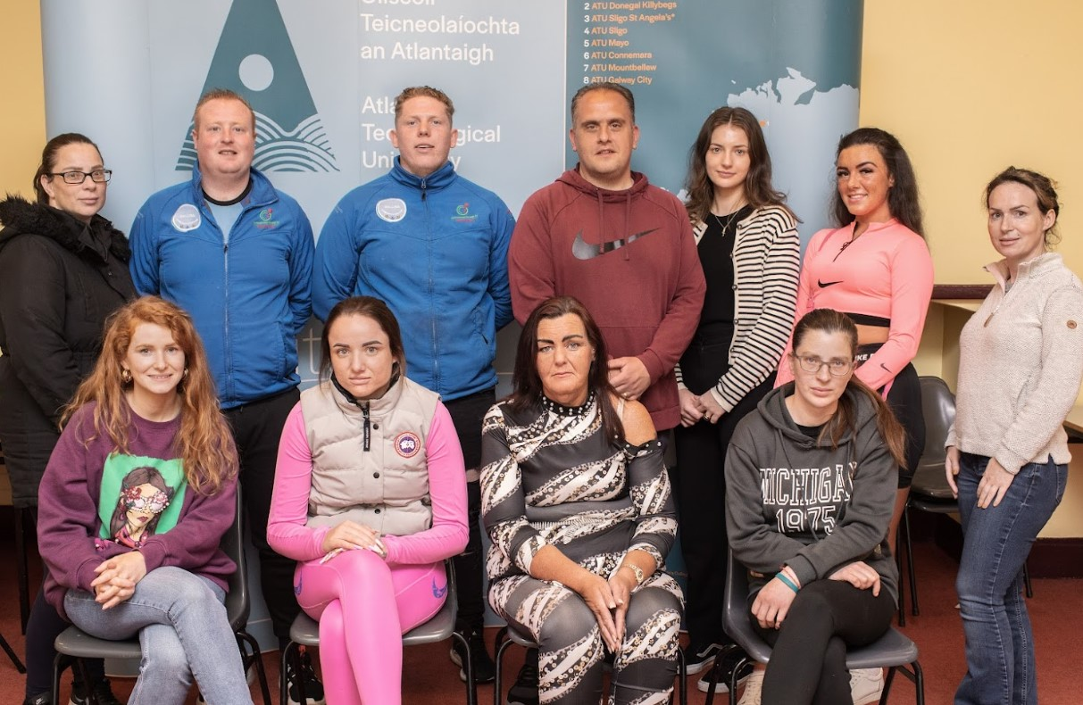
Introduction & Context
The Special Purpose Award (SPA) in Community Development Practice was developed on ATU's Mayo and Galway City campuses, specifically welcoming applications from the Traveller Community in response to an expressed need. The HSE approached ATU Mayo staff to support this distinct training need, which extended beyond Mayo into Roscommon, Galway, and other areas.
Two existing L8 modules from Community Development and Youth Work were offered as a SPA, launching in early 2024.
The evaluation complemented student experience, affirms Traveller students at ATU, and highlights barriers to participation

Slide 3
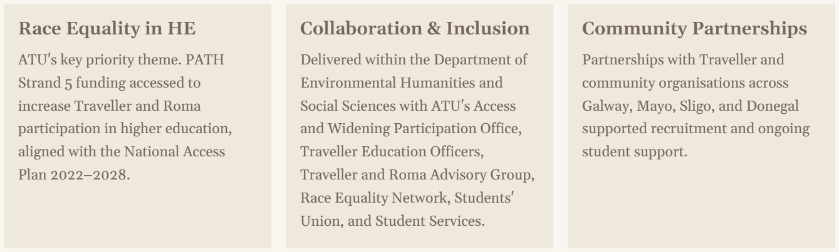
Race Equality and Collaboration

Slide 4
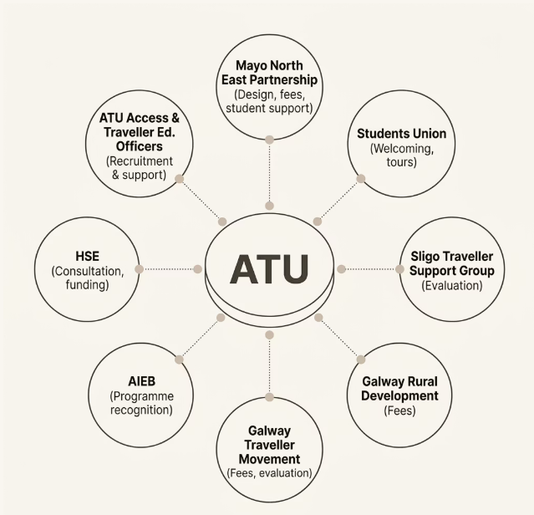
Working in partnership was central to the design and rollout of the Certificate in Community Development Practice.
Partnership was central to the programme's design and delivery. Internal and external partners contributed funding, recruitment, student support, and programme recognition

Slide 5
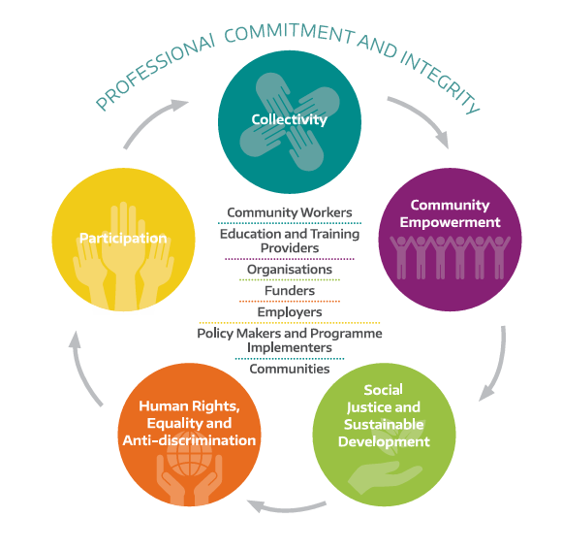

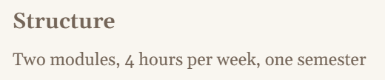
Certificate in Community Development Practice
10-credit introductory programme for emerging or existing community development practitioners, underpinned by the All-Ireland Standards for Community Work (2016) and recognised by AIEB as pre-professional education.

Slide 6

Recruitment & Entry
A derogation from standard entry requirements enabled 43 students from the Traveller Community to enroll. Applicants were assessed on aptitude and motivation through interviews in community settings.
Rationale
Many potential applicants did not complete the Leaving Certificate or have equivalent qualifications but were suitable candidates — ATU recognised this unique disadvantage.
Interview Locations
ATU Mayo, Mayo North East Partnership, Swinford, Kiltimagh, Ballinrobe, and Galway Traveller Movement offices.
Selection Criteria
Prior achievement, work/life experience, extracurricular activity, motivation, and alignment with National Access Plan target groups.

Slide 7
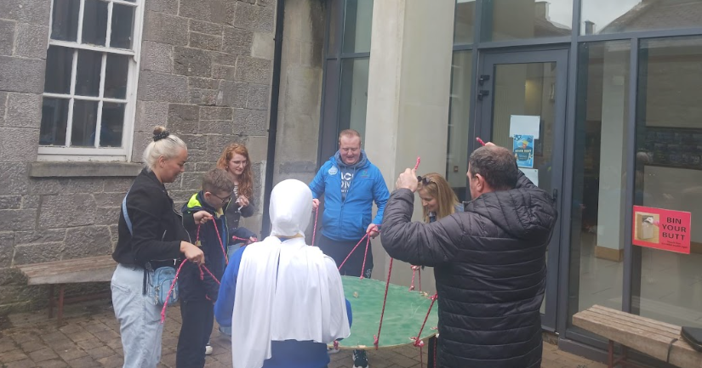
‘Community work/community development is a unique and distinct professional practice which is comprised of both a task and a process. The task is social change, to achieve equality, social justice and human rights and the process is the application of principles of participation, empowerment and collective decision making in a coordinated and structured way. Community Work is based on a set of values that are interdependent and intersectional with considerable cross-over between the knowledge, skills and qualities required and inherent in all of them.
Ethos and delivery of the programme reflected the professional discipline

Slide 8
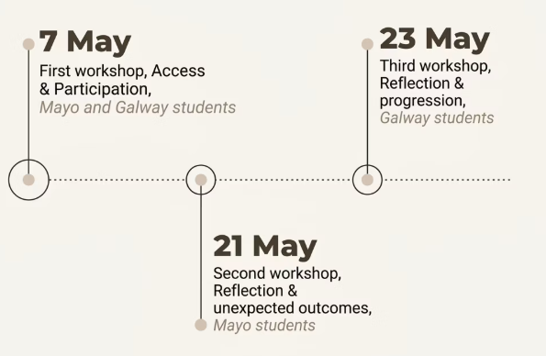
Evaluation Methodology
Programme Delivery
February–May 2024 · 13 weeks
13 students — Mayo Campus
30 students — Galway City Campus
Three interactive, experiential workshops facilitated by Galway Traveller Movement and Sligo Traveller Support Group staff. Feedback was anonymised to encourage open discussion.

Slide 9
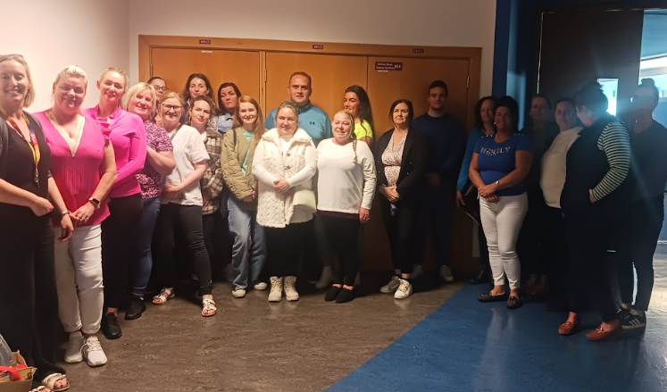
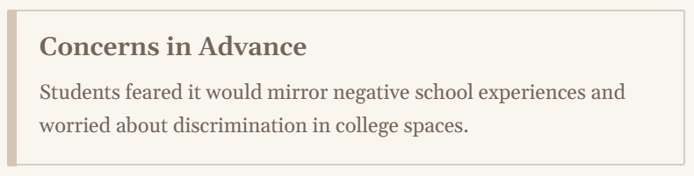
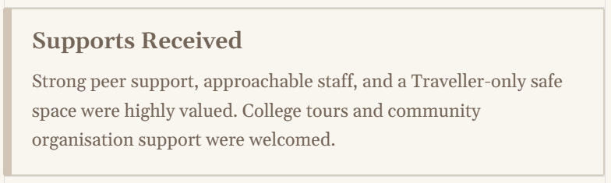
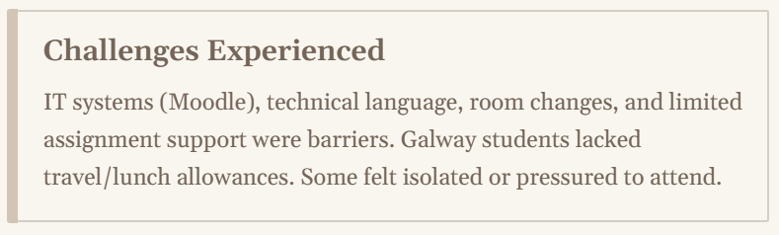
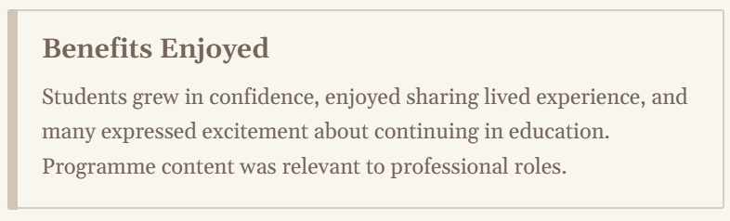
Key Findings

Slide 10
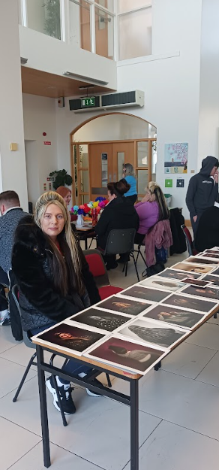
Recommendations
ATU Systems & Procedures
Standardise inclusive recruitment approaches
Add academic skills (literacy & IT) modules
Schedule classes in one room for full duration
Deliver subjects in blocks; cap classes at 25
Roll out cultural awareness training
Provide dedicated Traveller support on each campus
Student Supports
Travel and food allowances for all students
Clear progression routes to Higher Certificate
Future Planning
Target open days for Travellers and minority groups
Seek Traveller representation on ATU Board
Employ Traveller community members as academics
Continue partnerships with Traveller organisations

Slide 11
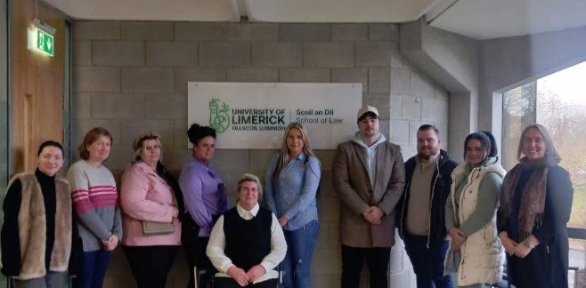
Building momentum
A call to action!
Students and staff commended ATU's initial efforts and urge the university to take a leadership role in race equality for Higher Education in Ireland and beyond.
Only 167 Irish Travellers held a third-level qualification in 2016 (CSO). Less than 10% completed upper secondary school, yet 60% of Travellers are under 25 — making higher education access a critical priority.
*While Census 2022 data are now available through CSO datasets, a clear updated headline figure is less widely reported, although more recent policy sources suggest modest improvement in participation rates.
Since this evaluation and initial roll out, a further 2 x courses have been run on the Donegal Letterkenny Campus and the Mayo Campus

Slide 12
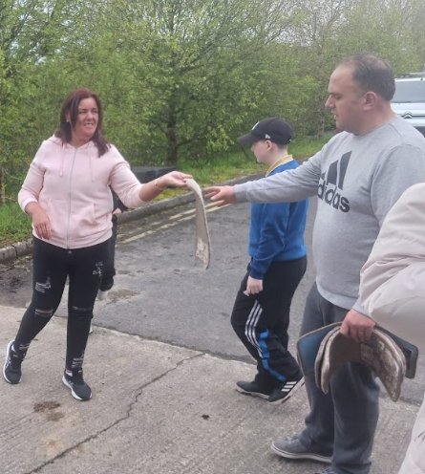
Reflections and key learning
The process demonstrated that the cultivation of “new attitudes” (Crowley, 2003) among staff and systems is essential to promoting equality, requiring openness to learning from those experiencing structural disadvantage.
Students consistently affirmed their expertise through lived experience & valued opportunities to shape the programme.
The programme led to increased confidence, strengthened peer support & new educational aspirations. This initiative illustrates how HEIs can advance PATH 5 objectives by embedding community partnership, culturally responsive pedagogy & flexible access routes.
The findings offer practical guidance for institutions seeking to meaningfully include underrepresented groups & position Traveller voices as co-creators of equitable educational pathways.

Slide 13
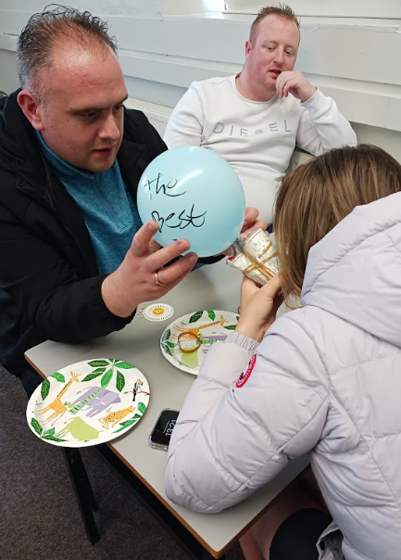
Thank you
Mairéad Cluskey, Department of Environmental Humanities and Social Sciences mairead.Cluskey@atu.ie
Atlantic Technological University

