Slide 1

Student Partnership in the National
Access Plan Mid-Term Review:
What Worked, What Didn't, and Building Meaningful Co-Design
Sinéad Lynch and Seán Macdermott

Slide 2
Agenda
Role of Student Advisors in the National Access Plan Mid-Term Review
Student Advisor Training: aims, hits and gaps
Development of the Student Engagement Plan
Student Recruitment and Consultation
What worked, what didn’t (and what you could do better!)
Building meaningful co-design
Key lessons and recommendations
Notes:
We were recruited as student advisors.
We received training.
We applied that training to develop the engagement plan.
We used that plan to recruit and consult students.
Here's what worked and what didn't.
Here's what meaningful co-design looks like.
Here are our recommendations.

Slide 3
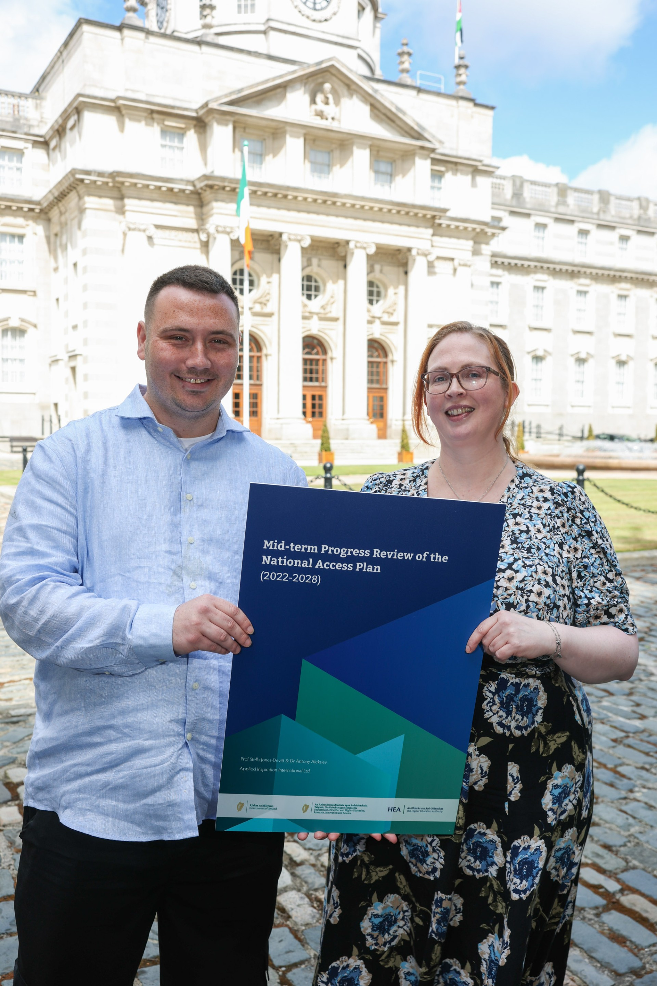
The Role of Student Advisors
The Role of Student Advisors
Recruited via NStEP to support the work of Professor Stella Jones-Devitt and Dr Antony Aleksiev of Applied Inspiration International
Responsible for the student engagement component of the review including:
Creating a student engagement framework
Recruiting students
Running focus groups and analysing data
Contributing to the final report

Slide 4
Student Advisor Training
Understand how to build and facilitate focus groups
Design effective focus groups and survey questions
Gather and present meaningful feedback
Using inclusive approaches to student engagement
Communicate effectively with stakeholders
Design communications for different audiences
Notes:
Talk about each one in turn, what the aims of each were, what skills were built,

Slide 5
Student Advisor Training
What was useful
Developed a greater understanding of research design and methodologies
Small group discussions with experts in areas relating to the research
Opportunity to develop experience on a National Project
Understanding communication strategies to target different groups
Supportive and inclusive environment that enabled active participation

Slide 6
Student Advisor Training
Suggestions for the future
Include more opportunities to apply research methods in practice
Enhanced recruitment and outreach training
Additional support for report writing and policy communication
Practical training in turning ideas into reports, presentations and other outputs
Opportunities to analyse findings and present recommendations

Slide 7
Development of the Student Engagement Plan
Identified key stakeholders involved in NAP priority group student engagement
Outlined key communication channels to reach NAP priority group students
Developed a recruitment strategy
Created targeted recruitment materials
Designed inclusive and adaptable focus group questions
Created flexible focus groups with options to meet participants needs
Notes:
Identified key stakeholders involved in NAP priority group student engagement
Outlined key communication channels to reach NAP priority group students
Developed a recruitment strategy
Created targeted recruitment materials
Designed inclusive adaptable focus group questions
Created flexible focus groups with options to meet participants needs

Slide 8
Identified Key Stakeholders
Representative Groups
Student Support
Community Groups
Student Societies
Student Unions

Slide 9
Identifying effective communication channels
Institutional staff (Disability, Access, etc)
Instagram
LinkedIn
Word of mouth
Posters
Tik-Tok???
Other social media

Slide 10
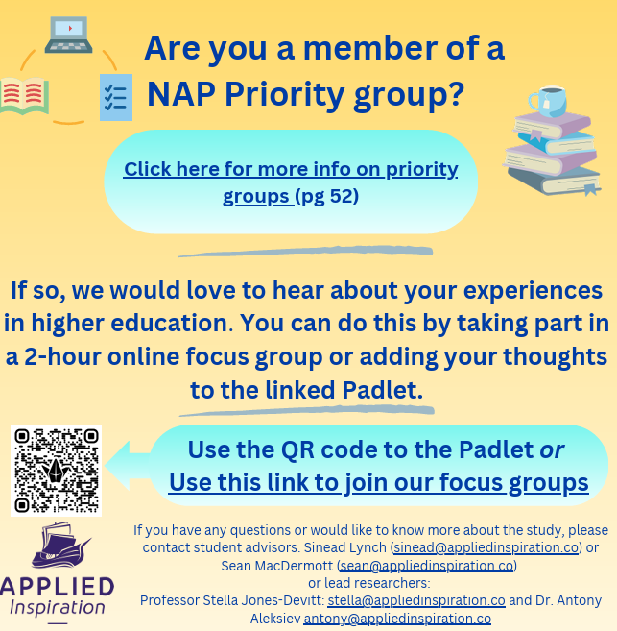
Targeted recruitment materials

Slide 11
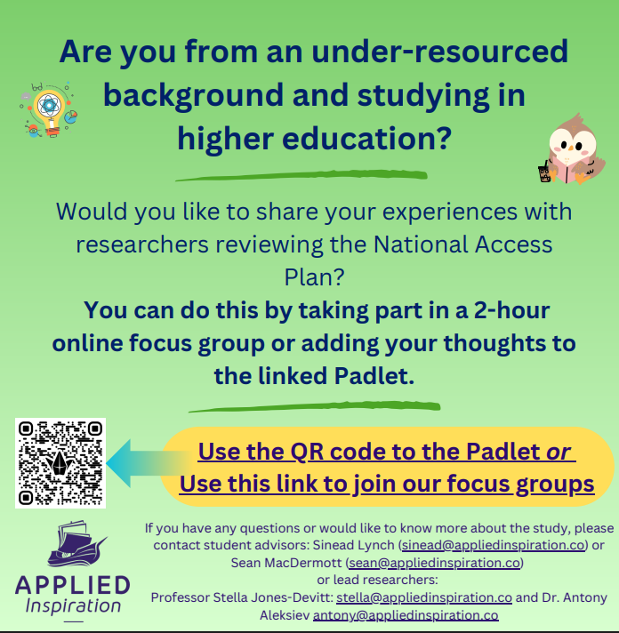
Targeted recruitment materials

Slide 12
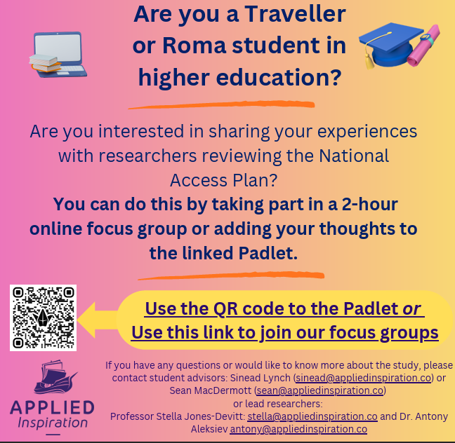
Targeted recruitment materials

Slide 13
What worked
Using multiple pathways reduced reliance on specific channels
Student- to - student recommendations were more effective in recruitment than any other form
Giving multiple options for times and dates allowed participants choice
People were able to swap dates and times as their needs changed
Follow up groups allowed us deeper insight into their perspectives on what was most important about NAP progression aims
Notes:
We used a combination of contacting staff directly
Student groups
Student unions
Community groups

Slide 14
What didn’t work and suggestions for the future
What didn’t work well | Suggestions
Not many Padlet responses | A questionnaire rather than a public Padlet may get more responses
Some NAP groups were underrepresented | Some institutions offered small incentives to encourage students to participate
Having all focus groups on Zoom may have created a distance we didn’t anticipate | Hybrid design of in- person and zoom groups may have been more accessible
Not everyone is comfortable speaking in a group – a more mixed design might have worked better | An option for one-to-one interview might address this
Notes:
We used a combination of contacting staff directly
Student groups
Student unions
Community groups

Slide 15
Building meaningful co-design
Involve students in all areas of the project
Provide practical training and support for students
Give students meaningful responsibility within the project
Create opportunities for students to influence decisions
Value student contributions throughout the lifecycle of the project
Notes:
We used a combination of contacting staff directly
Student groups
Student unions
Community groups

Slide 16
Student partnership is not about just listening to students. It’s about enabling students to influence decisions

