Slide 1
Supporting Travellers to access and flourish in higher education
Traveller and Roma Education Officer, DCU Access Service
17 June 2026

Slide 2
Today’s Speakers
Cathy Mcloughlin, Head of Access Services, DCU
Harry Mallon, Traveller and Roma Education Officer, DCU
Johnny McDonnell, Community Link Worker, TRES

Slide 3
Overview of presentation
Background: sowing seeds
PATH 5 funding
Timeline and evolution of Traveller work
PATH as an anchor
Presenting the data
Fostering relationships and building networks
What we have learned
The way forward

Slide 4
Background: sowing seeds
Prior to 2021: Work with Travellers siloed across the university with limited numbers supported via Access and PATH 2
2021: Following Covid-19, ring-fenced funding from Dormant Accounts, €600,000 (nationally) over two years, 2021 and 2022 for Traveller progression and retention
Dormant Account funding: focused on outreach
  Collaboration with STAR project
  Established Whidden workshops
Notes:
While DA provided important seed funding, projects were managed in isolation and highlights dthe need for a dedicated Traveller worker

Slide 5
PATH 5 funding (January-December 2023)
Benefits
Employ a part-time Traveller Education Worker
Coordinate diverse Traveller activities (pre- and post-entry)
Dedicated support for Traveller & Roma students
Build relationships with schools and communities
Limitations
Short-term funding
Staff costs only
Late awarding of funding
Subsidiary expenses and activities required funding from PATH 3 and philanthropy

Slide 6
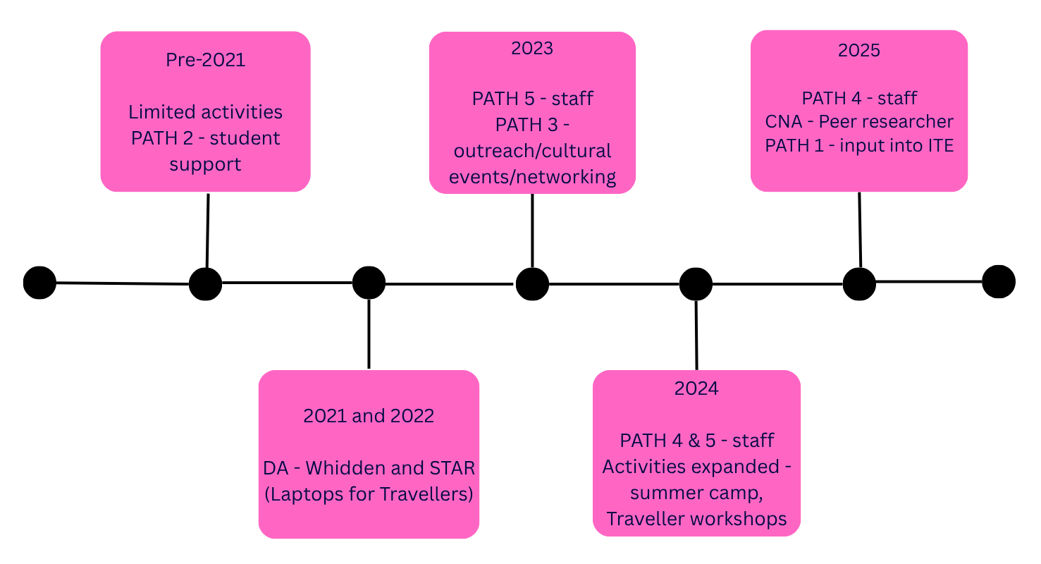
Timeline and evolution of Traveller work

Slide 7
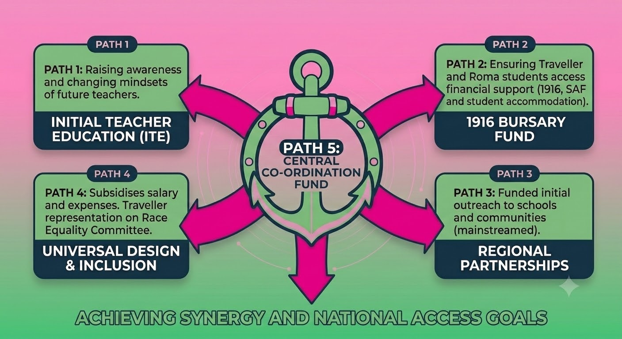
PATH 5: The anchor of coordination for PATH 1,2, 3, and 4

Slide 8
PATH 5
Student Support, pre entry & post entry
Whidden workshops
CNA - peer researcher
Outreach to both primary, secondary, and FET
Traveller & Roma cultural events
Summer camp 80 Travellers & Roma
National and regional presentations to key stakeholders
Representative on university committees
Lectures to ITE

Slide 9
Presenting the data
 | Pre Entry Travellers | Post Entry Traveller | Pre Entry Roma | Post Entry Roma | Total
2022/23 | 170 | 5 | 3 | 1 | 179
2023/24 | 299 | 17 | 5 | 2 | 323
2024/25 | 545 | 14 | 29 | 1 | 589
2025/26 | 996 | 12 | 55 | 1 | 1064
5
1
1064

Slide 10
Fostering relationships and building networks
Star Programme (NSP)
Community Link Workers (TRES)

Slide 11
What we have learned
Importance of dedicated staff member from the Traveller community
Limitations of short-term funding
Challenges of insufficient funding for post
Risk of overstretching role
Travellers appreciate role and eager to engage
Organisations value the work and want to engage
This year, two schools reported growing Traveller attendance due to outreach work

Slide 12
The way forward
Secure permanent role
Mainstream funding
Record and monitor data
Need to grow Roma engagement
Ensure advocacy and policy embedded in role
Traveller specific HE routes

Slide 13
Thank you

