Slide 1
Enhancing Access to Higher Education for Migrant Communities through the Development of Resources
Karen Carter -TU Dublin Access & Outreach
Gráinne Ward - TU Dublin Lecturer
Siphiwe Moyo - Empower

Slide 2

Presentation Overview
Introduction & background
Identifying the information gap
Developing the resources
Working in partnership

Slide 3
TU Dublin Access and Outreach
The Access and Outreach team works across all five TU Dublin campuses to widen participation in higher education.
It supports local communities and underrepresented groups in line with national and university strategies.
The team delivers activities to remove barriers and create alternative pathways.
It builds strong partnerships with schools, FET, and community organisations.

Slide 4
Taste of TU Dublin
A flexible experience designed to support adult learners explore higher education using bespoke information sessions that meet the needs and interests of each group
Delivered in partnership with education providers
Includes interactive activities, input from academic staff and students, and campus tours
Built on strong partnerships with academic departments and community organisations
Collaboration is key to the programme’s success

Slide 5
Taste of TU Dublin
The event typically includes:
  Information sessions
  Taster lectures or activities
  Student voice
  Campus/library tour to provide insight into university life

Slide 6
Information Gaps
Every Taste of TU Dublin – financial supports session
Question from members of migrant communities
  Can I apply for this?
  Are my existing qualifications recognised?
Question from people working with members of migrant communities
  How do I know who is eligible for what?
  What do ‘stamps’ mean?
Information scattered, had to know where to look and often need to dig a bit deeper to find information

Slide 7
My Background
TU Dublin 2017
Citizens Information – nearly 20 years
Migrants’ rights & entitlements
BA in Law 2004
CPD module Refugee, Immigration & Asylum Law
Law Society Certificate in Immigration Law & Practice 2022
PATH 3 working group 2021

Slide 8
First Steps
Answering the questions
Taste of TU Dublin with Empower
Information sessions
Printed/online resources

Slide 9
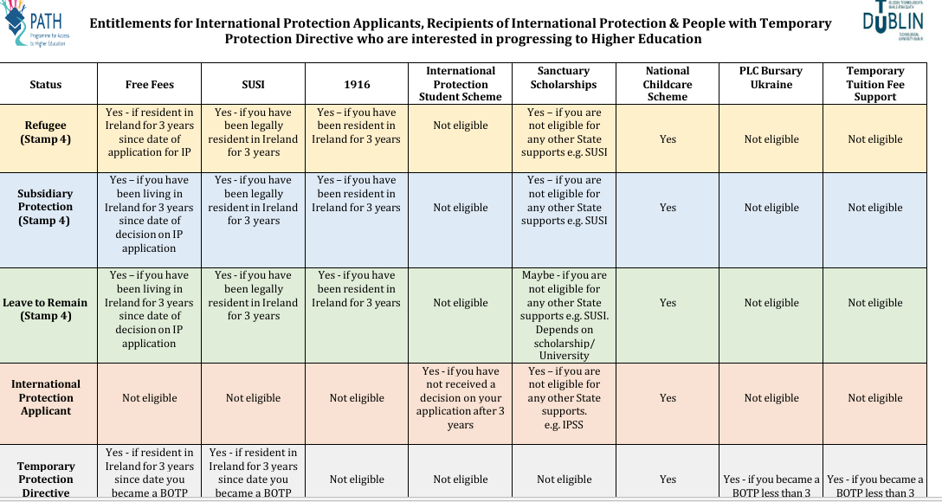
Table of Supports

Slide 10

Financial Supports for University in Ireland…

Slide 11


Resources
Guide

Slide 12

Next Steps
Webinar
Migrant Further & Higher Education Support Network-registration link

Slide 13

Empower
Taste of TU Dublin
Reviewing the Guide
Migrant Further and Higher Education Support Network (MFHESN)

Slide 14


Thank You!
Questions?
Karen.Carter@TUDublin.ie

