Slide 1
“Evidence-informed insights from Students with Care Experience and Higher Education, the first multi-institutional study in Ireland”
PATH Showcase Event 2026
June 16th 2026
Martin Flynn, Evan Healy, Jennifer Walsh

Slide 2




Partners

Slide 3
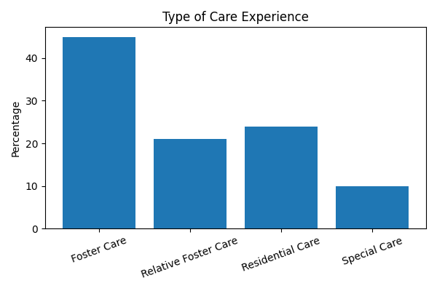
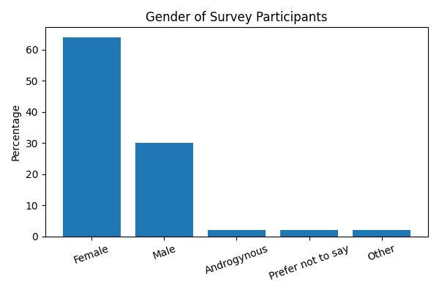
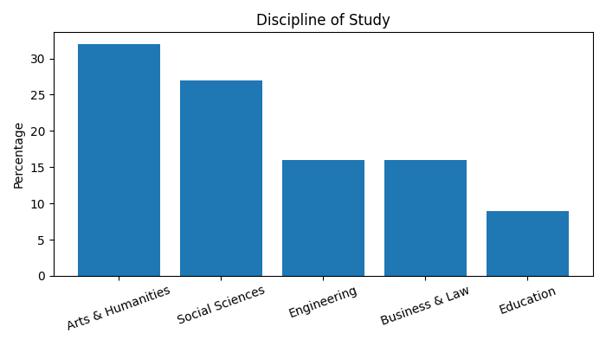
Context & Purpose
National Access Plan priority groups with data gaps.
Care-experienced students identified as under-represented and disadvantaged group.
Mixed-methods: survey (48), focus group, interviews.

Slide 4
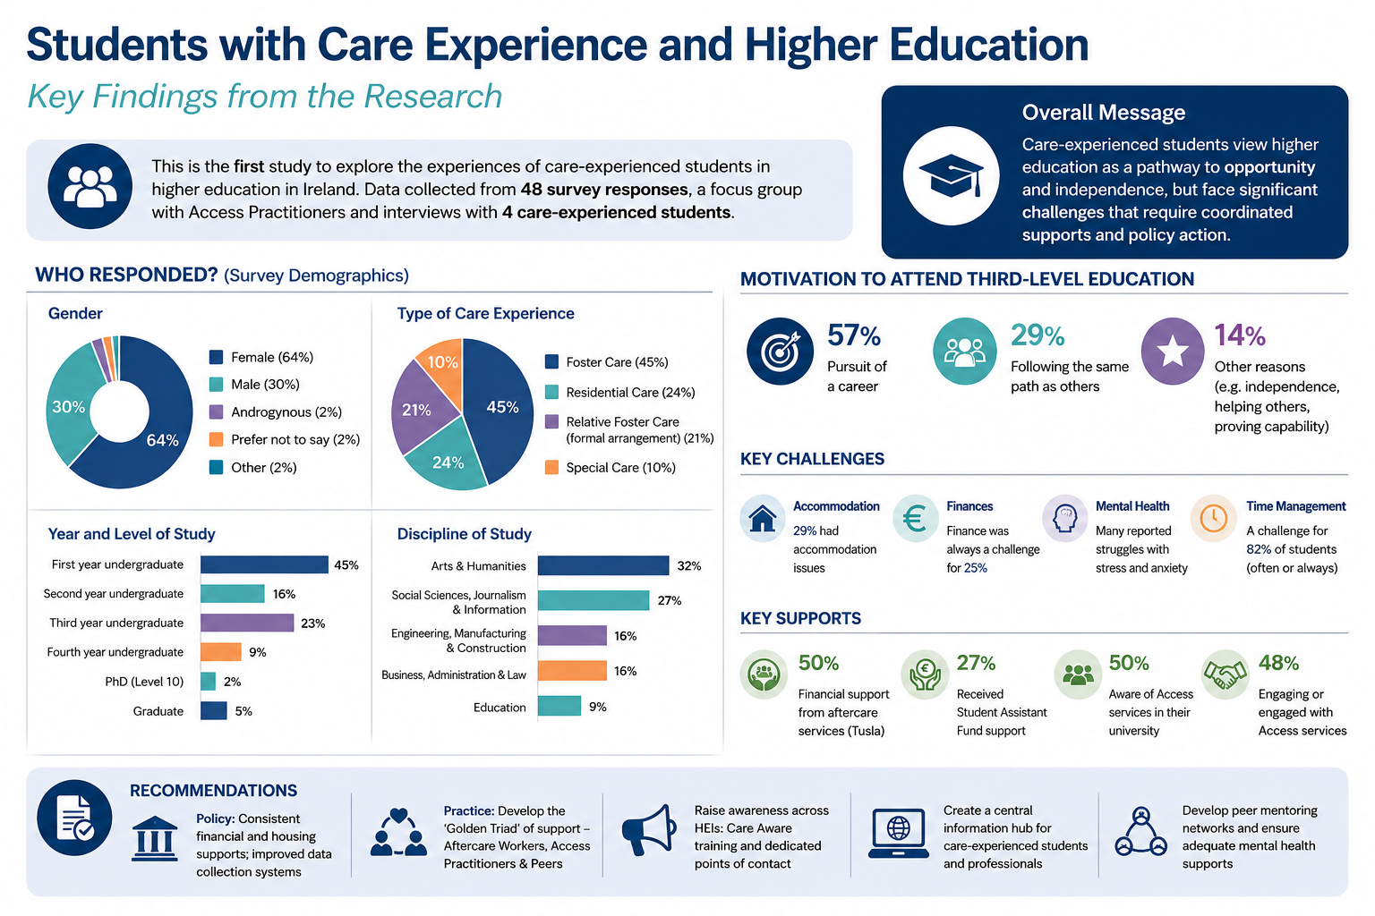

Slide 5
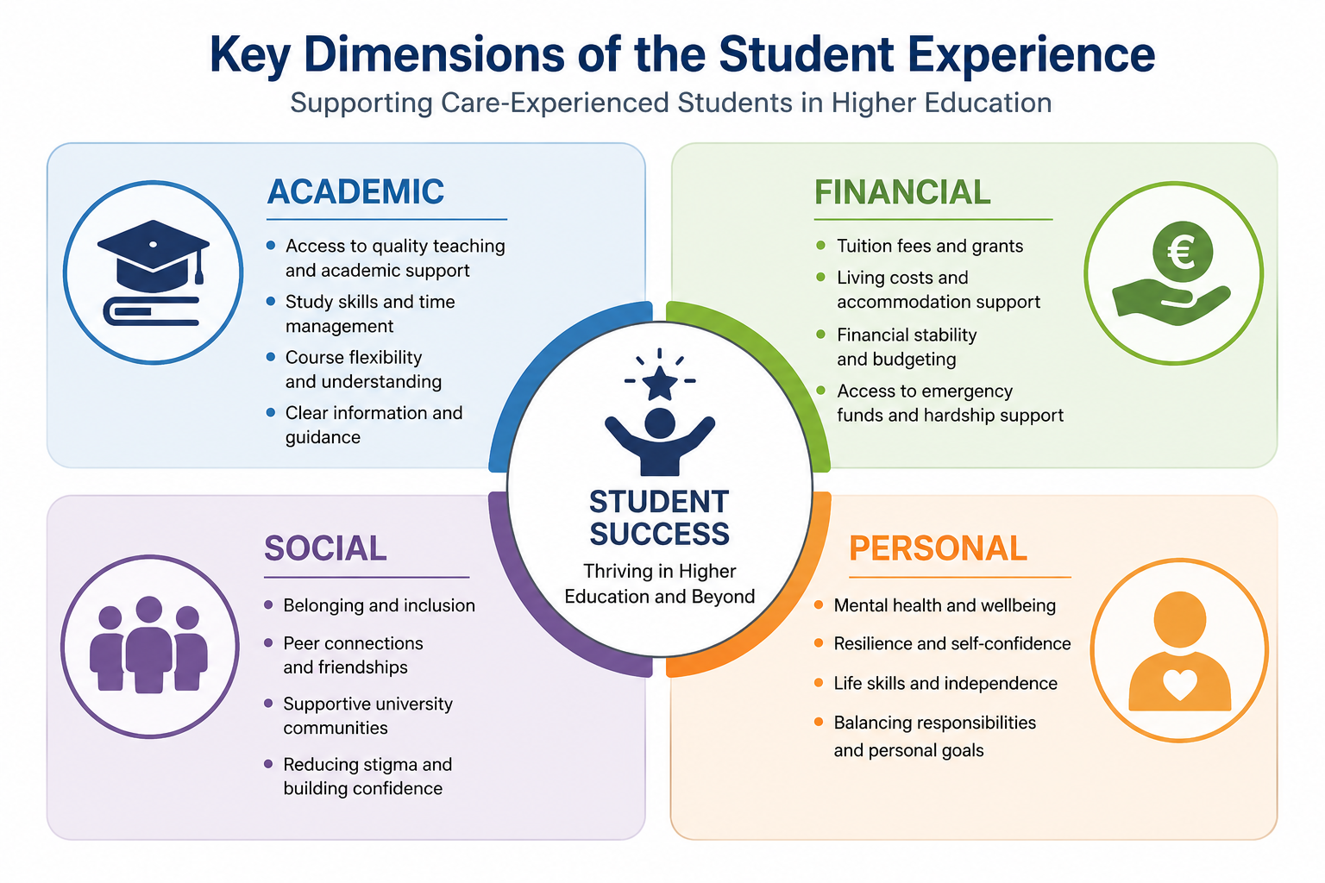

Slide 6
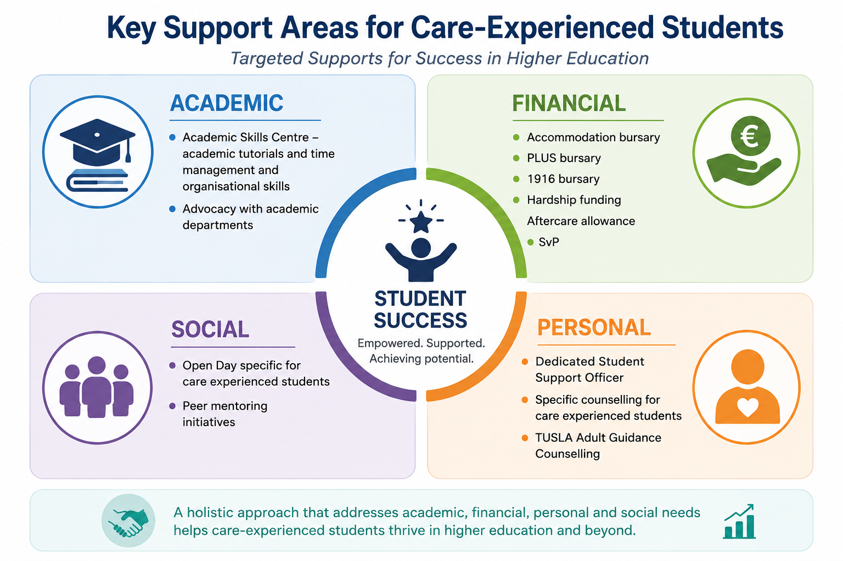

Slide 7
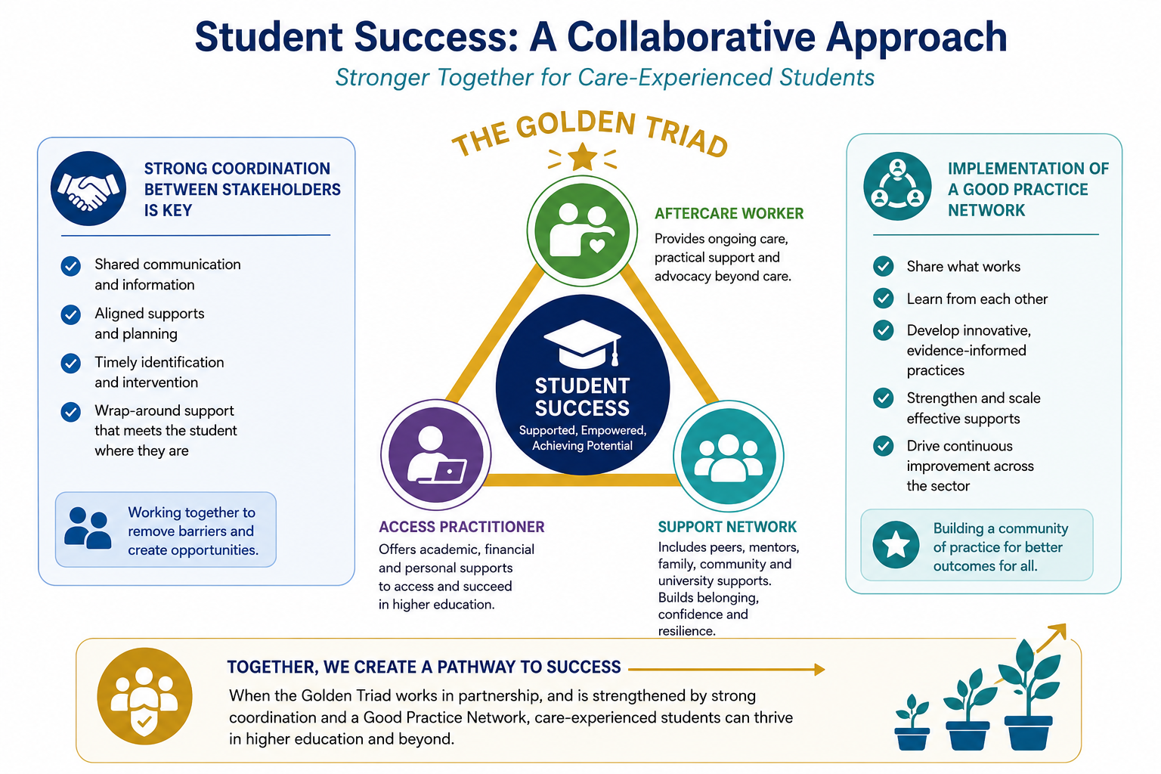

Slide 8
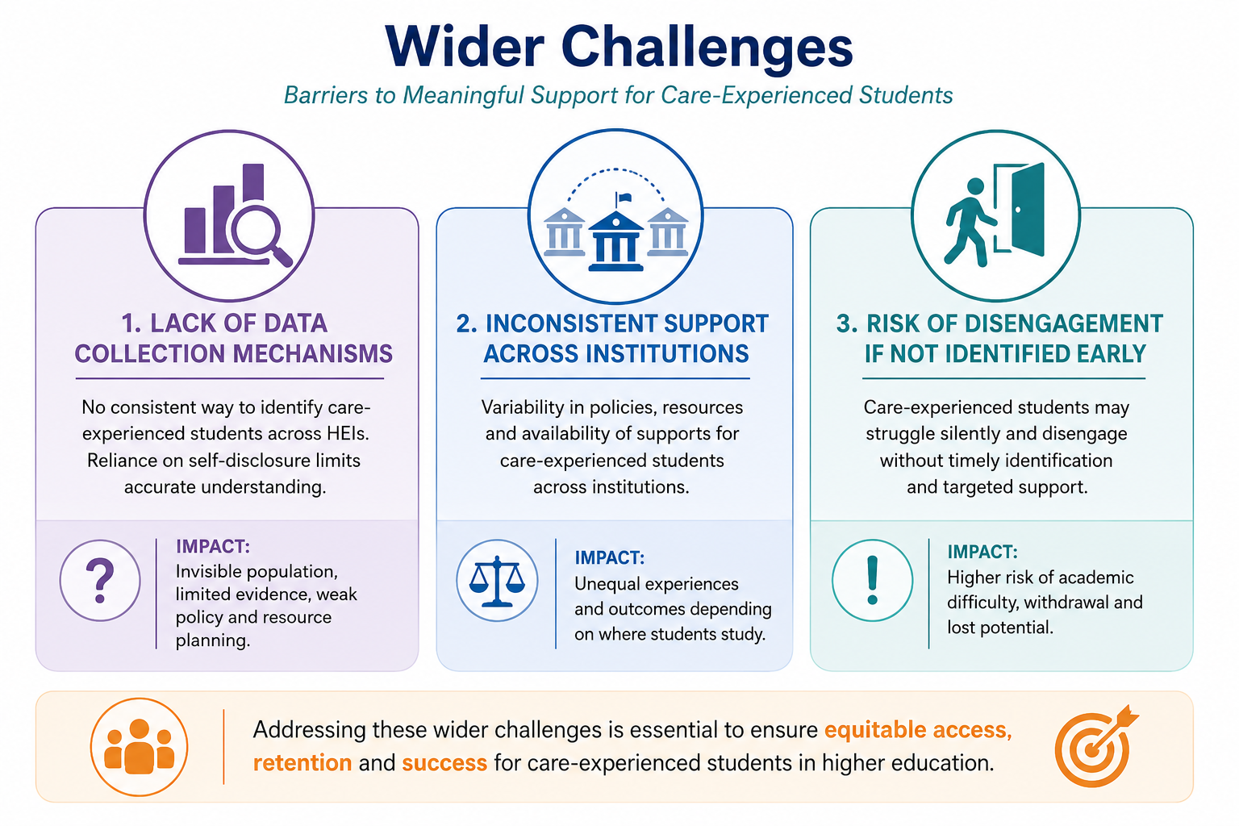

Slide 9
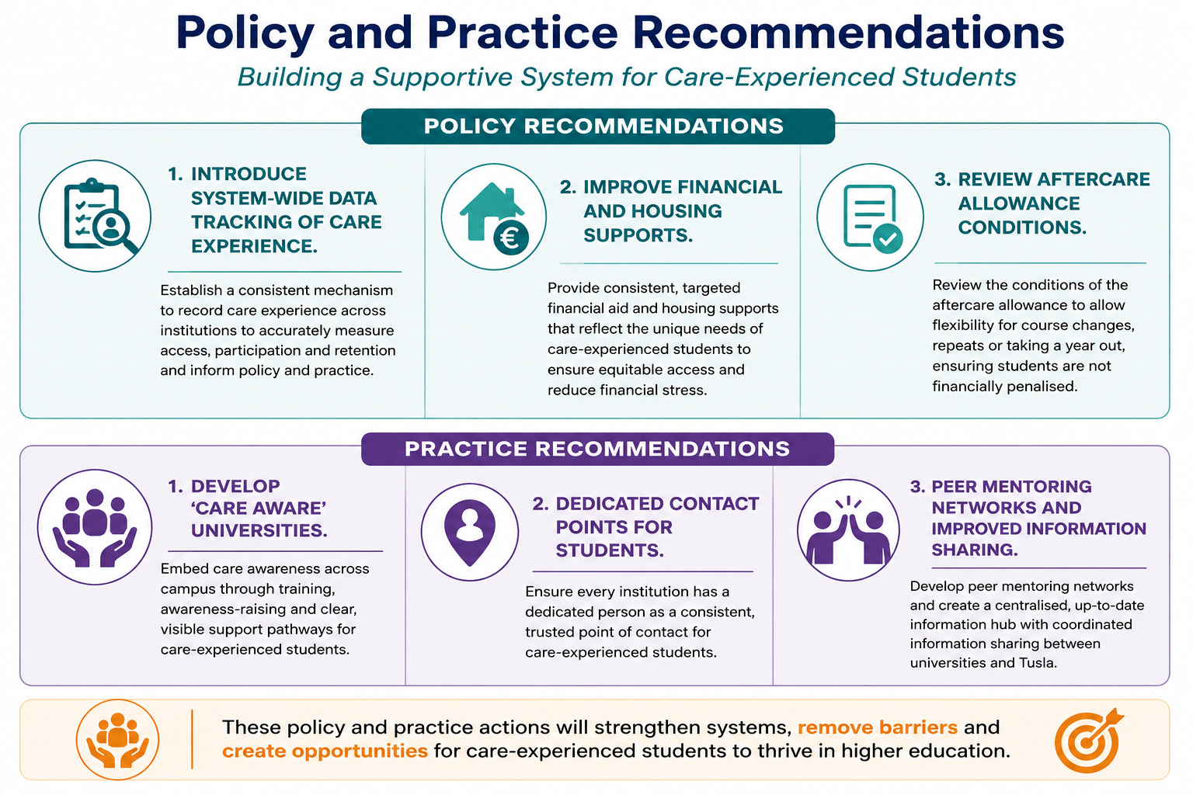

Slide 10
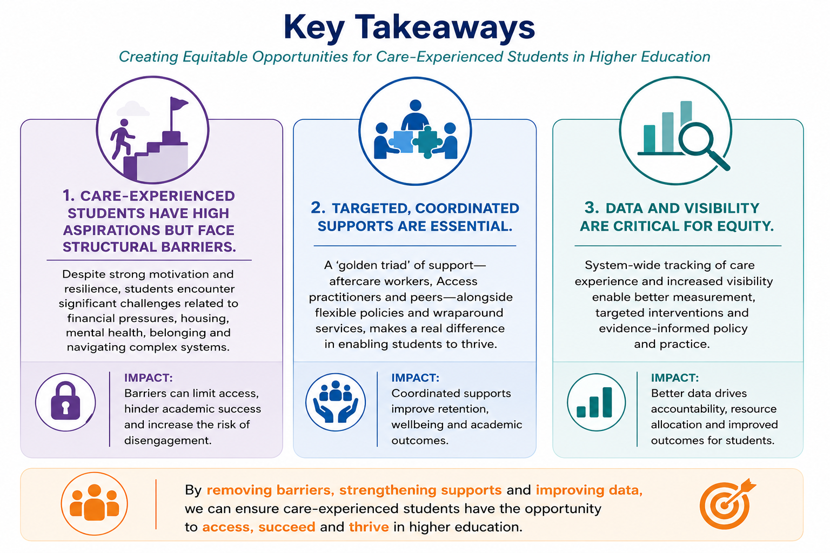

Slide 11


