Slide 1

VOICES
IN
VERSE:
An Introduction.
Alina Kostenko and Carmel Hennessy

Slide 2
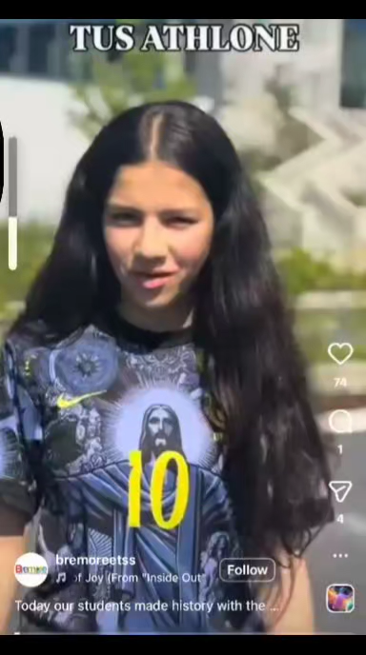
VOICES
IN
VERSE:
An Introduction.

Slide 3
40 Roma students (ages 13–17) Roscommon & Dublin
6 Workshops
(Jan–May 2026)
First Roma Youth Poetry Anthology
First Polyphonic Sound Archive of Roma Youth Voices in Ireland
Public Showcase Event
Voices in Verse: An Introduction

Slide 4

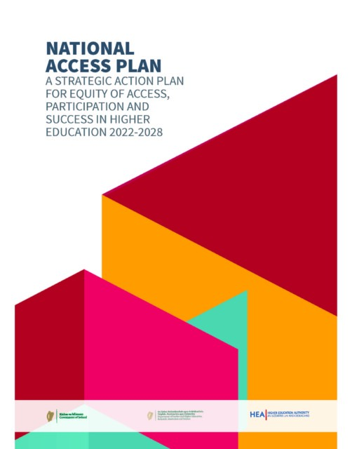


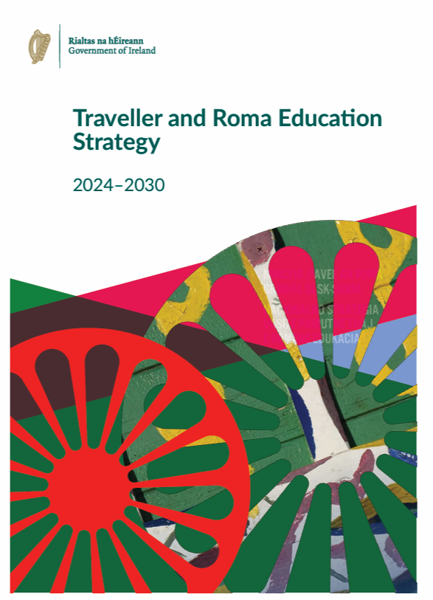

What Informed
This Work
Built on sustained school and community relationships developed via PATH 3 and further progressed with PATH 5 funding
Informed by PATH 3 funded Community Needs Analysis of Traveller and Roma Students Experience of Higher Education – A call to Action.
Opportunity to realise Race Equality Action Plan and align with PATH 4 objectives

Slide 5







COLLABORATIONS

Slide 6
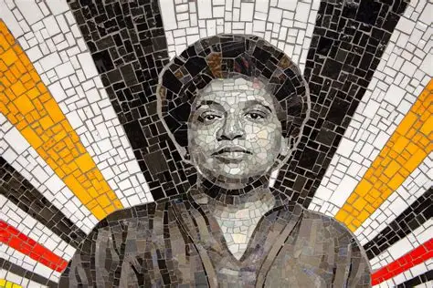
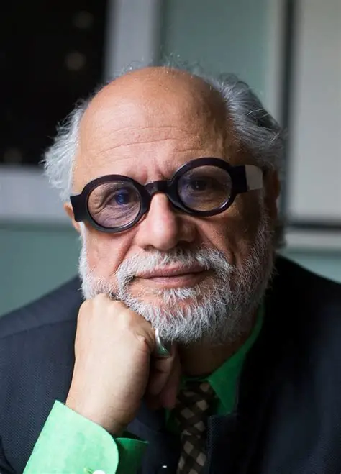
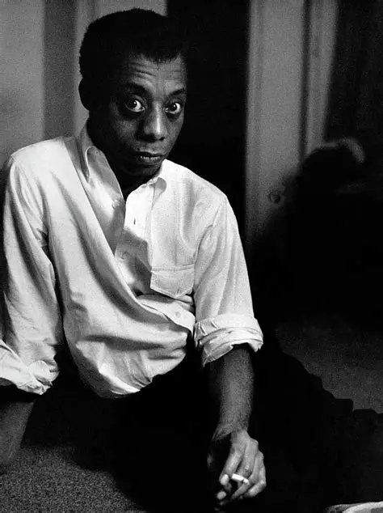
BUILDING RELIABLE SYSTEMS
Audre Lorde
“Your silence will not protect you.”
Voice is not decorative — it is survival, authorship, and the refusal of imposed narratives.
Homi K. Bhabha
“The stairwell becomes the liminal space, in‑between the designations of identity.”
Roma youth write from the third space — between cultures, languages, and expectations — producing new cultural forms.
James Baldwin
“The artist’s struggle for his identity is a part of his effort to give the nation its identity.”
Self‑definition is cultural work; when Roma youth write, they reshape how the nation understands them.

Slide 7
We speak the same language
ROMA LED FACILITATION
Roma-led facilitation changes the room
Removes the extractive gaze
Self-definition and cultural safety
Roma voices belong in public spaces

Slide 8
Authors, not subjects
WHAT ACTUALLY HAPPENED
Future aspirations
Students imagined higher education
Families experienced recognition
Teachers saw future possibilities
Young people became cultural producers

Slide 9
KEY TAKEAWAYS
Began as community practice
A creative space was built with intention
We listened to what emerged
Insights developed organically
Lived experience, dialogue and creative expression prioritised
Process-focused workshops
Agency, non-evaluation and voice over polish
These bottom-up insights can inform research, intercultural education, practice, and National/EU policy priorities

Slide 10
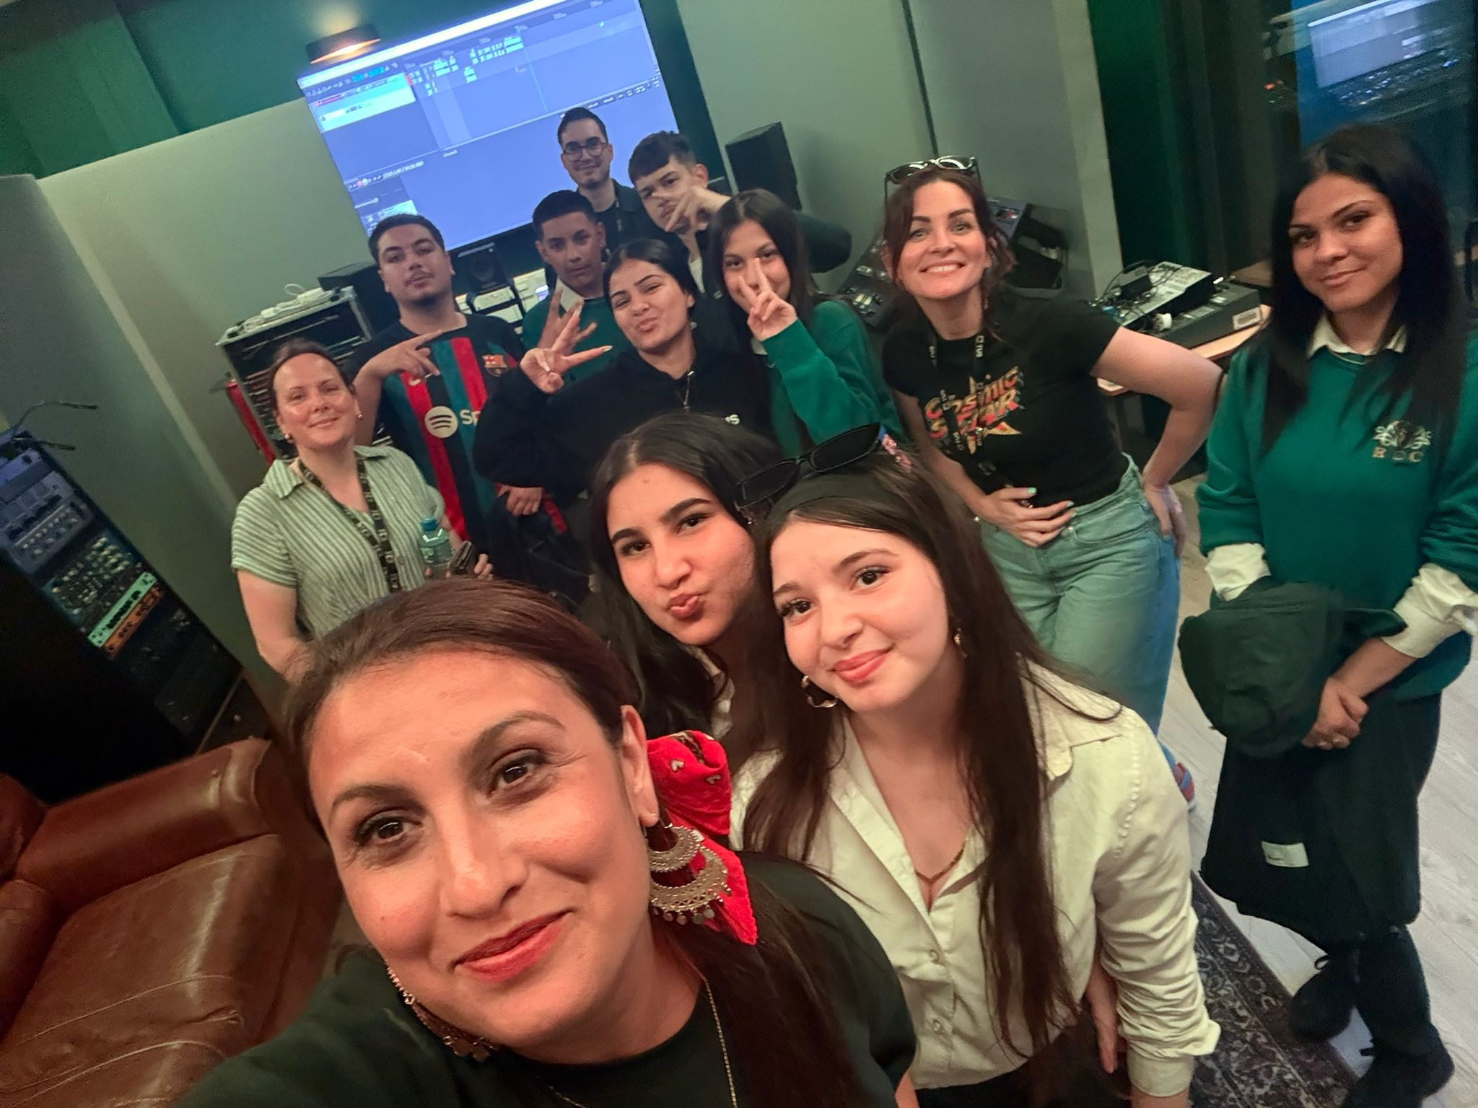
THANK YOU FOR LISTENING

