Slide 1

Micro-credential Learner fee subsidy 2026

Slide 2

Agenda
Introduction
Micro-credential Learner Fee Subsidy 2026
Call Eligibility Criteria
Assessment Criteria
Indicative Timetable
Call Application Process
Key Documents
Important Links
Applicant Eligibility Criteria

Slide 3
INTRODUCTION
This Call will build on the momentum of the Human Capital Initiative and support micro-credentials which were developed by the HCI and other micro-credentials developed across the higher education system.
The Learner Fee Subsidy will complement the core State-funded education and training system and is one of several initiatives designed to meet the current and future skills needs of the Irish economy.
Micro-credentials address the barriers to participation in lifelong learning, including time constraints for learners and inflexibility in current programme provision and delivery. The inherent flexibility in micro-credentials means that learners can access learning in discrete small units, at a time and pace which allows greater balance with both life and work.

Slide 4
introduction
The LFS 2026 will:
Allocate NTF monies to address key skills needs for enterprise and the economy.
Prioritise digital skills and objectives of the twin digital and decarbonising strategy, addressing objectives of the government as detailed in the National Skills Strategy, Climate Action Plan, Digital Ireland Strategy, and EU Objectives under the European Commission Union of Skills.
Notes:
See appendix 1 of the call document for the Priority ISCED Areas
The Digital Ireland strategy published in February has objectives to Empowering our people, workers and businesses to thrive in a digital economy and society, through responsive, inclusive digital and AI skills and literacy opportunities

Slide 5
Micro-credential learner fee subsidy 2026

Slide 6
Call eligibility criteria​
Only HEA-designated institutions and non-HEA designated higher education providers whose quality assurance procedures have been approved under the 2012 Act (re-engagement / QA approval processes) are eligible to apply under the LFS 2026 Call.

Slide 7
Call eligibility criteria​
  Micro-credentials submitted for funding must award between 5 and 20 ECTS which can lead to a higher education qualification that is aligned to the NFQ at Levels 6 to 9.
  Micro-credentials should fall under one of the eligible discipline areas (i.e. ISCED Codes), as outlined in the Call document. Micro-credentials outside of these discipline areas may apply, however priority will be given to the ISCED areas listed.
  Proposed micro-credentials should be stand-alone courses that upskill learners for the labour market upon completion.
  Micro-credentials should also have potential for a “stackability” component to encourage learners to return and build upon the micro-credential for further qualifications.

Slide 8
ASSESSMENT Criteria
  HEI application ranking.
  The Minister may require prioritisation of certain eligible discipline areas post submission of proposals to meet government policy commitments.
  NFQ level (a mix of levels is required to meet applicant cohort needs).
  Geographical spread (required to meet national and regional needs).
  Enterprise engagement in the development of the micro-credential and a clear indication of the enterprise demand.
  Assessment of cost; value for money.
  Available budget and relevance to regional and national skills needs.

Slide 9
Indicative timetable
Action | Date
WizeHive Application Portal Opens | 12:00 noon 26th March 2026
WizeHive Application Portal Closes | 12:00 noon 14th April 2026
Call Outcomes | May 2026
Micro-credentials Commence | May – December 2026

Slide 10
Call Application process

Slide 11
APPLICATION PROCESS
  Proposals must be submitted via the WizeHive portal using the Micro-credential Learner Fee Subsidy online application form.
  HEIs should ensure that the total cost per learner is entered on the application, as the subsidy will be calculated at 80% of that cost.
  Only fully completed and submitted proposals will progress to assessment stage. Any proposals in draft format will not be considered.
  The title of the micro-credential on the WizeHive application must match the title on the Ranked List of Proposals.
  Only proposals that are listed on the Ranked List of Proposals will progress to assessment stage.
  The signed off Ranked List of Proposals must be submitted to the HEA by email: HCI@hea.ie

Slide 12



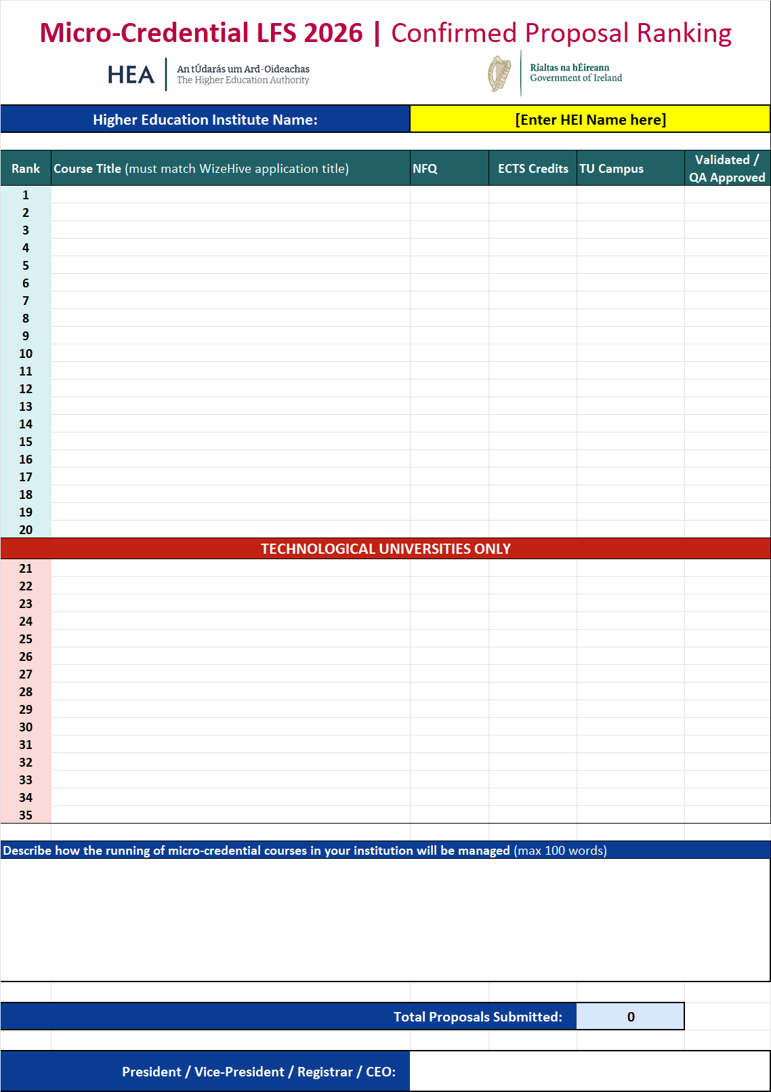
KEY Documents
Call documents:
Call document
FAQ document
Application documents:
User Guide for Submission of Proposals
Ranked List of Proposals Template
Templates for Validation / QA confirmation
(one per course, choose appropriate template)

Slide 13
Important links
All key documents are available to download from the HEA website:
https://hea.ie/skills-engagement/micro-credential-learner-fee-subsidy-2026/
The WizeHive application portal is accessible at:
https://webportalapp.com/sp/hea_micro_credential_2026

Slide 14
Applicant eligibility criteria

Slide 15
applicant eligibility criteria​
  Applicants must meet the published eligibility criteria in full for the category they apply under to enrol on a micro-credential.
  Hold a valid PPSN
  Be ordinarily resident in the Republic of Ireland
  Be an EU / EEA / UK / Swiss / Ukrainian national (or hold a valid Stamp 4 / Stamp 5 / Stamp 6 on their IRP card)
  Have lived in the EU / EEA / UK / Switzerland for 3 full years out of the previous 5 years (on a qualifying visa, if applicable)
  Meet the criteria for being:
    Employed
    Unemployed (and in receipt of a qualifying DSP payment)
    A Returner
    A Recent Graduate

Slide 16

Please submit questions to the HEA Skills Team:
HCI@hea.ie
Questions and answers from this briefing’s chat and those received by email will be included in the FAQ document, which will be available to download from the HEA website:
https://hea.ie/skills-engagement/micro-credential-learner-fee-subsidy-2026/

Slide 17
THANK YOU
Any queries, please contact:
HCI@hea.ie

