Slide 1


Blueprint for Progress: Delivering the Mid-Term Review
A proposed pathway for the mid-way evaluation of the National Plan for Equity of Access to HE
Professor Stella Jones-Devitt ・ Dr Antony Aleksiev
National Access Forum, 14th May 2025

Slide 2



Going for Goal!
Which one of the NAP goals do you think is the most important priority for:
Your work context AND the wider HE sector?
Make your way to the table(s) of choice
Inclusivity
Flexibility
Clarity
Coherence
Sustainability
Evidence-driven

Slide 3


Meet the Team
Applied Inspiration is delivering the evaluation of the mid-term review.
We have proven expertise in access planning, auditing, impact evaluation and regulatory advice in the UK and beyond.
Through our SEER service, we manage relationships with 26 HE Providers and lead collective impact reporting across our growing network.
Professor Stella Jones-Devitt
Director of SEER
Dr Antony Aleksiev
Head of Development & Innovation
Stella (PI) will lead project management, evaluation design, stakeholder engagement, synthesis of findings, and the co-creation of accessible outputs.
Antony (Co-I) will lead on quantitative analysis, support Student Advisors, and contribute to evidence gathering, synthesis and dissemination.

Slide 4


Slide 5
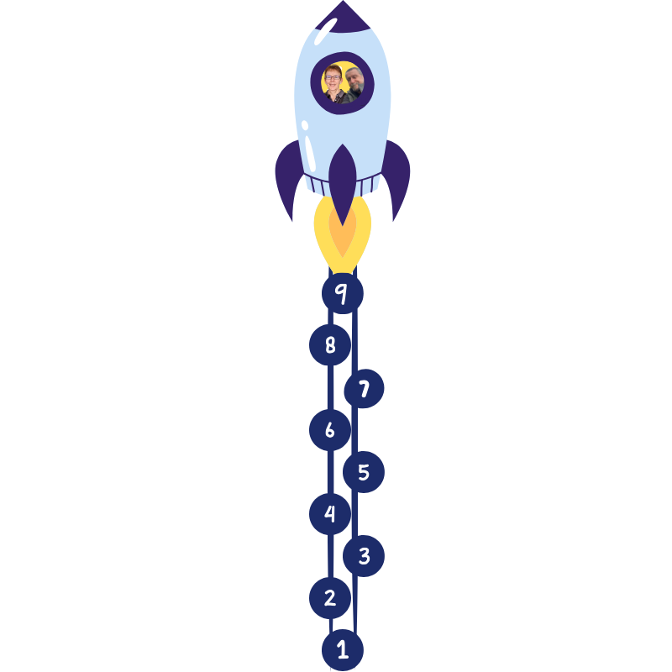

Mapping the Project Path
Use Most Significant Change methodology to share impact
Our proposed nine key stages for a successful mission.
Co-create an impact pathway with NAP Steering Group for 2025–28
Synthesize findings to evaluate mid-term progress
Assess progress against NAP access targets
Student consultations
Key stakeholder consultation
Initial gap mapping
Analyse documentation within project scope
Collaboratively develop a dynamic Theory of Change evaluation process

Slide 6
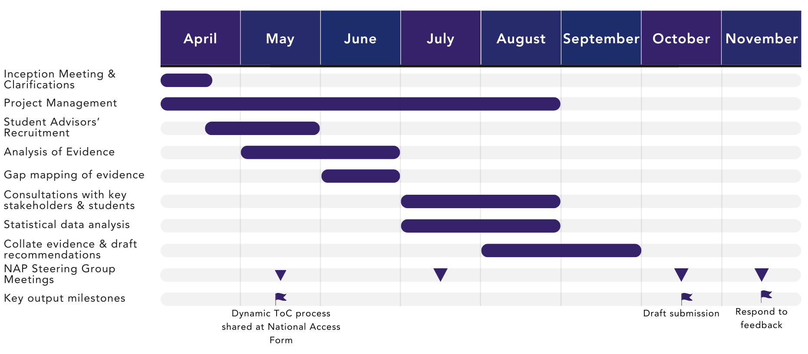
Proposed Timeline

Slide 7



Powered by
Used to
Explains
How interventions create desired change, based on evidence analysis
Analysis, stakeholder consultation and what works
Dynamic Theory of Change (ToC): A Blueprint Process for Evaluation
Account for advantages, barriers, viability and uncertainties
Identify assumptions and risks to revisit with stakeholders
Adapt to emerging evidence

Slide 8
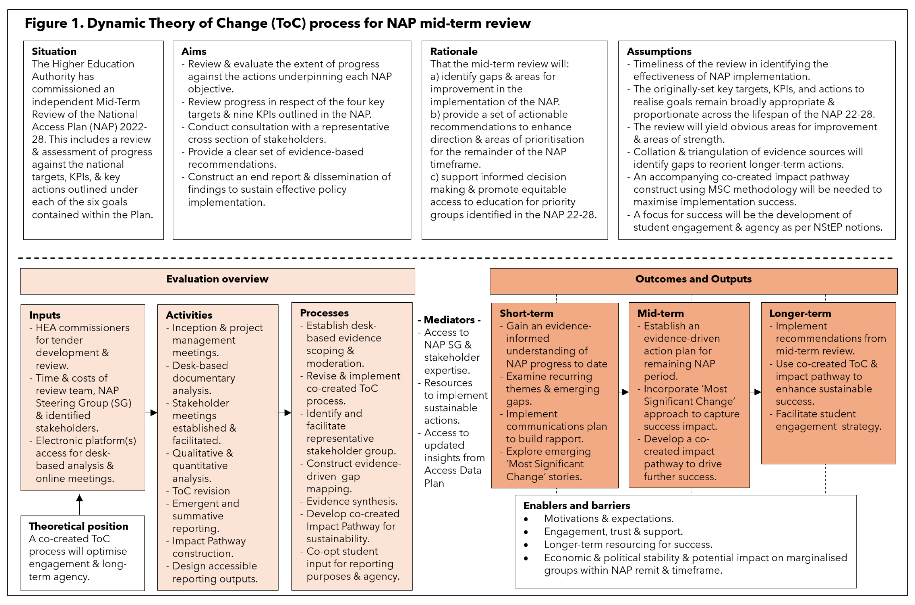

Slide 9


Do our assumptions, evaluation overview, outcomes and outputs match your expectations?
Is there anything else we need to know at this stage?
Dynamic Theory of Change (ToC): Our Blueprint for this Evaluation
Any urgent questions?

Slide 10

Group Task 1
For this task, please discuss at your table progress with the NAP goals and agree a consolidated, group rating on a No Progress to Goal Achieved scale across your representative institutions/organisations/perspectives and experiences.
Elect a group member to input your ratings when asked.
Discuss and agree a consolidated rating on progress in the NAP goals:
Inclusivity (UDL; staff and student diversity)
Flexibility (personalised, blended, remoted learning; RPL; targeting)
Clarity (IAG for access to HE; pre-entry mentoring; student centredness and alignment of support structures)
Coherence (joined-upness of approaches; partnership and collaboration)
Sustainability (capacity building; cost of HE study as barrier to target groups; funding and flexibility of HE offer)
Evidence base (evidence gathering; evaluation; impact monitoring of access and inclusion activities)

Slide 11
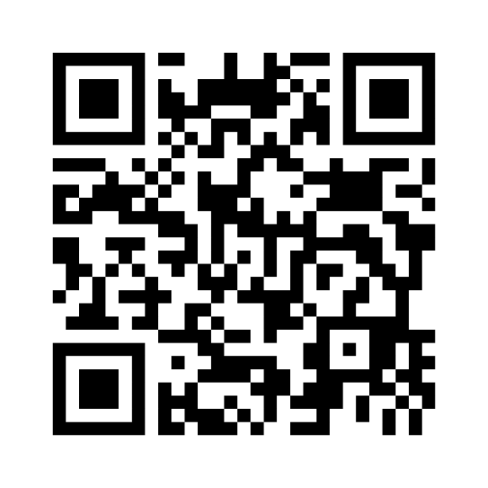
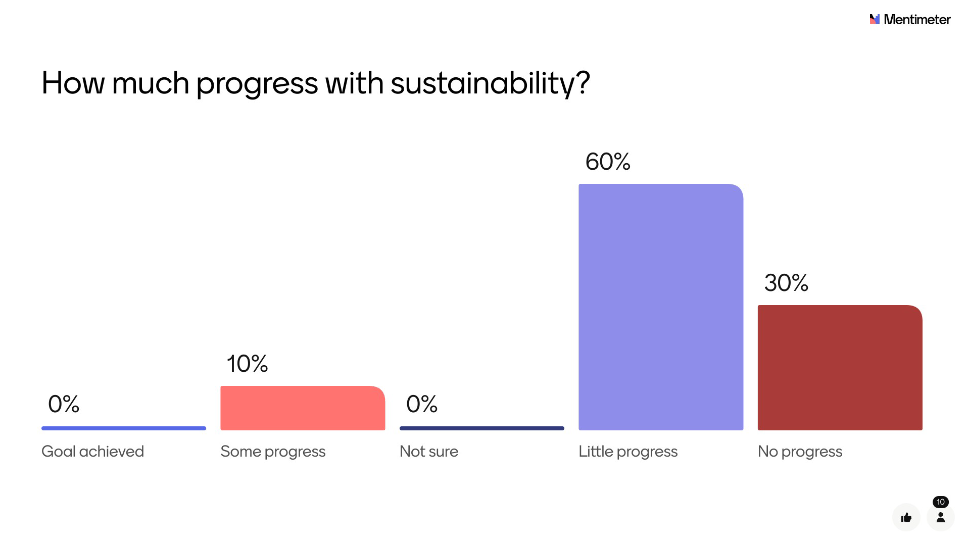
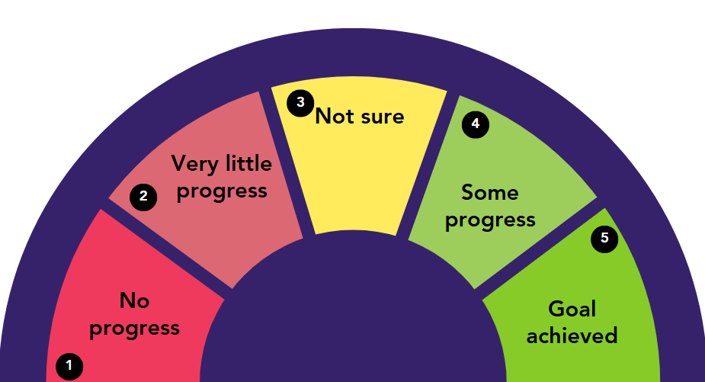
To vote, go to www.menti.com, or use the QR Code below, and enter 2949 4204
Mentimeter: Round One
Your elected respondent should vote the Group’s take on progress with the NAP goals.
All voting is anonymous.
In turn, how well has each of these progressed within your organisation(s)?
Inclusivity
Flexibility
Clarity
Coherence
Sustainability
Evidence base

Slide 12
Group Task 2
Pick a name tag from your current table and find the table it corresponds to. Each table itself has a label with the Group you will be joining (e.g., Group 1) and its assigned Topic: The topics are:
Topic 1: Partnerships and Collaboration
Topic 2: Access and Success Interventions
Topic 3: From Access to Sustainable Success
Topic 4: Flexible Learning
Topic 5: Evidencing Achievement
Student Group: Assigned Topic

Slide 13

Group Task 2
Create a flipchart map summarising your discussion.
Discuss your assigned NAP goal related topic and record ideas and thoughts on a Flipchart.
Topic 1: Partnerships and Collaboration
Topic 2: Access and Success Interventions
Topic 3: From Access to Sustainable Success
Topic 4: Flexible Learning
Topic 5: Evidencing Achievement
Student Group: Assigned Topic
Share ideas and agree consolidated responses on your assigned topic to these 4 questions:
What has worked well?
What hasn’t worked?
What's the biggest challenge?
What support is needed to improve?

Slide 14
Be ready to submit the group agreed questions via Mentimeter!
Group Task 3
For this task, please discuss at your table what questions should be explored as part of evaluating NAP progress in the topic your group considered in Task 2.
Discuss, record proposed questions on a flipchart, and agree as group on key questions for evaluating progress in your topic that would be useful to include.

Slide 15
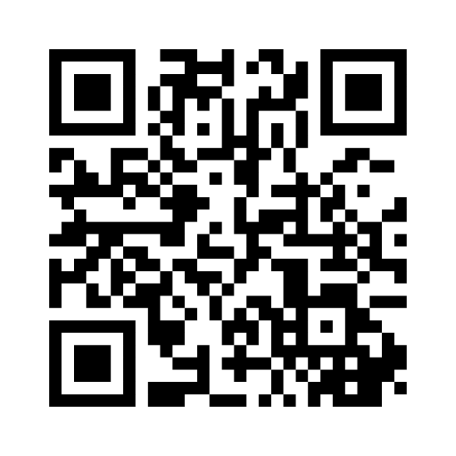
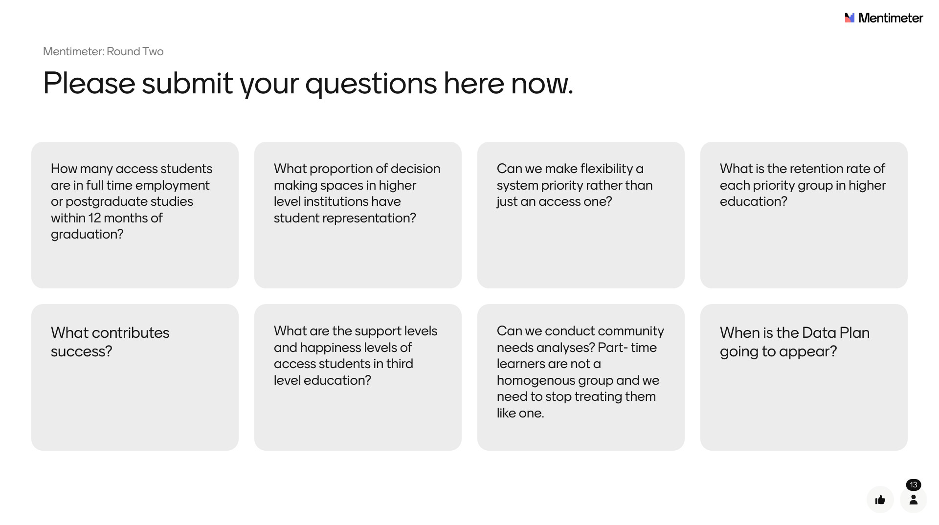
To vote, go to www.menti.com, or use the QR Code below, and enter 6785 4510
Mentimeter: Round 2
Your elected respondent should submit your Group’s BEST question, or TOP 3 questions, for evaluation of the assigned Topic.
All voting is anonymous.
Now, let’s discuss your answers!

Slide 16
Wrapping up & Next Steps
9 key steps
Completion in November 2025
Dynamic Theory of Change
Six goals to consider
Evaluating activities to date, necessary support and current challenges
Creating an ongoing Padlet so that you can add your thoughts
We need your input, engagement and support!

Slide 17




Thank you for your attention
Applied Inspiration
Appliedinspiration.co
stella@appliedinspiration.co
antony@appliedinpsiration.co

