Slide 1
NATIONAL ACCESS FORUM 2024 Progress to Date
Dr Louise Callinan
Head of Access Policy
22 April 2024

Slide 2
[AMBITION]
The ambition for our Higher Education system is:
“that the higher education student body entering, participating and completing higher education, at all levels reflects the diversity and social mix of Ireland’s population,
and
that our higher education institutions are inclusive environments which support and foster student success and outcomes, equity and diversity and are responsive to the needs of students and wider communities.”

Slide 3
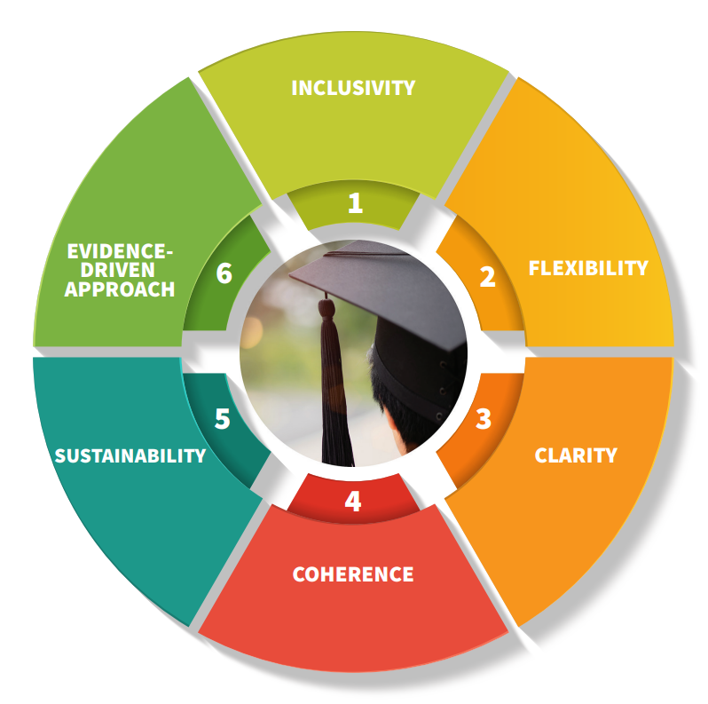
[INCLUSIVITY GOAL]
Positive experience – Universal Design
Inclusive decision-making structures
Diversity across fields of study, including teaching and early years education
Belonging
Accessible
INCLUSIVITY

Slide 4
[NATIONAL TARGETS FOR 2022 - 2028]
PRIORITY GROUP | Baseline (based on 2019/20 data) | Target for 2028 | Update (based on 2020/21 data)
New entrants from socio-economically disadvantaged areas (transition rate between school & higher education) | 42% | 54% | 44%
New mature entrants from socio – economically disadvantaged areas (% of mature new entrants from disadvantaged areas as a % of all disadvantaged new entrants) | 11% | 20% | 10%

Slide 5
[NATIONAL TARGETS FOR 2022 - 2028]
PRIORITY GROUP | Baseline (based on 2020/21 data) | Target for 2028 | Update (based on 2022/23 data)
New entrants with a disability (% of students with a disability as a % of all new entrants) | 12.4% | 16% | 13.8%
New entrants from the Traveller community (% of Traveller new entrants as a % of all new entrants) | 33 0.07% | 150 0.32% | 36 0.08%

Slide 6
[KEY PERFORMANCE INDICATORS]
Part-time/flexible learners
Further education award holders
Postgraduate study among selected priority groups
Student diversity across selected fields of study
Entry to HE from students attending DEIS schools
Lone parents
Completion and progression
Graduate outcomes
Students supported by FSD

Slide 7
[DATA UPDATES]
AREAS OF PROGRESS
New entrants from socio-economically disadvantaged backgrounds
New entrants with a disability
Student diversity across selected fields of study

Slide 8
[DATA UPDATES]
AREAS FOR IMPROVEMENT
New mature entrants from socio-economically disadvantaged areas
New entrants from the Traveller community
Part-time/flexible learners
Further education award holders

Slide 9
[INCLUSIVITY GOAL - KEY HIGHLIGHTS ]
WHOLE-OF-INSTITUTION APPROACH TO UNIVERSAL DESIGN
UD policies and practices across HEIs
Digital accessibility of websites and e-learning infrastructures
Staff and student UDL resources and curriculum development
Capacity building through CPD including training for UDL badge
Cross-sectoral activities including ALTITUDE, the National Charter for UD in Tertiary Education
Quiet and sensory spaces

Slide 10
[INCLUSIVITY GOAL - KEY HIGHLIGHTS ]
A MORE DIVERSE TEACHER WORKFORCE
Socioeconomic profile of new entrants to ITE courses
Improvements observed in the % of new entrants to both primary and secondary teacher education courses from disadvantaged areas
First Irish Sign Language Primary School Teachers graduate at DCU in October 2023
MORE DIVERSE STUDENT POPULATION ACROSS ALL PROGRAMMES AND ALL LEVELS OF STUDY
AHEAD/NDPAC Collaboration

Slide 11
[INCLUSIVITY GOAL - KEY HIGHLIGHTS ]
OPPORTUNITIES FOR STUDENTS WITH INTELLECTUAL DISABILITIES
Three-year pilot of higher education courses for students with intellectual disabilities
Co-created recognised courses to be delivered in 10 HEIs across the country
Support future evidence-informed policy
Extensive student consultation as part of the call and development of the courses
MORE INCLUSIVE ENVIRONMENTS
Additional €1.8m announced in February 2024

Slide 12
[AREAS OF CHALLENGE]
Scaling of supports and capacity
PATH Impact Assessment delays
Financial barriers to participation
Administrative and resource capacity

Slide 13
[PRIORITIES]
Updating DIS targets and KPIs
Mid-term review in 2025
PATH 4 Phase 2 Implementation
New Access Data Plan

Slide 14
[QUESTIONS FOR DISCUSSION]
NAP Targets & KPIs
What factors contribute to success in increasing priority group participation in higher education?
Inclusivity Goal
Linked to the Inclusivity Goal, what are the main learnings from NAP to date?
Priorities for year ahead
Are there any examples of good practice that have been implemented/supported by your institution/organisation to enhance the sense of belonging for priority group student within HEIs?
As we approach the halfway point in NAP implementation in 2025, what should be our areas of focus for the next 12 months?
In areas where we are underperforming, what can be done to enhance participation?

