Slide 1
Educational Attendance and Attainment of Children in Care, 2018 - 2023 Higher Education Authority National Access Forum 2024 Aideen Sheehan, Statistician CSO Statistical Systems Coordination Unit, Horizontal Reports 22nd April 2024

Slide 2
Introduction
Presentation is based on CSO Frontier Report Published on 2nd August 2023
Link: Educational Attendance and Attainment of Children in Care, 2018-2023
Author: Karola Graupner
Contents of this presentation
Background, Data and Methods
Cohort characteristics and numbers
Key Findings – educational attendance, attainment and outcomes

Slide 3
Background
Policy demand for more information on children in care in Ireland in education – very limited data available previously
Dept of Children, Equality, Disability, Integration and Youth Care Experiences Project – major data and research programme examining lives of children in care and adults who were in care
CSO was requested to provide analysis on children in care from administrative data sources focusing on education

Slide 4
Data, Methods and Safeguards
Specified data from Tusla’s children in care (TCM) dataset matched to datasets from Dept of Education, HEA, SOLAS, Revenue and others – eg school/ third level enrolment records.
Statistics Act,1993. Allows CSO Director General request data from public bodies & government departments under Section 30 of the Act for statistical analysis. Extensive consultation, documentation and GDPR measures.
Data stored securely in CSO’s Administrative Data Centre. Data matching proposal must be approved by CSO DG
Personal details removed from analysis datasets and Protected Identifier Key (PIK) used to match datasets.
Statistician does not have access to raw data, and only anonymised statistical totals are published – no personal details.

Slide 5
Contents of the Frontier release
CSO part of working group with DCEDIY, Tusla, DOE and other stakeholders to discuss policy needs and relevant statistical outputs throughout process. Final report focused on:
Characteristics of children in care 2018-2023
School attendance
School attainment
Outcomes for those aged 18-22

Slide 6
Cohort numbers – children in care April 2018-Jan 2023
9,744 children in care in January 2023 or who left care since April 2018
Of these 7,534 (77%) could be linked to other admin data sources including Revenue, HEA, and Dept of Social Protection.
The report presents a statistical educational overview of the linked children in care (and care leavers) only.
Of the 7,534 individuals that could be linked, 5,112 were ‘children in care in January 2023’, i.e. aged 0-17 years and on a care placement with Tusla.
Remaining 2,422 were ‘children who left care since April 2018’, aged 0-23 years. 1,844 of these turned 18 during this time – focus of Outcomes section.

Slide 7
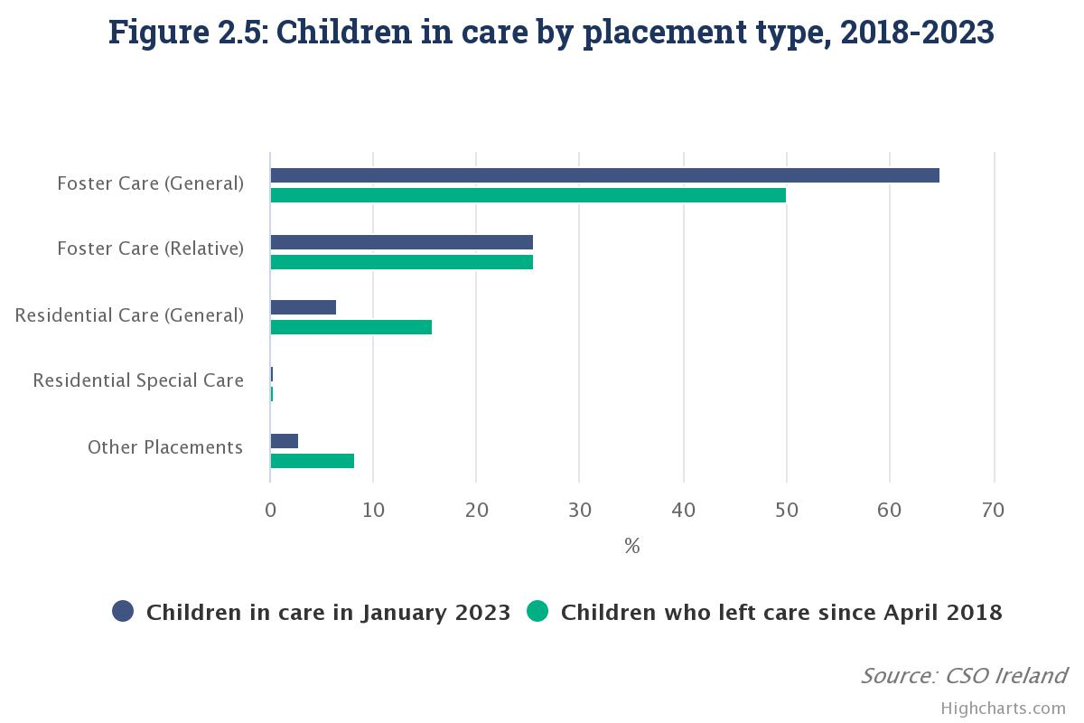
Characteristics of children in care in Jan 2023 (N=5,112)
51% male, 49% female
95% Irish nationals (compared to 89% of all children)
91% of those in care in Jan ‘23 in foster care (general foster care-65%; relative foster care -26%)
58% in care 2-<10 years

Slide 8
School attendance – absences 2018/19
Tusla Educational Support Service (TESS) dataset records children absent 20+ days from school.
In 2018/19, 11% (554) of children in care were absent from primary or post primary school for 20+ days compared with 7% of all children. Average 43 days v 34 days.
TESS
11%
7%

Slide 9
Absences of 20+ days by type and length of care, 2018/19

Slide 10
School attendance – changing school
Of children in care enrolled at primary school since 2015/16, 30% were enrolled at more than one primary national school, while this figure was 13% for all children.
Of children in care in post primary school since 2012/13, 19% were enrolled at more than one school, while this was 6% for all children.

Slide 11
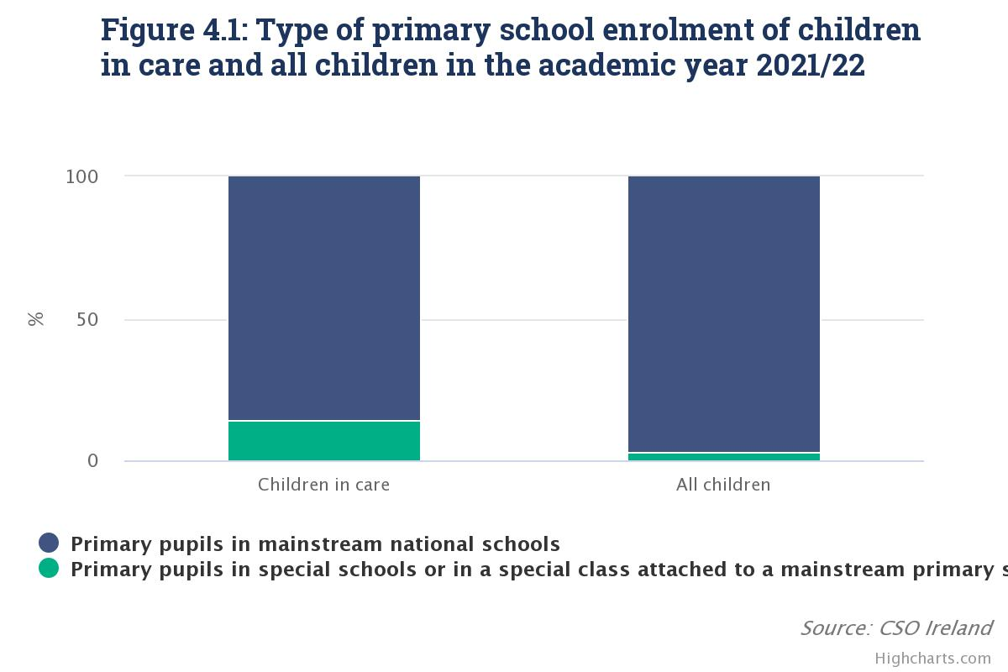
School attainment – school type
14% of children in care at primary school in 2021/22 were in a special school or special class attached to mainstream school. (411 out of 2,541)
This compares with 3% of all children. (16,829 out of 533,239)

Slide 12
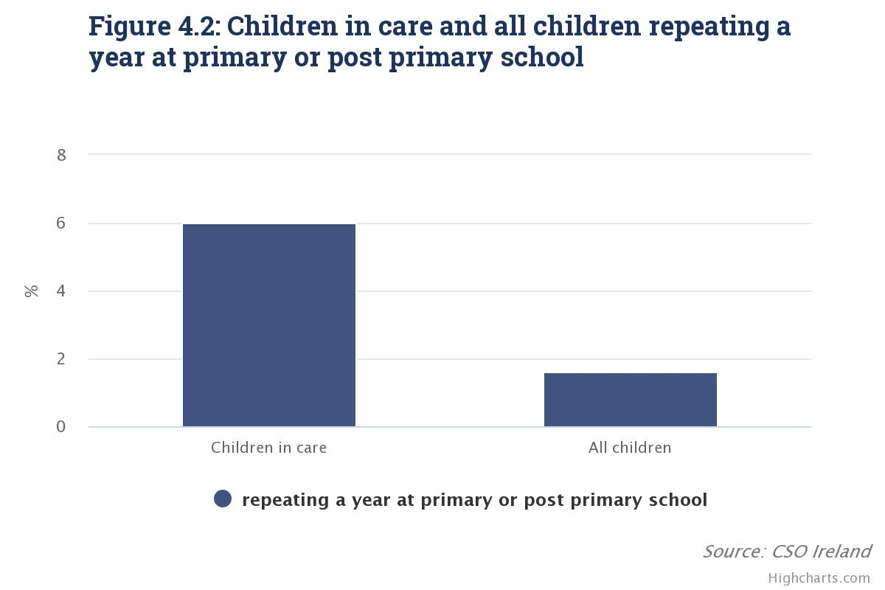
School attainment – repeated year
6% of children in care enrolled in primary or post-primary school repeated one or more years
This compared with just under 2% of all children.

Slide 13
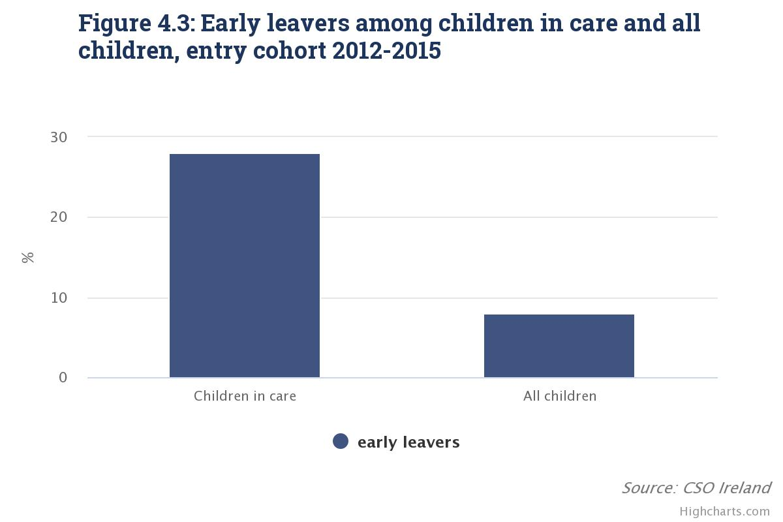
School attainment – early leavers
Of children in care who started post-primary between 2012-2015, 28% left school early without Leaving Cert (202 out of 722), compared with 8% of all children.
Early leaving rates lower for:
Foster care,16% v Other care 72%
Females 23% v Males 34%,
Longer in care (5+years) 19% v shorter (<5 years) 44%
28%
8%

Slide 14
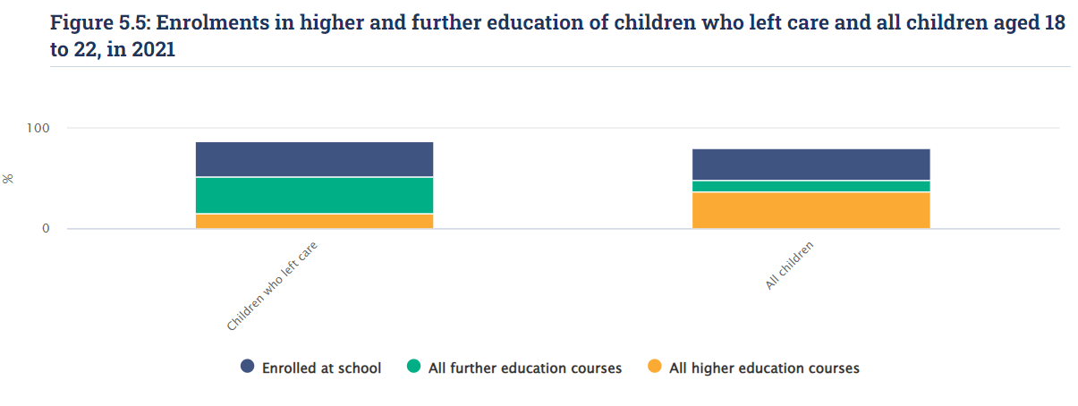
Education outcomes in 2021 for those aged 18-22 (in Jan ‘23)
In 2021 for care leavers aged 18 to 22:
37% in further education 15% in higher education 35% in school.
Of all children aged 18 to 22:
11% in further education 37% in higher education 33% in school.

Slide 15
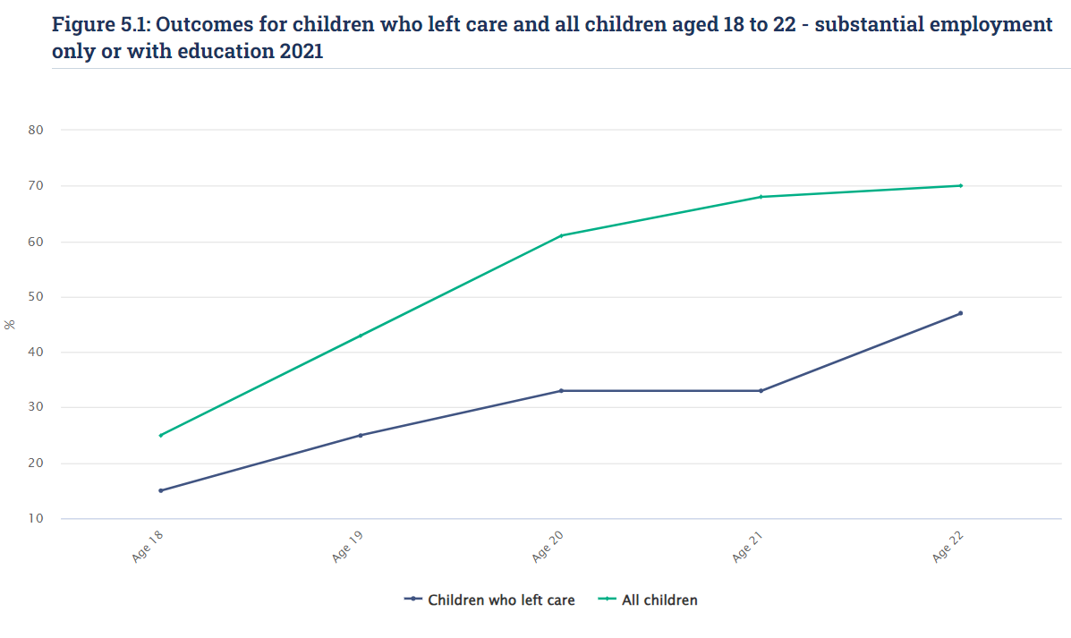
Employment outcomes in 2021 for children aged 18-22 (in Jan ‘23)
By age 22
47% of children who left care in ‘substantial employment’ or ‘substantial employment and education’, compared to 70% of all children.
70%
47%
Notes:
Could we make this clearer???

Slide 16
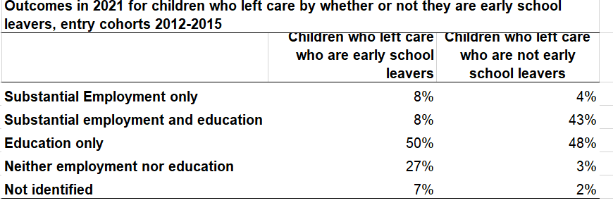
Outcomes for care leavers aged 18-22 (in Jan 23) by early school leaving status
Care leavers that left school early less likely to be in employment, education or combination of both in 2021 (66% in total) compared with those who did not leave school early (95% in total).

Slide 17
Data providers
Tusla
Department of Social Protection
Revenue Commissioners
Department of Education
SUSI
HEA
SOLAS
QQI

Slide 18
Thank you More information https://www.cso.ie/en/releasesandpublications/fp/fp-eaacc/educationalattendanceandattainmentofchildrenincare2018-2023/ Email: sscu@cso.ie

